Slide 1

The World’s Leading Battery Manufacturer

Slide 2


Emission Reduction Legislation & Influences
Vehicle Emission Reduction Technologies
Battery Technology, Terminologies & Specification
Absorbed Glass Mat (AGM) Battery
Enhanced Flooded Battery (EFB)
Battery Look-up (LIVE Demonstration)
Battery Management & Configuration
Introduction to Vehicle Autonomy

Slide 3
Emission Reduction Legislation & Influences

Slide 4


Emission Reduction, Fuel Economy & Taxes
Reducing CO2 Production
Improving Fuel Economy
Vehicle Showroom Taxation
Showroom taxation is based on vehicle manufacturers average CO2 emissions per g/km over limit
 | UK CO2 TARGETS
 | 2012 | 2015 | 2020
 | 154 g/km | 130 g/km | 95g/km
 |  | -15% | -25%

Slide 5

Additional Influences
As well as the environmental influences on vehicle technology, the following have also dramatically increased the demands placed on the battery:
Higher and higher levels of electrical consumption due to the addition of numerous state-of-art comfort, convenience and safety systems

Slide 6
Emission Reduction Technologies

Slide 7

Regulation & New Automotive Technologies
Battery related eco-solutions and vehicle systems that have been designed to fulfil regulation implementation include:
Idle Stop/Start (ISS)
  Known as a Micro hybrid 1 vehicle
ISS and kinetic energy recovery
  Known as a Micro hybrid 2 vehicle
ISS, kinetic energy recovery with reversible restart
alternator
  Known as a Micro hybrid 3 vehicle (VALEO iStARS)
ISS, kinetic energy recovery and starter/generator engine assist using a high voltage mains chargeable battery
  Known as a Mild hybrid vehicle (BMW eDrive PHEV)
ISS, kinetic energy recovery and starter/generator full electric drive
  Known as a Full hybrid vehicle (Toyota Prius)

Slide 8


Idle Stop/Start (ISS) MicroHybrid 1
The automatic Stop/Start function turns off the engine when it is not needed, either in a traffic jam or a stop/go traffic situation.

Slide 9

Kinetic Energy Recovery MicroHybrid 2
The alternator output is controlled by an ECU to reduce engine loads, fuel consumption and emissions, therefore increased demands are placed on the battery to support vehicle electrical loads.
Charging is optimised when the accelerator is released or the brake applied (regenerative braking).
Kinetic energy that would normally be lost is then converted into electricity by the alternator and stored in the battery.
When the accelerator pedal is depressed, the alternator is deactivated which ensures the full power of the engine can be directed to the drive wheels.
The system continually monitors the level of battery charge and if necessary maintains charging even during acceleration to prevent a complete discharging of the battery.

Slide 10
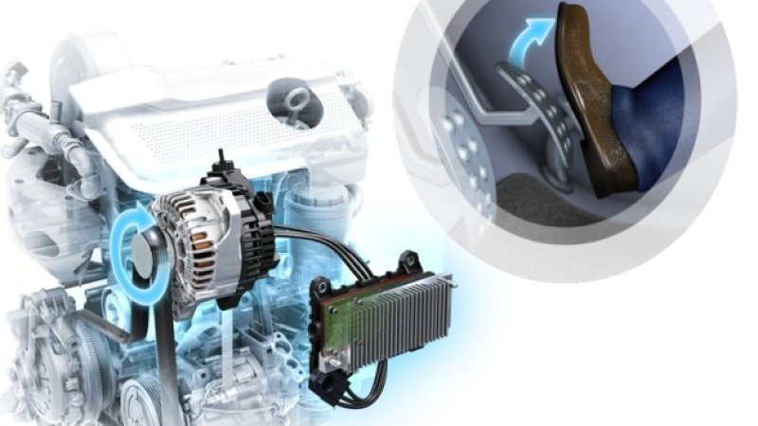
Micro Hybrid 3 (Valeo iStARS)
This system features an integrated reversible restart alternator/generator instead of the conventional separate starter motor and alternator assemblies.

Slide 11
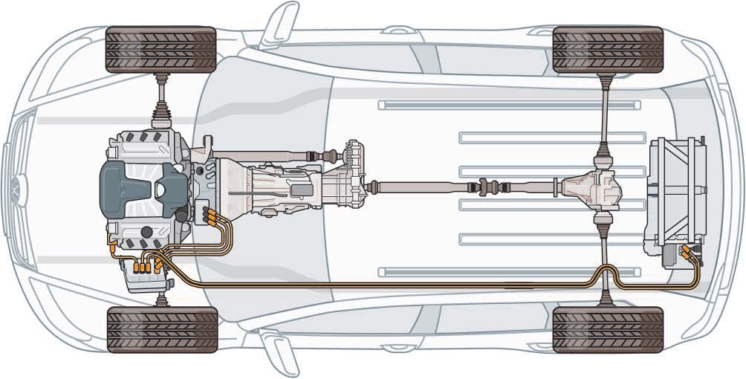
Mild Hybrid (PHEV)
The Mild Hybrid (PHEV) system features an integrated starter/generator, plug-in high voltage battery as well as a lead acid auxiliary battery.

Slide 12
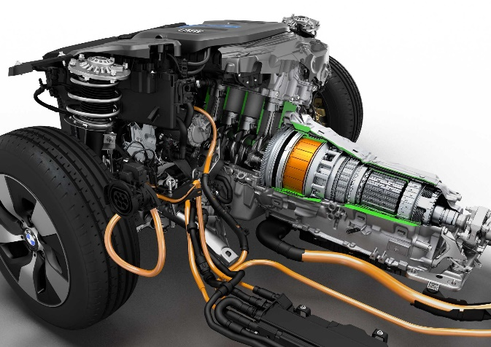
Mild Hybrid PHEV Operation (BMW)
In addition to operating the start/stop and brake regeneration functions the integrated starter/generator and high voltage battery provide electric motor assistance to the internal combustion engine under the following conditions:
  launch from a standstill
  Overtaking (WOT conditions)
This feature enables vehicle manufacturers to:
  Reduce engine capacity (downsizing)
  Reduce CO2 emissions
  Enable low capacity engines to have improved performance
  Improve vehicle fuel economy

Slide 13
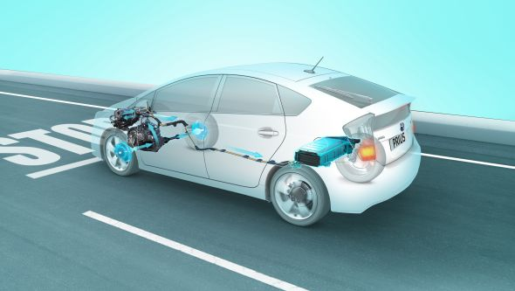
Full Hybrid (Toyota Prius)
Toyota’s Hybrid Synergy Drive system is comprised of seven primary components:
Petrol engine
Electric motor
Electric generator
Power control unit
Power split device
Motor and generator
High voltage battery
The petrol engine and electric motor can work together to drive the vehicle or can each be used in isolation.

Slide 14
Technology, Terminology & Specification

Slide 15
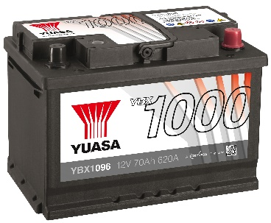


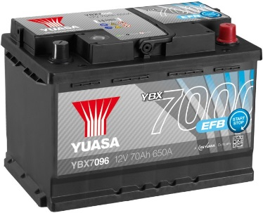
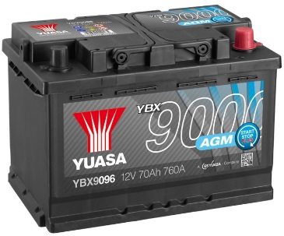


Lead Acid Battery Starting Specifications
YBX1000 = Conventional Flooded 20,000 starts
YBX3000 = Conventional Flooded 30,000 starts
YBX5000 = Conventional Flooded 50,000 starts
YBX7000 (EFB) = 270,000 starts
YBX9000 (AGM) = 360,000 starts
Notes:
20,000 = 229
30,000 = 344
50,000 = 574

Slide 16
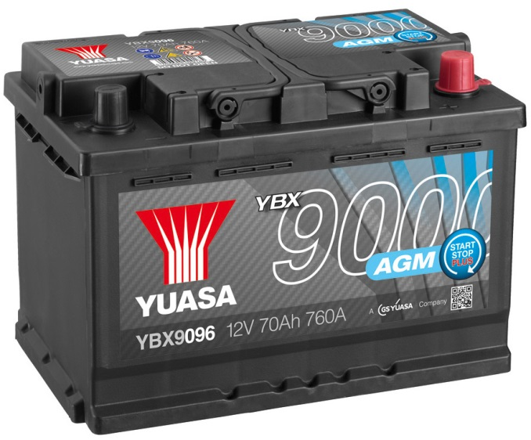
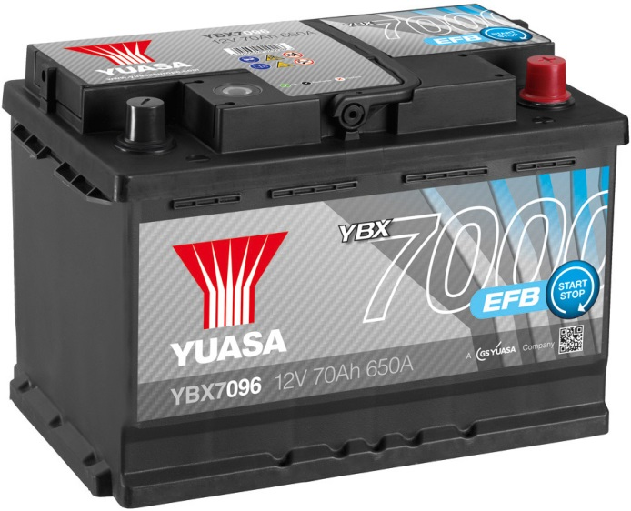
Terminologies Explained
Production of vehicles featuring new technologies designed to reduce CO2 emissions and improve fuel economy will have increased to approximately 70-80% of all vehicles produced in Europe in 2015 (In excess of 30 million vehicles).
High volume production vehicles from 2008/09 will therefore feature technologically advanced and modified forms of the conventional flooded Lead acid battery. These are:
  AGM (Absorbed Glass Mat)
  EFB (Enhanced Flooded Battery)

Slide 17
AGM (Absorbed Glass Mat)

Slide 18

AGM Battery
The AGM battery has been developed for the following applications:
High specification luxury vehicles with a great number of electrical systems and consumers
Vehicles equipped with the latest fuel saving and emission reduction technologies such as:
          Idle STOP/START
  Brake regeneration
  Battery management Systems
  Alternator control

Slide 19
EFB (Enhanced Flooded Battery)

Slide 20

EFB Battery
The EFB battery has been developed for the following applications:
Entry level vehicles featuring Idle Stop/Start where CO2 emissions and fuel economy requirements are reduced

Slide 21
AGM & EFB Sales & Marketing Issues

Slide 22

AGM/EFB Sales & Marketing Issues
If it is stipulated that the replacement battery for a vehicle is specified as an AGM/EFB type then this is the only battery type that is fit for purpose.

Slide 23
Vehicle Application Dangers!
Incorrect application of battery technology and/or specification will result in the loss of vehicle system functionality and premature battery failure.
YBX1000 = 20,000 starts
YBX3000 = 30,000 starts
YBX5000 = 50,000 starts
YBX7000 (EFB) = 270,000 starts
YBX9000 (AGM) = 360,000 starts
Notes:
20,000 = 229
30,000 = 344
50,000 = 574

Slide 24
DOD Recovery Comparisons
✓
✗
✓
Conventional Flooded
Conventional Flooded
AGM
5% DOD recovery is the normal safe operating condition resulting in good battery life
35%+ DOD recovery
results in excessive plate damage and reduced battery life
50% DOD recovery is a safe operating condition to support Micro-Hybrid systems resulting in good battery life

Slide 25
Incorrect Application Outcomes
Incorrect application of conventional flooded Lead acid battery in place of an EFB or a conventional flooded Lead acid battery/EFB in place of an AGM will result in premature battery failure due to:
Excessive battery cycling as conventional flooded Lead acid batteries have much lower cyclic specifications than EFB and EFB have much lower cyclic specifications than AGM
Excessive plate damage caused by high battery Depth of Discharge (DOD) which conventional flooded Lead acid or EFB are not designed to support
Accelerated loss of plate surface area and resultant CCA (up to 16% in 1st week of service for conventional flooded Lead acid)
Installing a battery that is not of the correct technology and specification for an application based on price will result in greatly increased battery failures and customer complaints!!!

Slide 26
Battery Management Systems (BMS) & Battery Configuration

Slide 27
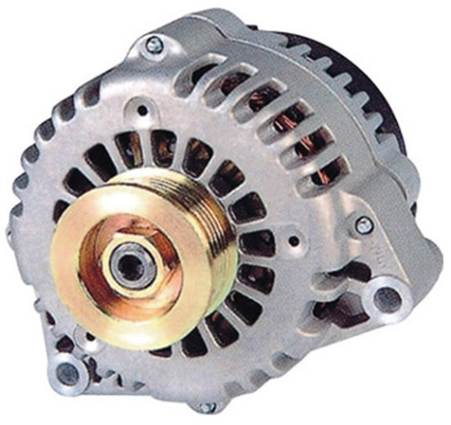
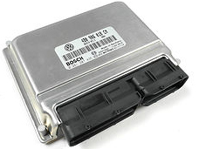
BMS Overview
BMS are designed to adapt the vehicles charging strategy based on battery status.
The aim is to increase the availability of the Start/Stop system with the detailed data evaluation of the battery and accurate control of the alternator output.
START
A
STOP

Slide 28
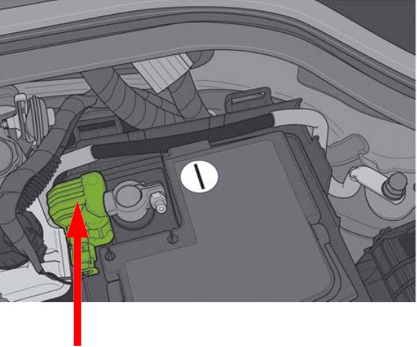
BMS Sensor & Control Module
The BMS uses information from a battery monitoring control module with integrated sensor located on the negative terminal battery cable clamp to measure and evaluate the physical battery variables of:
Temperature (T)
Voltage (V)
Charging current (I)
Discharge current (I)

Slide 29
BMS Sensor & Control Module Functions

Slide 30
Control Module Functions
The BMS control module calculates the following battery parameters based on the data transmitted from the battery monitoring sensor and adapts the charging system accordingly:
Battery down recognition
  If the battery sensor fails to detect a battery for a set time frame
Voltage currently required for optimal battery charging
Engine start capability
  Indicates whether the battery is presently capable of starting the engine
How much charge can currently be withdrawn from the battery until the limit of engine start capability is reached
Actual battery state of charge (SOC)
Battery ageing
  Ageing of the battery can be determined from parameters such as energy storage capacity and actual battery power
Battery static voltage
Battery internal resistance

Slide 31
New Battery Configuration

Slide 32
Why is Battery Configuration Necessary?
A replacement battery has different charging requirements to a battery that has reached the end of its serviceable life.
The BMS must therefore be reset when the battery is replaced to prevent the use of an incorrect charging strategy which could result in:
Loss of Micro-hybrid system functionality
Increased CO2 emissions
Increased fuel consumption
Loss of vehicle system functionality
Premature battery failure!!!
START
A
STOP

Slide 33
Autonomous Vehicles

Slide 34
Autonomous Vehicle Overview
Levels of driving automation or autonomy are a set of guidelines determined by the Society of Automotive Engineers (SAE) to describe the differing levels of autonomy in driverless cars.
There are currently 5 functional levels in total, with one being the most basic and five being the most advanced.
As the sophistication of vehicle autonomy increases and we move on to level 3 there is a need for auxiliary batteries to support the main electrical system in the event of a fault.
Lead acid batteries do not have the performance suitable to support autonomy levels 4 and 5 and will be replaced by lithium ion technology battery types.

Slide 35


Level 0 Hands On Full Driver Control
The driver is in complete control of the vehicle and is responsible for all vehicle controls and roadway monitoring.
Steering, Brakes & Throttle

Slide 36

Level 1 Hands On with Drive Assistance
The most basic type where one element of the driving process is taken over in isolation using sensors, control modules and cameras but the driver is still in control of the vehicle.
Active Cruise Control, Lane Departure Assistance & Basic Collision Warnings

Slide 37


Level 2 Partly Automated Driving
Vehicle computers take over two or more functions from the driver and are intelligent enough to integrate speed and steering systems together using multiple data sources.
These systems can brake automatically, accelerate and,
unlike level 1, take over the steering of the vehicle.
The driver continues to remain in control of the car and must
always pay attention to traffic.
Radar Guided Cruise Control, Steering/Lane Departure Assistance & Automated Parking

Slide 38


Level 3 Highly Automated Driving
Vehicle computers can take control of safety critical systems and the vehicle can drive itself however the driver must be on-hand to intervene when requested.
Driver has more freedom to completely turn their attention
away from the road under certain conditions hand over
complete control to the car.
With conditional automation systems, the car will be able to
drive autonomously over long distances in certain traffic
situations, such as on motorways.
The driver, however, must be able to take over control within a few seconds.
Steering, Acceleration & Emergency Braking

Slide 39


Level 4 Fully Automated Driving
Vehicle is fully autonomous in controlled areas, performs all safety-critical functions and monitors road conditions with the driver present.
The driver, however, must remain fit to drive and capable of taking over control if needed, yet the driver would be able to sleep
temporarily.
If the driver ignores a warning alarm, the car has the authority to move into safe conditions, for example by pulling over.
Front & Rear Collision Avoidance, High Precision GPS & Pedestrian Detection

Slide 40


Level 5 Full Automation (No Driver)
Vehicle is fully autonomous anywhere with an optional driver. Capable of driving in every scenario including extreme environments and all terrains.
Drivers don’t need to be fit to drive and don’t even need to have a license.
The car performs any and all driving tasks.
Everyone in the car is a passenger.
They will only drive at relatively low speeds within populated
areas.
Highway driving will be possible initially, but will only be used in defined areas of city centres.
System capable of all driving modes without human intervention

Slide 41
Thank you for your attention

Slide 42


