Slide 1


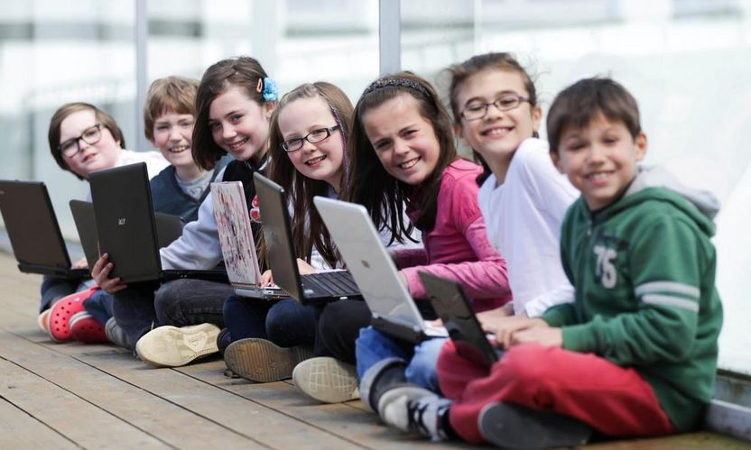
10th February 2016

Slide 2
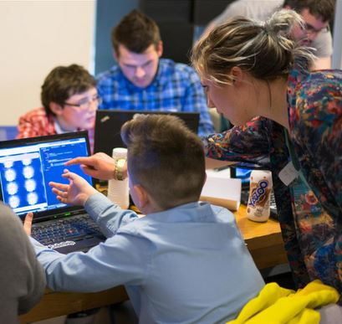
Overview of Coderdojo
CoderDojo is an open source, volunteer led, global movement of coding clubs (Dojos) for young people between 7 and 17.
CoderDojo is a wholly not-for-profit community and all Dojos are free of any charges to all participants
Each Dojo is a local, independent club that follows the CoderDojo Charter
Founded in 2011 in Ireland, there are now 750+ Dojos in 65 countries
There are 103 Dojos in the UK

Slide 3
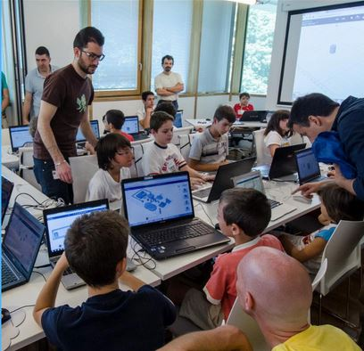
CoderDojo aims and mission
Vision
Our vision is a world where every child has the opportunity to learn about technology for free and be creative in a safe and social environment
Mission
Our mission is to grow our network of affiliated clubs to reach as many children as possible
Community
We encourage and facilitate our community to share their learning experiences, resources and knowledge and give participants, mentors and parents a sense of community for life

Slide 4

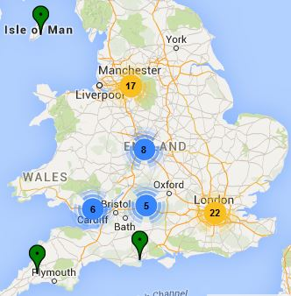
CoderDojo England and Wales
Promote the formation of Dojos in England and Wales
Provide Dojos with guidance, help and central services for developing their activities and membership
Promote the adoption of best practices and ethics of the global CoderDojo movement in the region
Organise national activities and events to increase public awareness of the CoderDojo movement
Represent English and Welsh Dojos in the global CoderDojo community

Slide 5
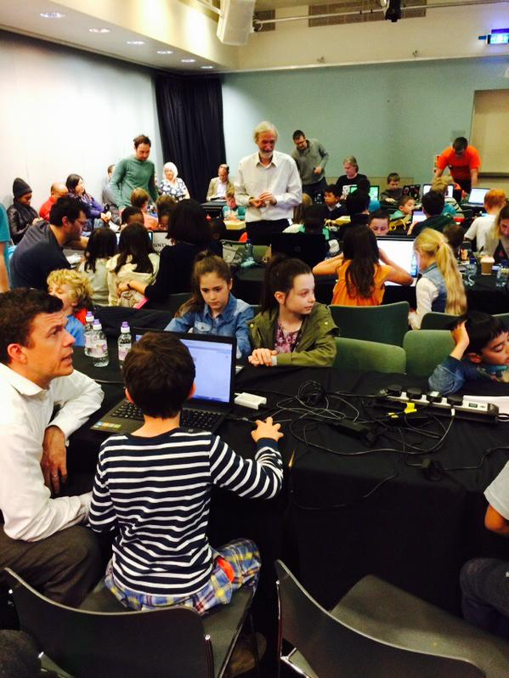
How we support new Dojo’s
Help with planning, logistics, promotion and ticketing
Advice on room set-up and choice of activities
Supply of coding project materials for different levels of ability
Provision of experienced mentors to help lead initial sessions

Slide 6








CoderDojo Foundation
Event
Partners
Pro Bono Sponsors
Financial
Sponsors

Slide 7
















CoderDojo England and Wales
Venue Sponsors
Event Partners

Slide 8








Special Events
Houses of Parliament
Buckingham Palace
Mozfest London - 2014 / 2015
European Parliament - 2014 / 2015
Googlers Give Day
BBC - Make It Digital – 2015
Southbank Centre - Web We Want Festival - May 2015
Salesforce - Developer Conference - May 2015
BAFTA - Young Game Developers 2015

Slide 9



Special Events
Over The Air Festival 2015
Girls Only Dojo
Girls Only Dojo - Thomson Reuters – Jun 2015
Girls Only Dojo – UCL – Jan 2016
World Economic Forum – Davos – Jan 2016

Slide 10








Collaborative Partners

Slide 11
Benefits
#DojoDates
#CoolestProjects
#EUCodeWeek
Huge goodwill generated
in the community
Rewarding for volunteers
Popular with adults and children joining in
High Visibility
Excellent CSR opportunity
Recognition
#STEMcareers
#RaspberryPiJam
#GirlGeeks

Slide 12
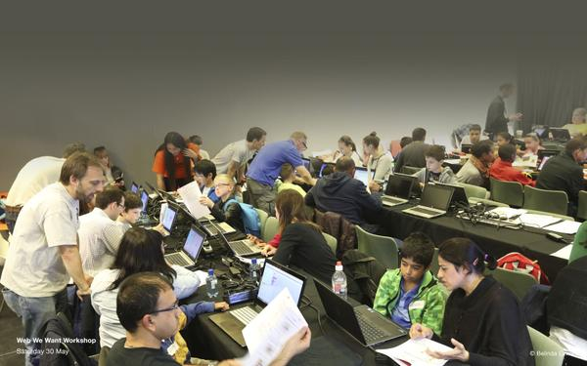
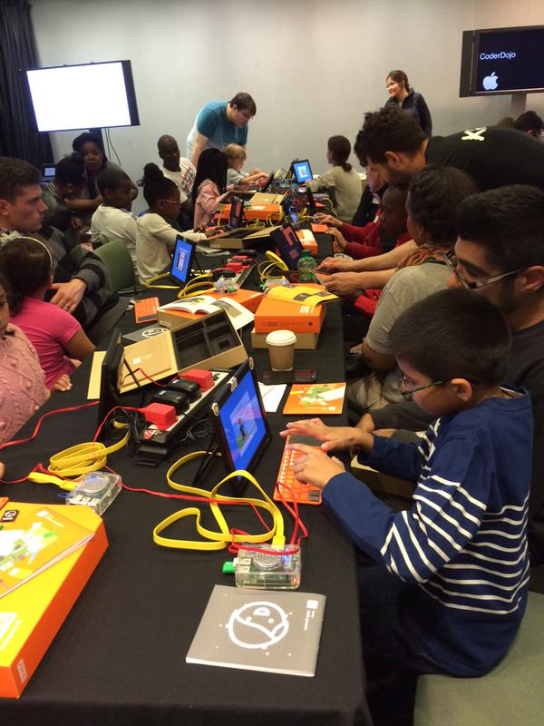
How does it work?
Corporate host or other venue provides suitable space free of charge
Organiser (‘champion’) may be on corporate staff or emerge from local community
Technology volunteers (‘mentors’) give their time and expertise
Children bring a parent or carer and a laptop
They learn coding, digital making and valuable ‘soft’ skills
Dojos range from 15 kids up to 100+
Learning materials available free from CoderDojo knowledge base (‘Kata’) and other open sources
Typically held monthly on weekend afternoon, but timing is at discretion of the host, champion and mentors

Slide 13
Why is CoderDojo important?
Technology
skills gap
There’s a lost generation of young people who can use technology, but don’t know how to create it
Computer Science and programming only entered the National Curriculum for schools in England & Wales in September 2014
Industries are struggling to find enough technology skilled staff
Inspires young coders to aspire to be the next generation of professional coders
Coding is the language of the future
Equal opportunity
More girls in
STEM careers
Inspiring digital creativity
Problem solving and other skills
Importance of informal learning

Slide 14
The skills gap
The UK is facing a chronic skills shortage in STEM subjects.
Computing and digital skills is no exception!
Almost half (45%) of UK businesses are experiencing an “extensive” shortage of IT talent, which is hampering productivity, according to research by IT skills and training body CompTIA.
Eric Schmidt
Executive Chairman and Former CEO of Google
"The country that invented the computer is throwing away its great computer heritage by failing to teach programming in schools. I was flabbergasted to learn that today computer science isn't even taught as standard in UK schools.
"Your IT curriculum focuses on teaching how to use software, but gives no insight into how it's made."

Slide 15
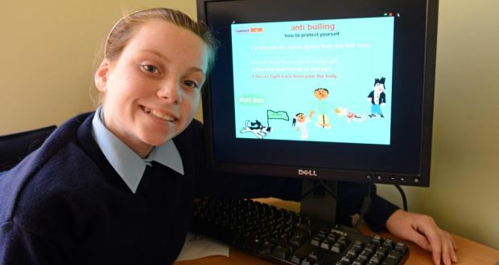
Equal opportunity
Technology
skills gap
Every child has an equal opportunity to learn
Our movement is inclusive of everyone regardless of background, race or culture
Making a difference - freedom of expression to deal with life’s challenges and help others by sharing
Equal opportunity
More girls in
STEM careers
Inspiring digital creativity
Problem solving and other skills
Importance of informal learning

Slide 16
Making a difference
Dyslexic Alphabet Game – Game Developed by two dyslexic brothers to help them with learning the Alphabet
Maths Game – Developed by 11 year old boy to help his sister and himself learn their number bonds
Anti Bullying Quiz - Built by 12 year old girl, A quiz designed to teach children what to do if they are dealing with bullies
Fix my Pothole - Built by John - Helps communities to notify their councils about the locations of potholes in the area
School Exclusion – Louis 11 was excluded from class with his grades were slipping – found Coder Dojo gateway to finding his focus - http://www.bbc.co.uk/news/technology-31841902

Slide 17
More girls in STEM careers
Technology
skills gap
Currently 30% of Dojo attendees are girls
Dojos struggle to attract girls aged 12-16
Stereotyping and unconscious biases discourage girls from choosing STEM subjects
Girls only sessions aim to build up young girls’ confidence
Making the learning relevant to girls
Showcase positive female role models
Appeal to their creative sides
Equal opportunity
More girls in
STEM careers
Inspiring digital creativity
Problem solving and other skills
In 2013 women made up 14% of all computer science graduates – down from 36% in 1984
New York Times, 31 May 2014
Importance of informal learning

Slide 18
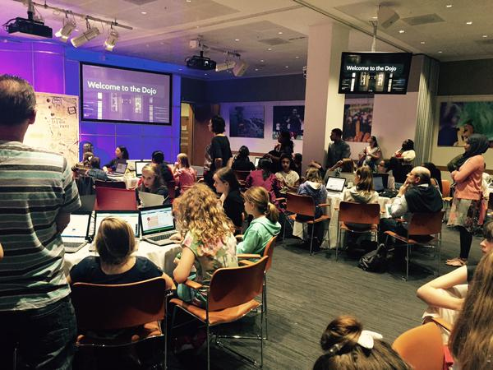
More girls in STEM careers
Technology
skills gap
Our aim is for Dojo attendees to reflect an equal split
Eventually we hope that girl-specific interventions will become unnecessary
Equal opportunity
More girls in
STEM careers
Inspiring digital creativity
Problem solving and other skills
Importance of informal learning

Slide 19
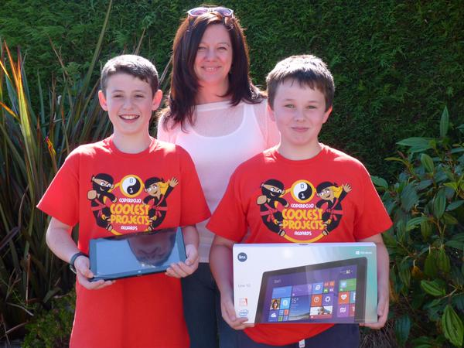
Inspiring digital creativity
Technology
skills gap
Enable young people to become a generation of technology-savvy digital creators
Raising awareness of potential technology career pathways
Business and industry
Science and technology
Media, game design and creative industries
Equal opportunity
More girls in
STEM careers
Inspiring digital creativity
Problem solving and other skills
Importance of informal learning

Slide 20
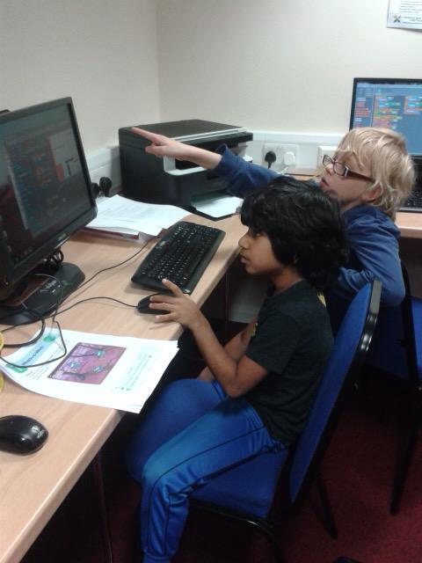
Problem solving and other skills
Technology
skills gap
As well as coding, the youngsters learn valuable ‘soft’ skills that enhance their life chances and future employability
Collaboration and teamwork
Confidence building
Creative problem solving
Logical thinking
Presentation skills
Communication skills
Mentoring skills
Equal opportunity
More girls in
STEM careers
Inspiring digital creativity
Problem solving and other skills
Importance of informal learning

Slide 21
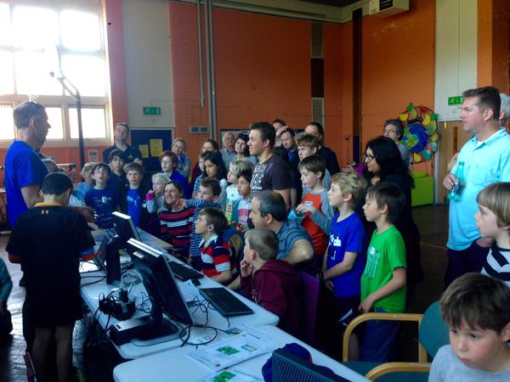
Informal learning
Technology
skills gap
Many studies stress the importance of informal learning to supplement school
Young people have the opportunity to explore technology in an enjoyable and low pressure environment
Role models and leadership by volunteers from the technology industry
Equal opportunity
More girls in
STEM careers
Inspiring digital creativity
Problem solving and other skills
Importance of informal learning

Slide 22
Mentors
Mentors
Mentors are tech savvy individuals who love to code!
Mentors do not have to be programmers
Mentors plan and facilitate the Dojo sessions
Mentors encourage teamwork and collaboration
Non-Technical Volunteers & Parents
Help with registration, social media, emails or admin

Slide 23
What Skills Kids Learn !
Children participating in CoderDojo learn a mixture of hard and soft skills including:
Coding
Collaboration
Teamwork
Presentation
Communication
Mentoring

Slide 24
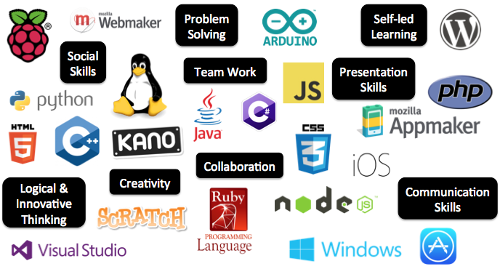
What kids can learn!

Slide 25
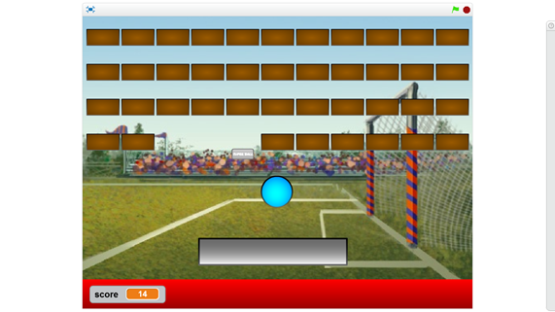
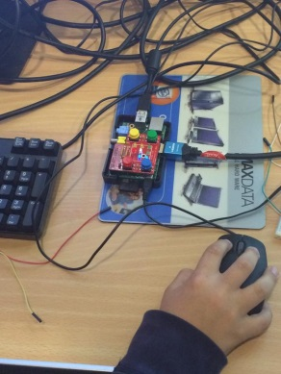
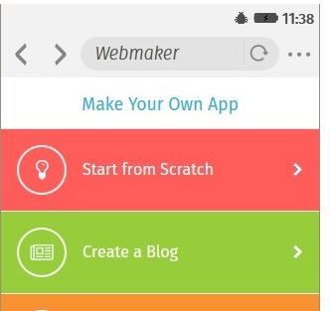
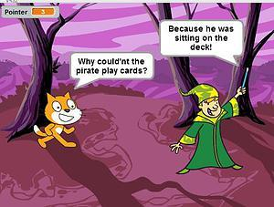
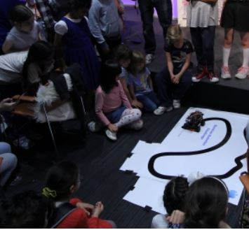
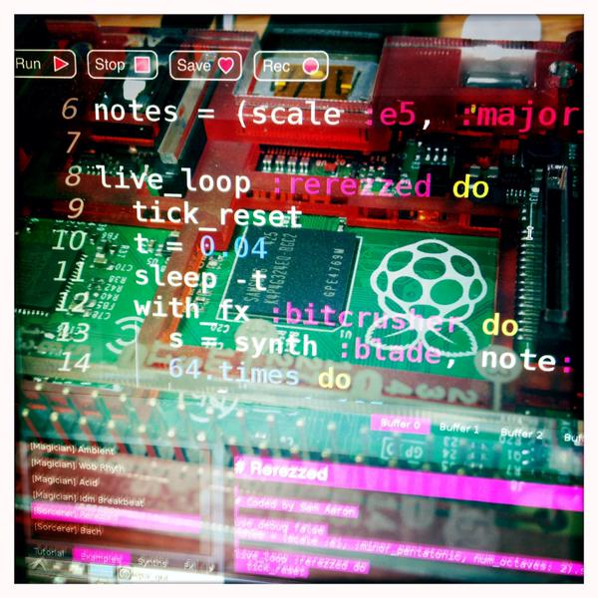
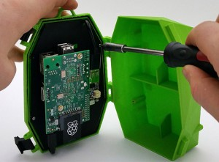

Projects and activities
Video games
Quizzes and word games
Mobile apps
Electronics
Internet of things
Robotics
Web page design
Digital music

Slide 26
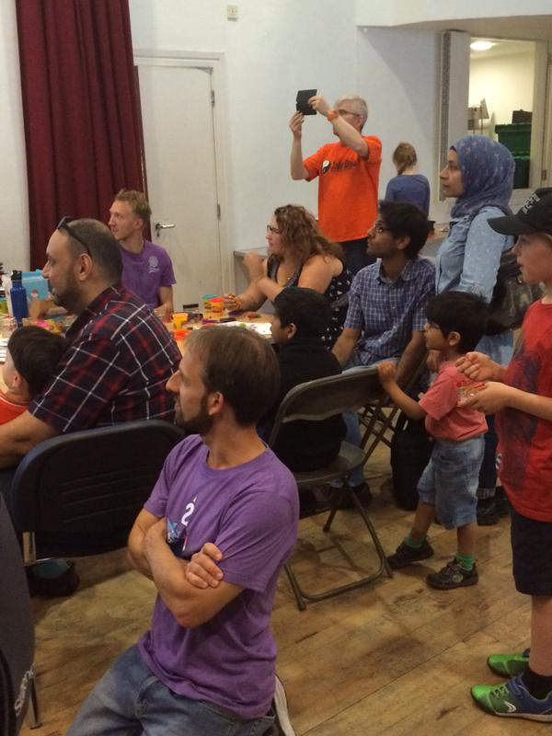
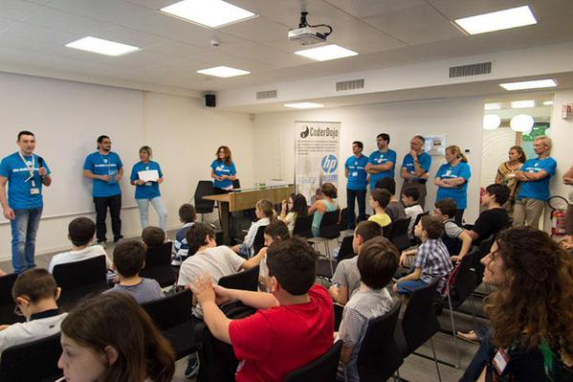
Example session programme
Registration
Welcome
Join groups
Coding
Break
Coding
Show & Tell
Wrap up

Slide 27

Delivery And Content
Sushi Cards - Creative Commons licensed
Take a collaborative community approach to content. Consume and contribute!
MOU - other resources

Slide 28
Case Study - John Lewis Partnership
Duke of York hosted a Dojo at Buckingham Palace
Victoria Business Improvement District (BID) introduced CoderDojo to John Lewis Partnership
Started as Bi-Monthly but now monthly from Nov 2015
First Dojo’s were run in conjunction with CoderDojo
JLP staff have now run the Dojo’s with support from CoderDojo
JLP Mentors participate in other CoderDojo London Events
Expanded to Waitrose in Bracknell
Discussing role out to regional offices
Business Improvement District working in partnership with CoderDojo London to establish Dojo’s in other areas of city.

Slide 29
Case Study - Dragon Hall
Community based Dojo in Covent Garden.
Dragon Hall provides place of learning in a disadvantaged area of London.
Dragon Hall runs wide range of activities for 4 to 17 years.
Dragon Hall hosted first Dojo in Oct 2015.
Dragon Hall has helped CoderDojo establish relationships with other organisations providing free Digital Skills for young people.
Average attendance is 50 / 60.

Slide 30
Case Study - Thomson Reuters
Thomson Reuters supporting CoderDojo
Thomson Reuters keen to support initiative to support kids coding but also to encourage girls into STEM careeers
Hosted CoderDojo London Girls Only Dojo to introduce CoderDojo to Thomson Reuters
Successful event and are supporting an Initiative to host CoderDojo globally
New York
Zurich
Bangalore
Singapore
Operating model to Partner with local CoderDojo Groups and Tech Partners
Encouraging Staff to be involved and participate under CSR and DI policies
https://storify.com/ocroberts1/girlsonlycoderdojo

Slide 31
CoderDojo
Thanks
&
Above All: Be Cool!

