Slide 1
Telecom and Software
Is it real engineering?
Richard Bodin CEng MIET
18th March 2025
Notes:
45 mins
Questions at end… not monitored
Mute all
Presentation shared

Slide 2
Agenda
A bit about me
Telecom evolution over 30 years
How is telecom “engineered”?
  Requirements
  Redundancy/capacity approaches
  Solutions over time
Conclusion

Slide 3
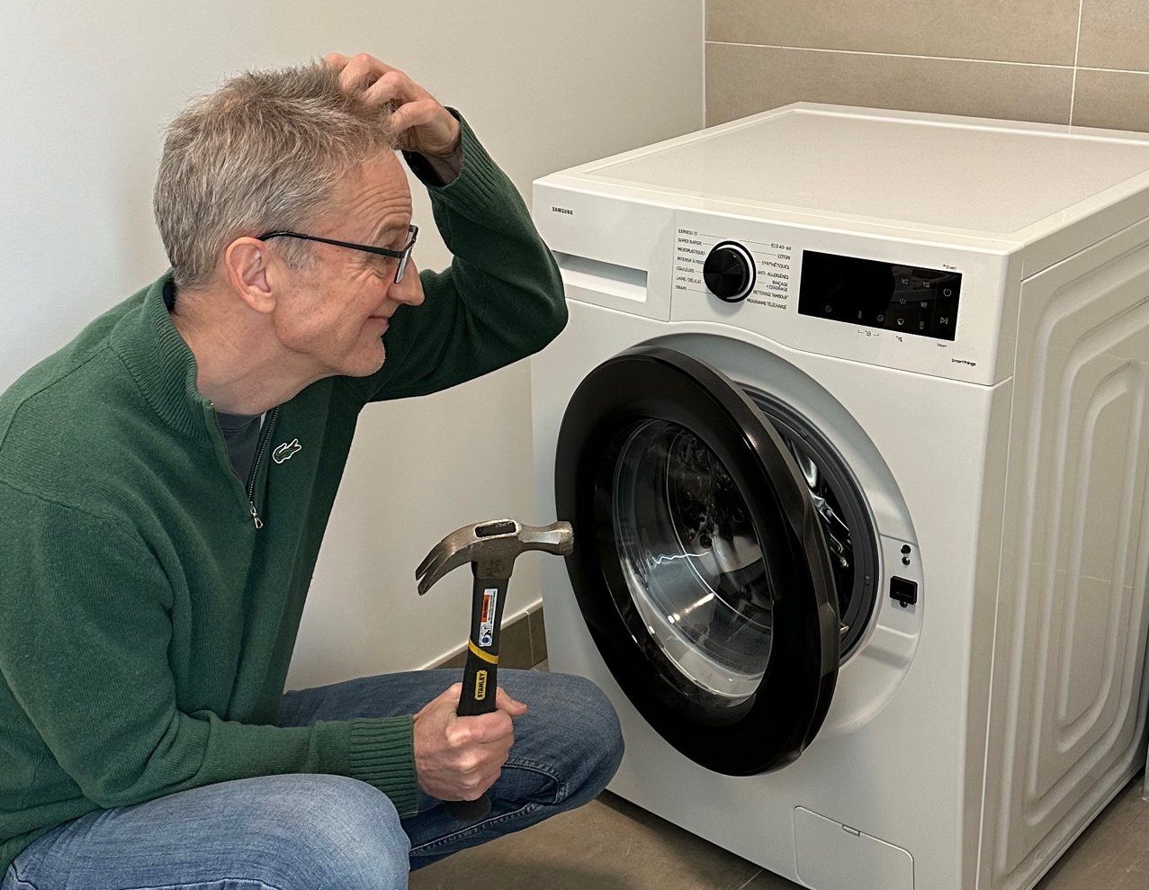
Richard’s background
1991 - MEng Microelectronics & Software Engineering
  University of Newcastle upon Tyne
Career
  Nortel – software developer (UK, USA)
  Blueslice – product management (Canada)
  Mavenir – sales engineer (France)
2006 – Chartered Engineer with IEE
Areas of expertise
  Network database
  Voice, data, messaging application core
  Radio computing infrastructure
  Cloud computing – AWS Solution Architect
Richard’s Mum: Are you a real engineer? Can you fix my washing machine?

Slide 4
Agenda
A bit about me
Telecom evolution over 30 years
How is telecom “engineered”?
  Requirements
  Redundancy/capacity approaches
  Solutions over time
Conclusion

Slide 5
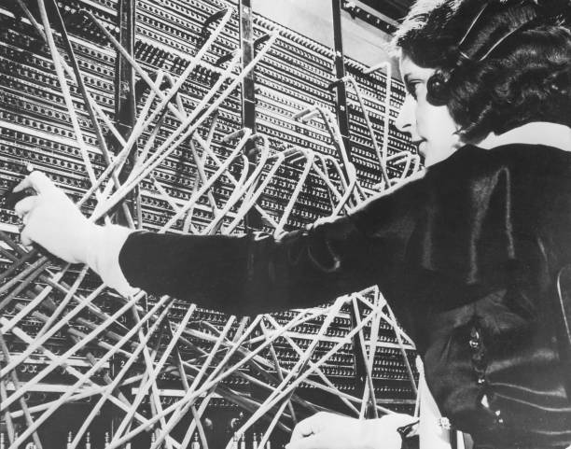
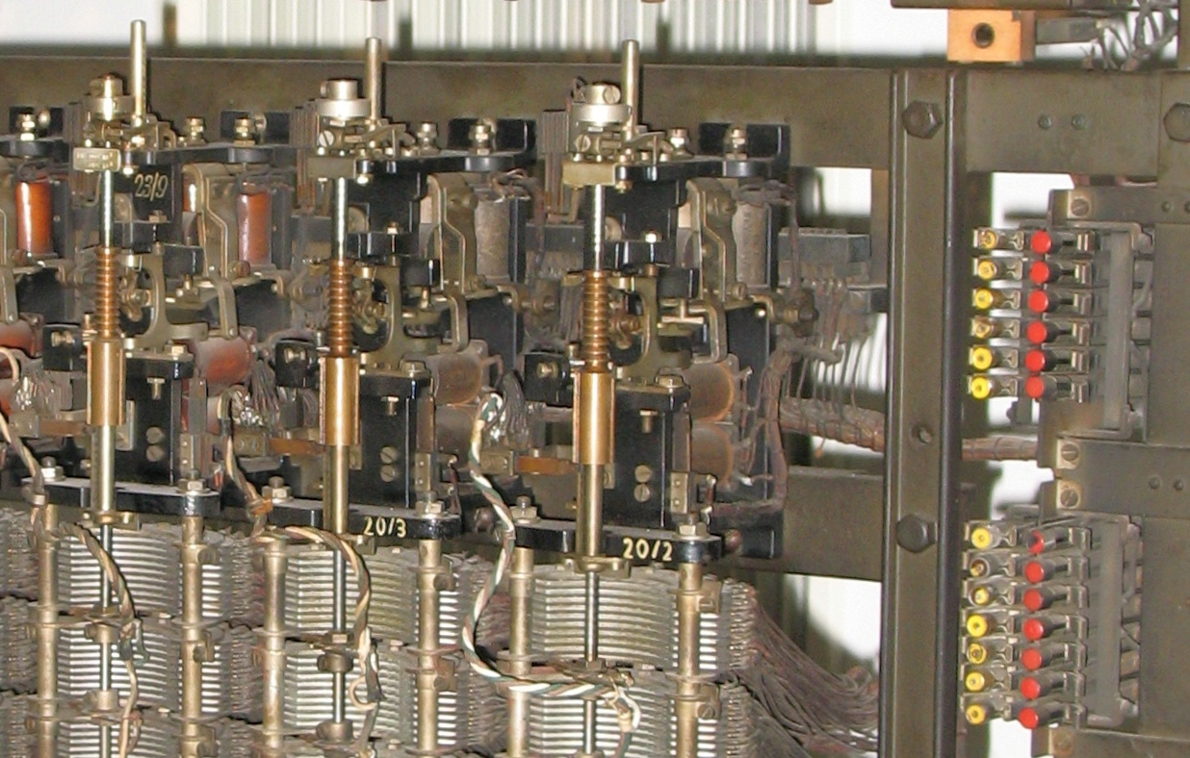
Not a history of this!
…Mechanical and Electrical engineering

Slide 6
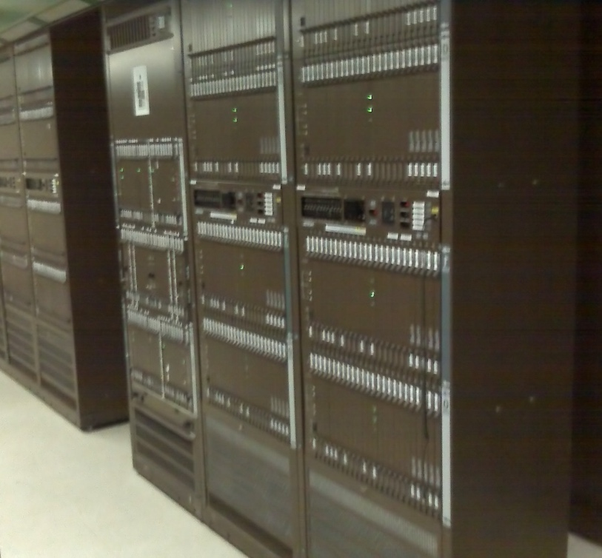
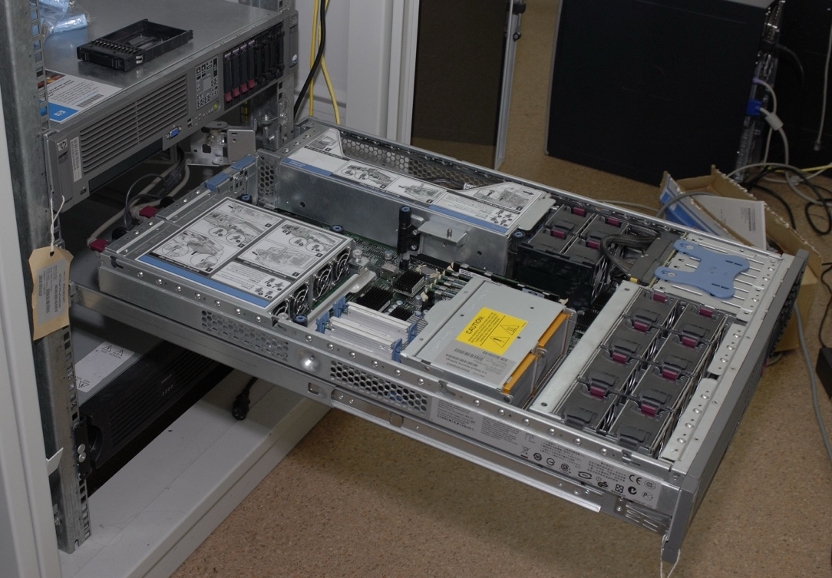
Digital switching
…Software Engineering
1990s
2020s
Specialised hardware
e.g. Nortel DMS-100
“Commercial Off The Shelf”
(e.g. HP Proliant)
Digital switching
Long development process
Cloud deployment
Short iterative development process
Journey from custom telecom solution to IT software application

Slide 7
Telecom operator business model
“Service provider”
  Voice (forwarding, barring, voicemail), Messaging (store & fwd)
  $$$ per service, limited competition
  Lots of money to build a solution
Mobile ARPU France €40–50/month in 1990s
Mobile ARPU France
~ €20/month in 2020s
“Bit pipe”
  Pipe for VoIP (WhatsApp, Viber) & video (YouTube)
  $$$ per Gb, massive competition (e.g. SFR/Red 130Gb = 9 €/month)
  Solution price pushed down
ARPU = Average Revenue Per User

Slide 8
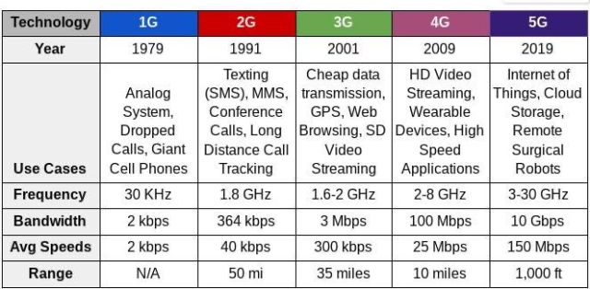
Technology evolution
What is the Killer App?
Key 5G use cases:
eMBB - high bandwidth
URLLC - low latency “edge”
mMTC - machines
Other features:
Slicing
Private networks
Edge deployment
Non-terrestrial Networks
Reliable voice and texting
Downloadable apps (e.g. iPhone)
Video and social media
https://techjunction.co/tech-question/1g-2g-3g-4g-5g-6g/

Slide 9
Agenda
A bit about me
Telecom evolution over 30 years
How is telecom “engineered”?
  Requirements
  Redundancy/capacity approaches
  Solutions over time
Conclusion

Slide 10
Telecom network engineering requirements
Technical
  Always on
  Works with all devices - standardisation
  Lots of users/devices (people, machines)
  High volume of usage (voice, messaging, data)
  Peaks of traffic (overload, sometimes unpredictable)
Operational
  Cheap to purchase and install
  Easy to operate, maintain and upgrade

Slide 11
Trade offs – the perfect solution?
Media & I/O
Compute & Memory
Storage
Voice packets
Data transfer
Session state
Profile data
Signaling
Authentication
Different services (voice, data, etc) exert load in different ways
They must balance!

Slide 12
Agenda
A bit about me
Telecom evolution over 30 years
How is telecom “engineered”?
  Requirements
  Redundancy/capacity approaches
  Solutions over time
Conclusion

Slide 13





Capacity scaling
Increase
capacity
Vertical scaling
Horizontal scaling
In the next slides…
Process
Process
=
Process
Process
Process

Slide 14
Redundancy – 2N
1a
State changes
1b
Stateful software
State is replicated
“Sticky” sessions
Automatic fault detection and switchover to standby
Double (2N) hardware needed!
e.g. N=3 → 6 processes needed
Traditionally, telecom applications are like this
Load
Load balancer
2a
State changes
2b
3a
State changes
3b
FAULT
Standby takes over

Slide 15
Redundancy – N+1 (or N+m)
1
Stateless software
Load shared across all instances
Automatic fault detection and redistribution
Less hardware needed
E.g. N=3 → 4 processes needed
Most IT applications are like this (with back end database)
Load
Load balancer
2
Traffic redistributed
3
4
FAULT

Slide 16
Redundancy – session store
1
Stateful software
Common storage of state
Retrieval of state on failure
Less hardware, but more complex
State changes
Load
Load balancer
2
State changes
Session Store
3
State changes
State changes
4

Slide 17
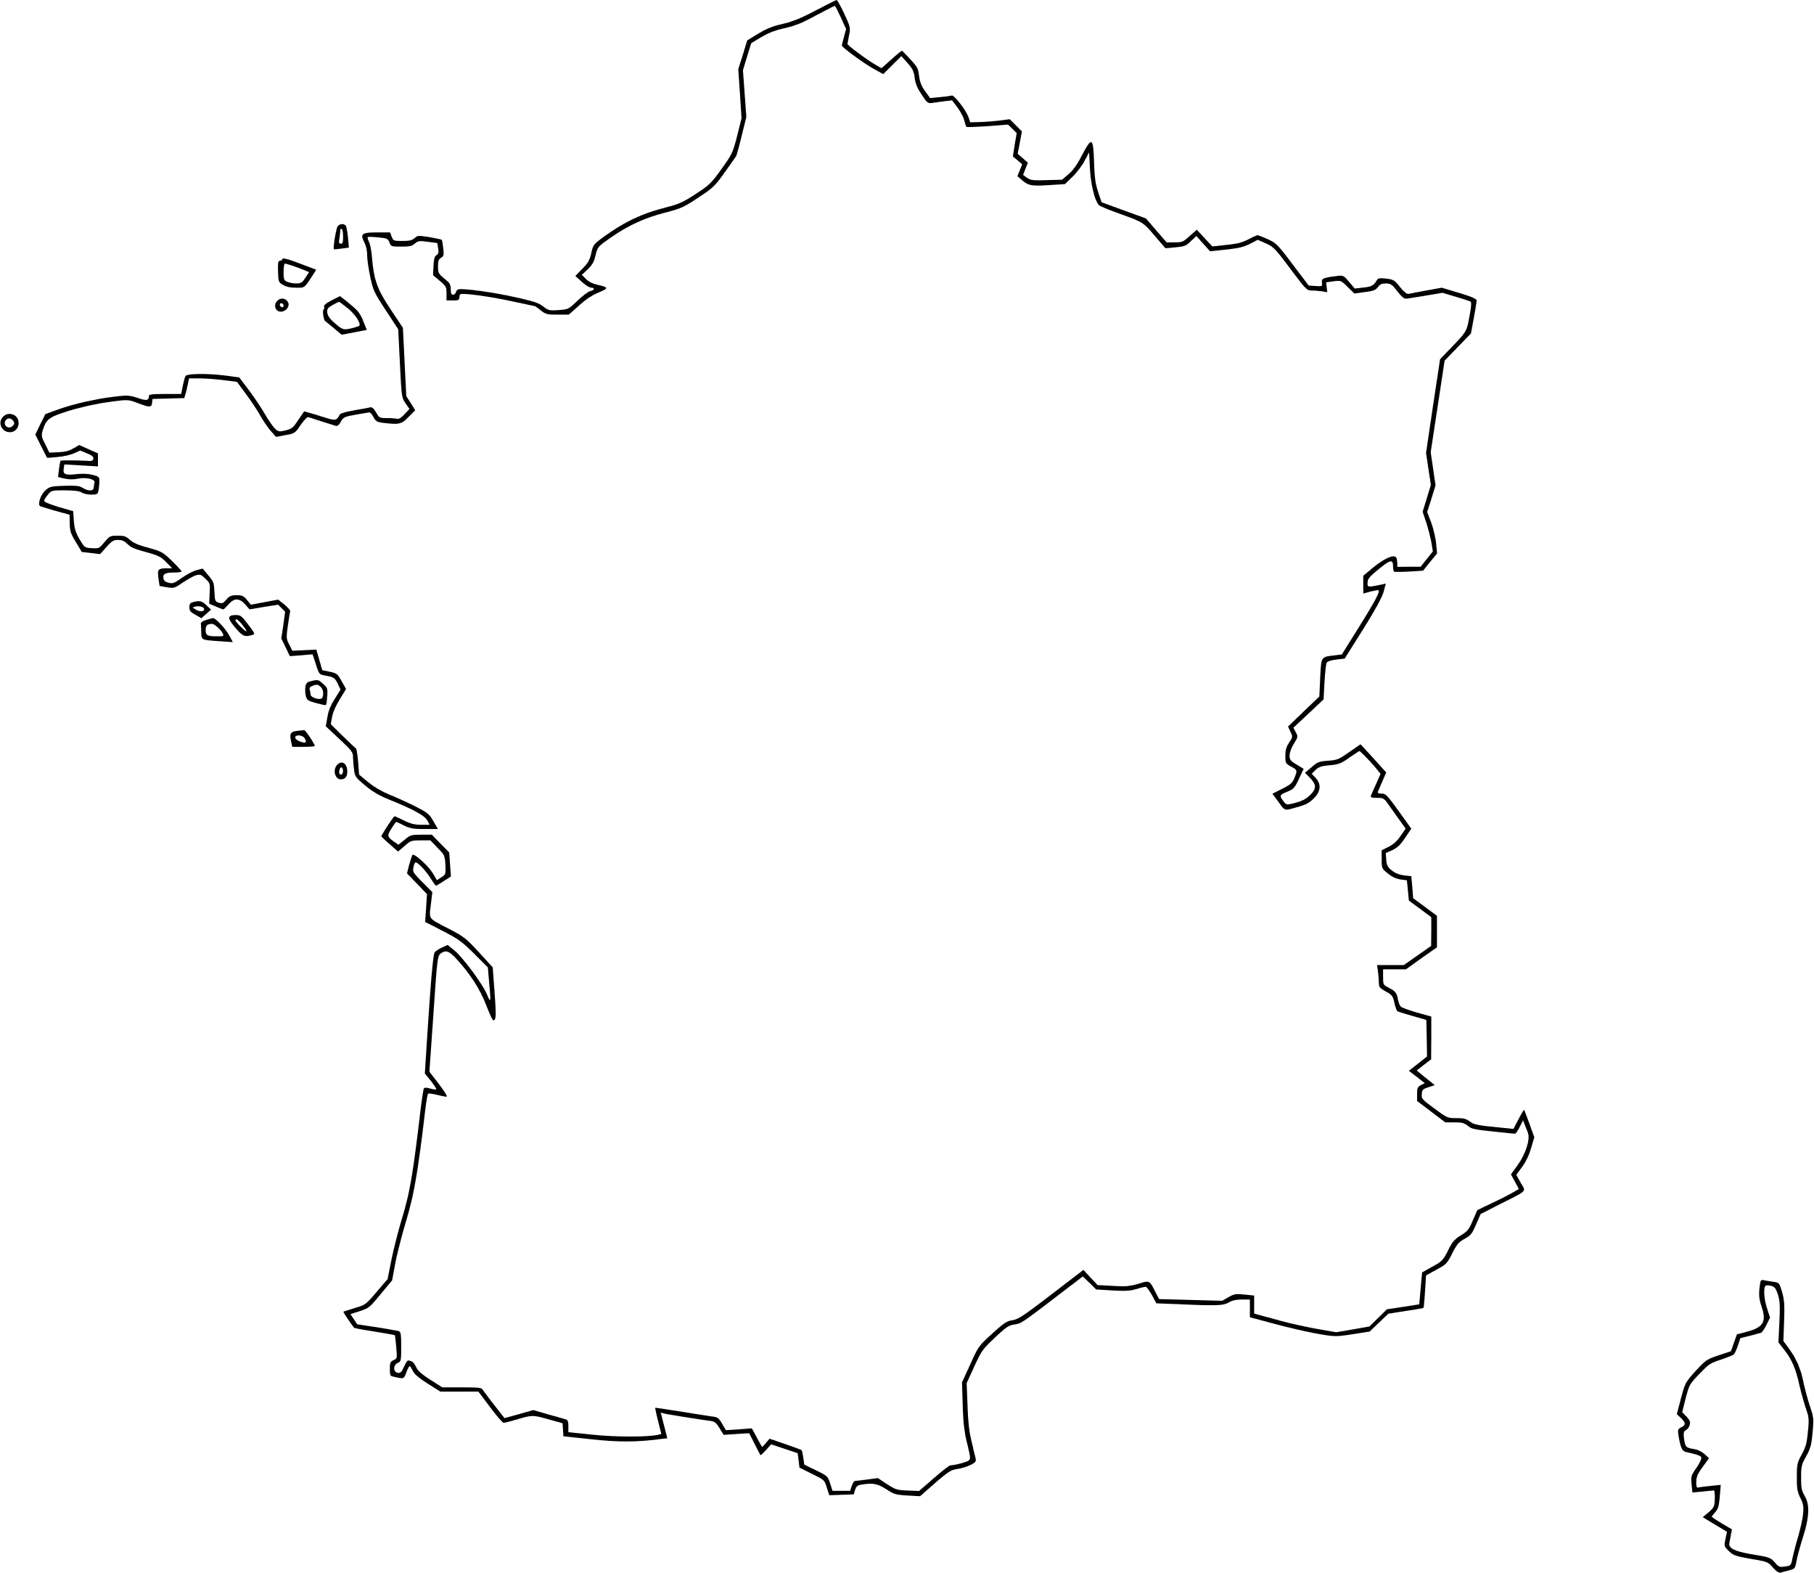
Geo-redundancy
1a
State changes
1b
Load balancer
2a
State changes
2b
3a
State changes
3b
Paris
State changes
Marseille
1a
State changes
1b
Load balancer
2a
State changes
2b
3a
State changes
3b

Slide 18
Agenda
A bit about me
Telecom evolution over 30 years
How is telecom “engineered”?
  Requirements
  Redundancy/capacity approaches
  Solutions over time
Conclusion

Slide 19
Monolytic solution
1990
2000
2010
2020
Big software blob
Big software blob
Control
Media
State
Duplicate
for scale
Custom hardware
Custom hardware
Nortel DMS
2N redundancy at hardware level

Slide 20
Control/media separation
1990
2000
2010
2020
Control software
Control software
Control
& State
Duplicate
for scale
Custom hardware
Custom hardware
Media software
Media software
Media
& State
Duplicate
for scale
Custom hardware
Custom hardware

Slide 21
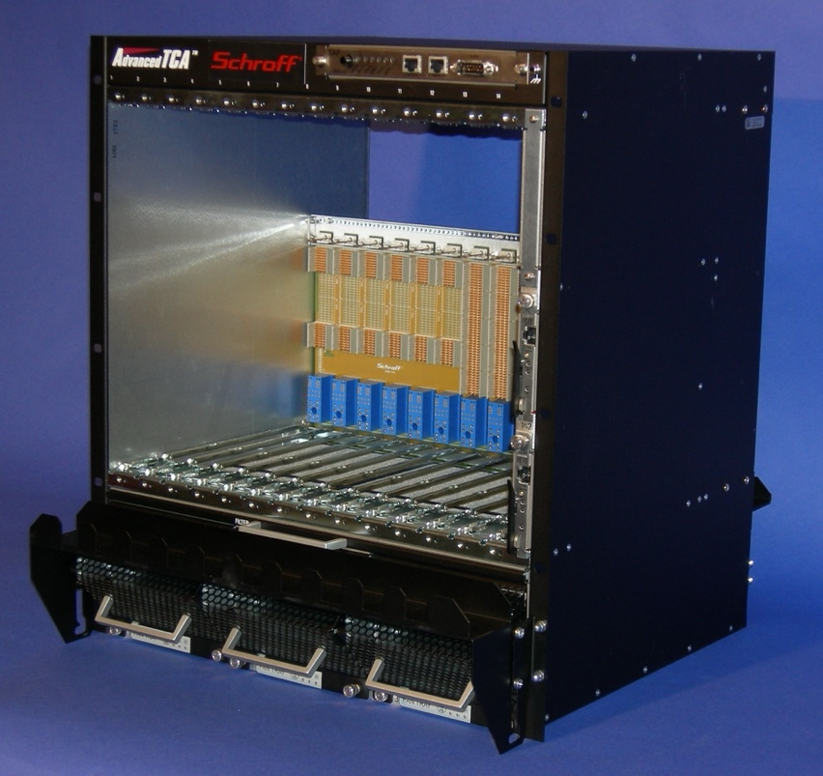
Commercial hardware
1990
2000
2010
2020
SW
SW
SW
SW
SW
SW
SW
SW
SW
SW
Control
State
Duplicate
for scale
HW
HW
HW
HW
HW
HW
HW
HW
HW
HW
Chassis
Chassis
SW
SW
SW
SW
SW
SW
SW
SW
SW
SW
Media
State
Duplicate
for scale
HW
HW
HW
HW
HW
HW
HW
HW
HW
HW
ATCA: Advanced Telecommunications Computing Architecture
Chassis
Chassis

Slide 22

Evolution to IT
1990
2000
2010
2020
Bare metal, virtual machines, containers
State
SW
SW
SW
Control
SW
SW
SW
SW
SW
SW
Server
Server
Server
Media
Private or public ”cloud”

Slide 23
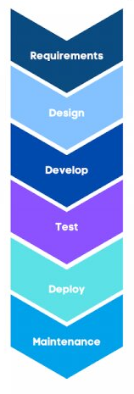

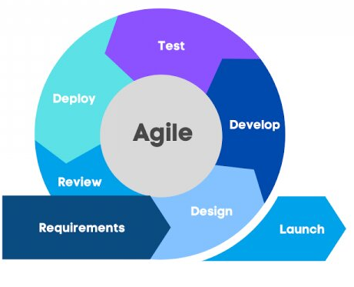

Development philosophies
1990
2000
2010
2020
Agile
Waterfall

Slide 24
Agenda
A bit about me
Telecom evolution over 30 years
How is telecom “engineered”?
  Requirements
  Redundancy/capacity approaches
  Solutions over time
Conclusion

Slide 25
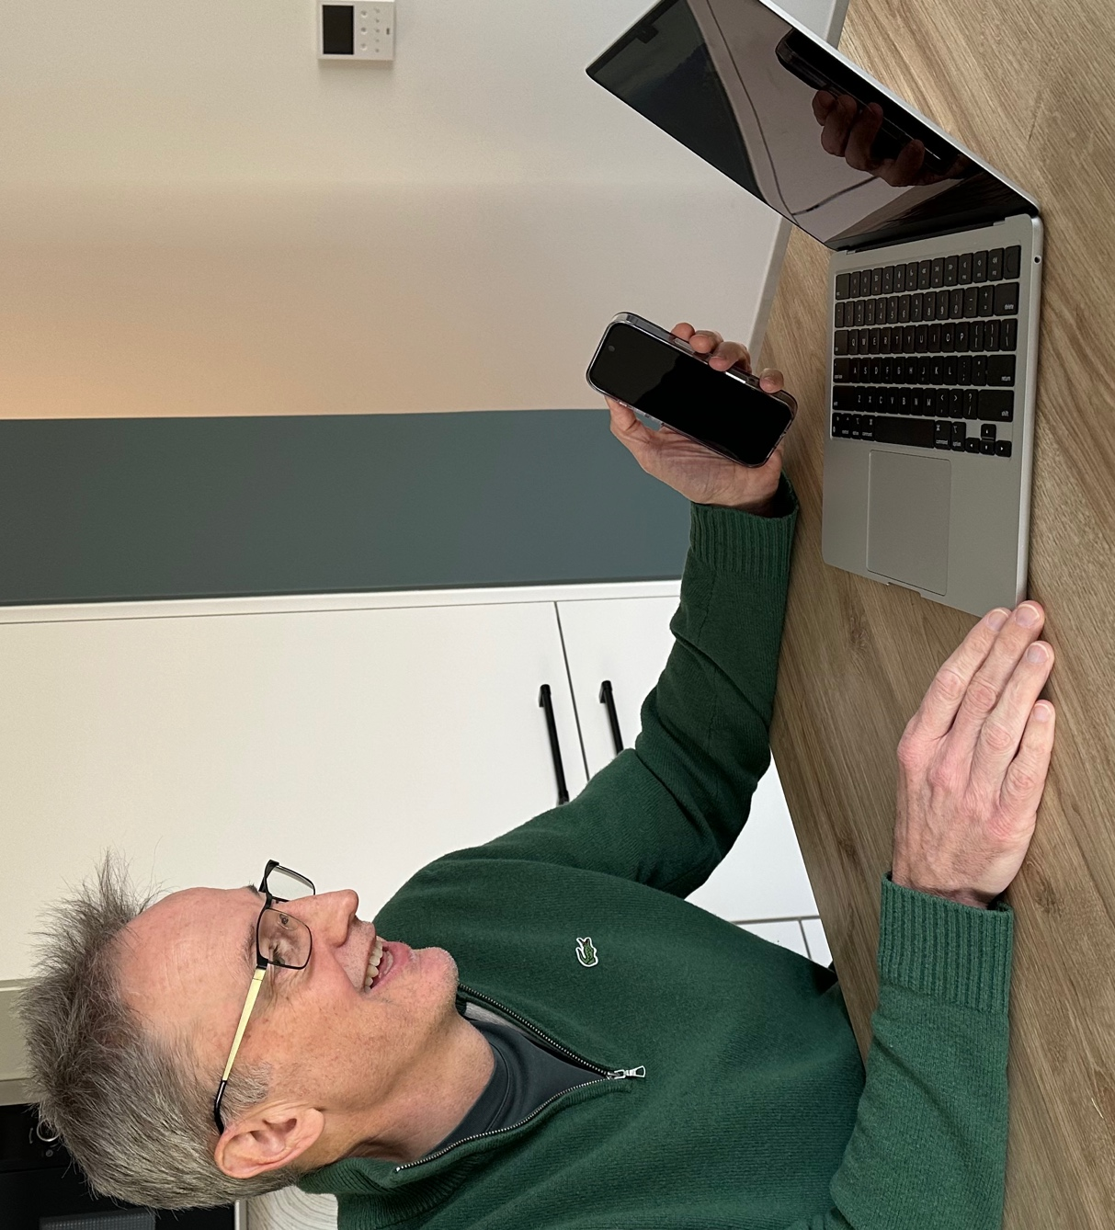
Conclusion
* According to Wikipedia so it must be true
Engineering is *
  practice of using natural science, mathematics, and the engineering design process
  to solve problems within technology
  increase efficiency and productivity and improve systems
Telecom & Software → Real Engineering!

