Slide 1
Water, Water, Nowhere:
The Utility We Can't Live Without
Aoife Kelly
Global Lead Sustainable Design, Life-Sciences and Advanced Manufacturing
Arcadis
Notes:
5 min
Good evening and thankyou for coming to this evenings lecture and networking event.
I want to thank the IET for hosting these lecture series and a particular thankyou to Pedro Osorio a colleague of mine from Arcadis who is a volunteer here at the IET who suggested we talk about some of the projects we are working on around the globe focusing on net zero and manufacturing.
I am here to talk about water.
Because water is never just a water problem.
It's an energy problem.
An infrastructure problem.
A resilience problem.
A risk problem.
A cost problem.
And very often, a systems problem.
And that is why it is so fascinating.

Slide 2

Why they keep letting me into meetings
Notes:
1.5 min
Now before we begin, a quick word about myself.
I am not a water treatment specialist.
My role is slightly different.
I work as a Global Lead Sustainable Design, supporting our Pharmaceuticals and Advanced Technology,
Mu background is architecture but I have been in these sectors for 15 years now.
I really like architecture, BUT I LOVE Sustainability and that is why I moved into this role.
my job is to bring specialists or sme’s together in one room to find the most appropriate solutions for our projects and clients, and as you can see that involves asking lots of questions.
I am a firm believer that within sustainability when one discipline makes a decision it WILL impact on other areas, in a negative or positive way, getting these teams together we can plan for and identify where we may have missed an opportunity or a risk.

Slide 3
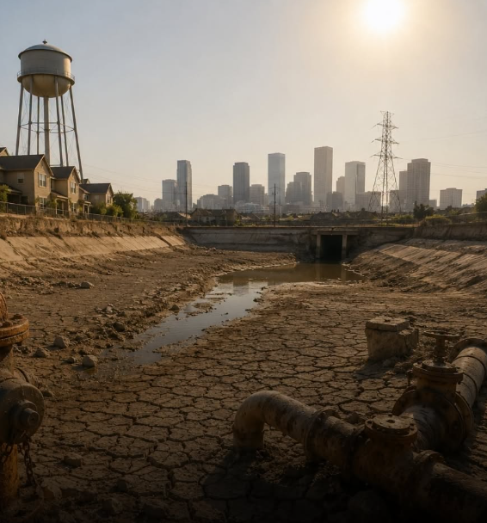
What happens when reliable water can no longer be assumed?
Notes:
1.5 min
This summer alone has been a stark reminder of where we are headed for freshwater supply.
We know global freshwater demand is projected to exceed available supply by approximately 40% by 2030 if we keep going the way we are.
Right now, around four billion people experience water scarcity for part of the year.
Look at the Danube - In July 2026, it fell to its lowest level ever recorded in Budapest.
The river dropped below the previous record set in 2018, exposing sandbanks, rocks and infrastructure that would normally never be seen.
Two nuclear plants that draw water for cooling from the Danube had to shut down reactors for safety–
We are moving from a drought situation to an energy security issue.
In the UK over 40% of the population were impacted by water restrictions.
When water becomes scarce, the first response is often to build more supply.
But resilience starts somewhere else and that is what I want to talk about this evening.

Slide 4

INVESTIGATION ONE
The Water We Never See
Notes:
6 mins
To create resiliance we need to follow the water, where it goes and how it is used.
So….. I am framing this presentation as a series of investigations, mysteries with (I hope) a clear outcome, the case study for this evening is a very large pharmaceutical campus in a water stressed region of the US, demonstrating that if we can do it there we can do it anywhere…

Slide 5
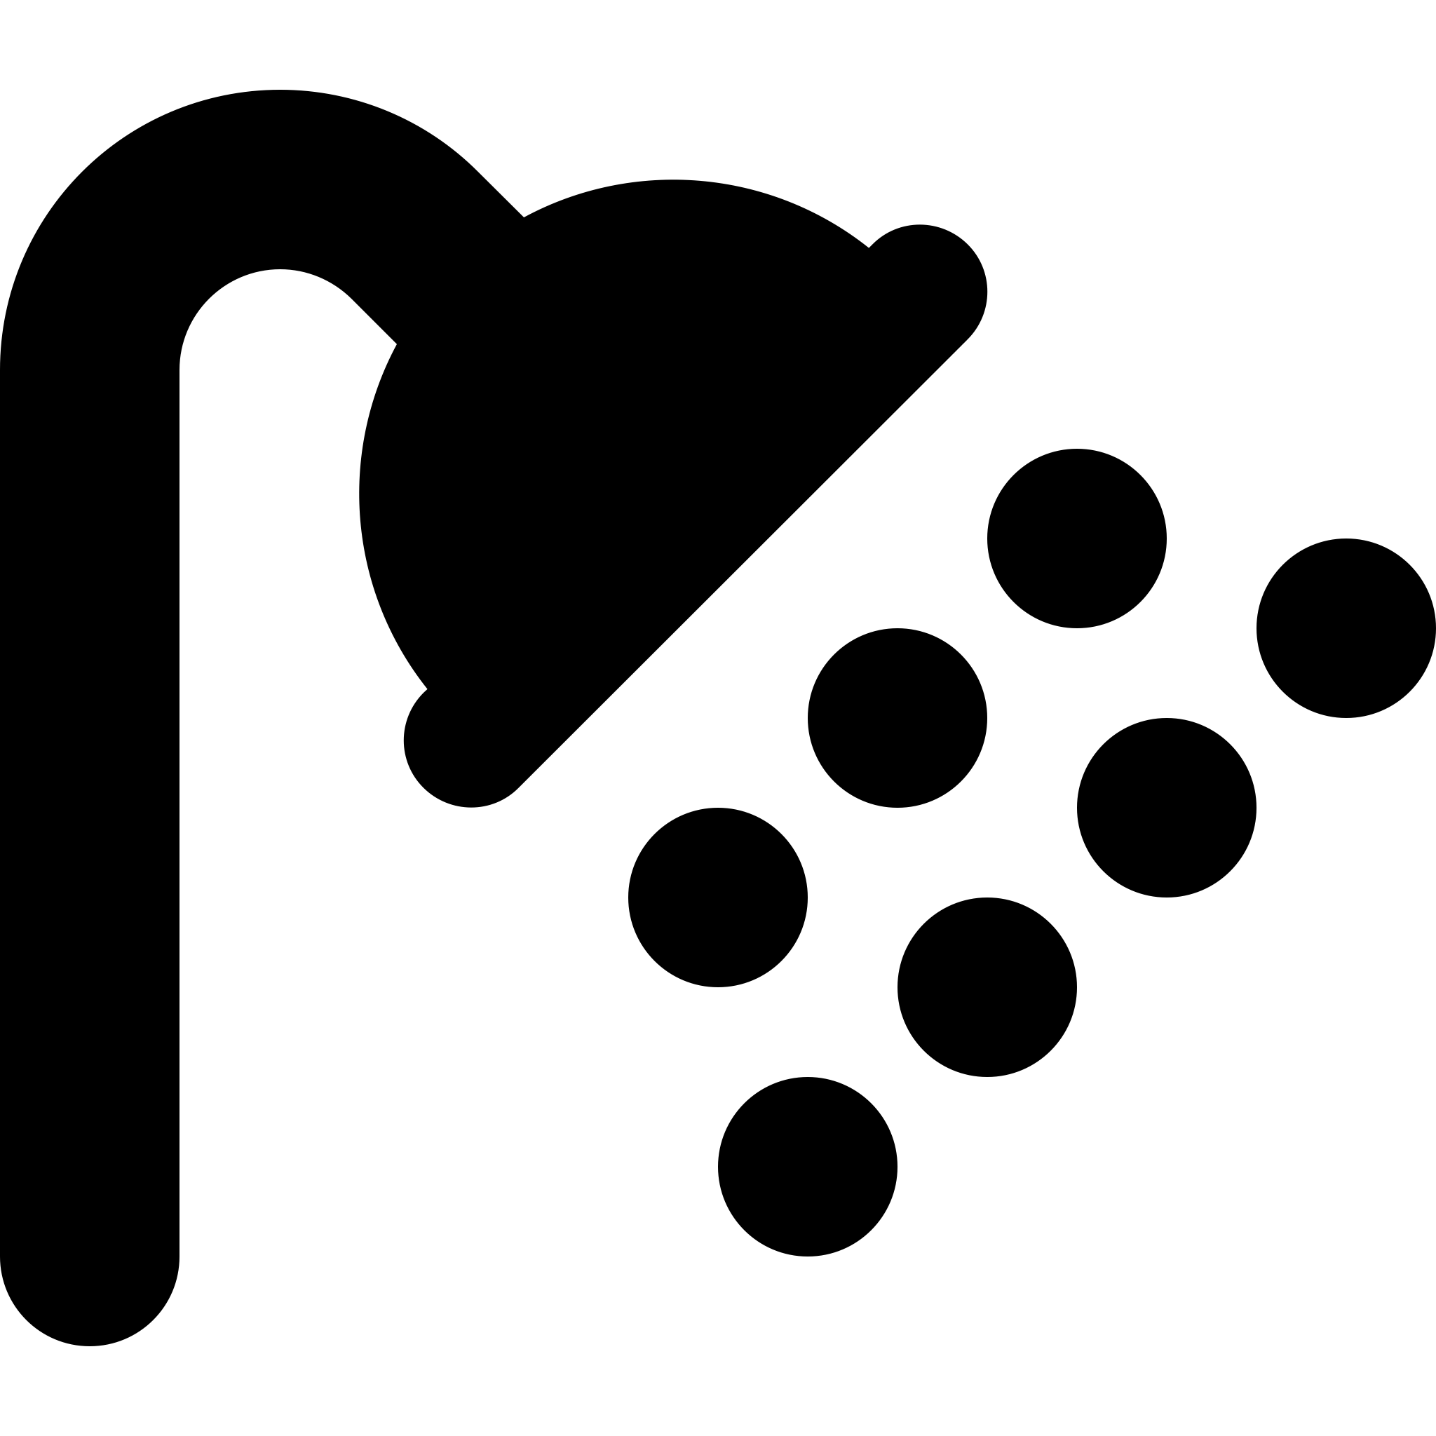






How much water do you think
you used today?
YOUR VISIBLE
DAILY WATER USE
120 – 150
Shower
Tea / coffee
Toilet *
Taps
LITRES
5%
ABOUT
of total water use
Laundry
Cooking
Drinking
So where is the other 95%?
* Flushing plus leaks is where most household demand actually sits,
Notes:
[1.5 min — ends 07:00]
* Flushing plus leaks is where most household demand actually sits

Slide 6







The water we do not see
YOUR TOTAL
DAILY WATER FOOTPRINT
WHERE THE HIDDEN WATER SITS
3,500 – 5,000
Food production
Electricity
Manufacturing
LITRES PER DAY
95%
AROUND
is hidden from view
Consumer products
Infrastructure
Healthcare
Buildings
The water footprint extends far beyond the tap.
Notes:
[1.5 min — ends 08:30] Water is embedded in almost everything we use, consume and depend on
Most of the water we depend upon is completely invisible.

Slide 7



Water’s Journey
ABOVE THE WATERLINE
The two bills you actually see
The real cost of water is not purchasing or releasing it to sewer, it is treating it, moving it and using it, those costs can be up to 5 x times the cost of purchase!
BELOW IT
Everything else the litre costs you
REDUCE, RECOVER, REUSE
MAINS / CITY WATER
BUILDING
USE
WASTEWATER
WASTEWATER
TREATMENT
TO SEWER
Notes:
[2.0 min — ends 10:30]
We are probably familiar with the “tip of the iceberg” analogy used for water use, and I want to build on that here.
Hidden costs include:
Energy to heat, chill and pump and treat it
Labour and maintenance
On-site treatment
Offsite treatment
Permitting costs

Slide 8
INVESTIGATION TWO
The Hardest Place To Save Water
Notes:
9 mins
Lets get into our case study,

Slide 9
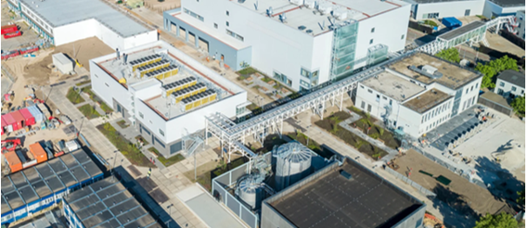



If water resilience works here,
It can work almost anywhere.
LESSONS FOR THE WIDER BUILT ENVIRONMENT
Offices
Hospitals
Universities
PHARMACEUTICAL MANUFACTURING
TRANSFERABLE
LESSONS
Patient Safety
Product Quality
Campuses
Districts
Cities
Regulatory Environment
Validated Manufacturing
THE SURPRISING STARTING POINT
Not treatment. Not technology. Not reuse.
UNDERSTANDING COMES FIRST
Notes:
1.5 min
back to an earlier question:
What happens when reliable water can no longer be assumed?
And more specifically:
What can one of the most highly regulated manufacturing environments in the world teach us about designing a more water-resilient future?
Because if we can solve water challenges in an environment where:
quality cannot be compromised
production cannot stop
compliance cannot be relaxed
safety cannot be sacrificed
then perhaps the lessons are useful far beyond a pharmaceutical facility.
Perhaps they apply equally to:
offices
hospitals
universities
campuses
districts
cities
And perhaps the most important lesson is this:
The answer is almost never to build a bigger supply first.
A little about this site, it is a huge multi-campus site, in a water stressed area of the USA. They have strict permitting requirements on discharge, and know that water restrictions are only going one way, they want to get ahead of the risk and manage reduction now as a project rather than a critical risk management strategy.

Slide 10




Where Did the Water Go?
CENTRAL UTILITY PLANT
Purified water, WFI, plant steam,
cooling tower make-up
386 Ml/y · 53%
DISCHARGED
~667 Ml/y
92% of intake
INCOMING
727 Ml/y
purchased
DOMESTIC & HVAC
Restrooms, cafeteria, labs
237 Ml/y · 33%
IRRIGATION 95 Ml/y · 13%
CONSUMED /
EVAPORATED
~60 Ml/y · 8%
THE COST LADDER
Per 1,000 litres
*Converted from US$ to £
MAINS WATER
~£1.93
RO / PURIFIED 2×
~£3.93
WFI ~5×
~£9.02
TO SEWER
~£0.60
AT EVERY STAGE, ASK
Enough water?
Correct quality?
Available when needed?
Can we reuse it?
Notes:
2.5 min
The Sankey is the evidence slide. Point at it, do not read it.
Back to the tip of the iceberg slide above, we know what comes in and goes out, but we can alter what happens inbetween, Start on the left: 727 million litres a year bought in. One stream, before anyone has made a single decision about it.
The split is the point. More than half goes to the central utility plant — purified water, WFI, plant steam and cooling tower make-up. The biggest water user on a pharmaceutical campus is not the product. It is the plant that makes and moves the water.
A third is domestic and HVAC. Thirteen per cent is irrigation, on a site in a water-stressed region. Think about that
Now the right-hand side: about 92 per cent leaves as discharge, only 8 per cent is consumed or evaporated. Almost everything istreated, used once and sent away.
Say out loud what PW and WFI are — purified water for process use, water for injection for product contact and final rinse. Assume half the room does not know, and none of them will ask.
The cost ladder underneath: mains water, roughly double for purified, roughly five times for WFI. Sewer looks cheap, and that is exactly why people ignore what they put down it.
Important caveat, say it out loud: the 5× is a purification ladder, not distribution. WFI is not five times the volume — it is five times the cost per litre. That is why the volumes are small and why wasting it hurts.
Where the mysteries live: three of the four coming up sit inside that utility band. This diagram is the map of where we went looking.
Hand off to the vote: so that is where the water goes.
Now — you have ten million pounds. Where do you spend it?

Slide 11
The Wrong First Answer
You have £10 million to invest in water. Where do you spend it?
01
02
03
04
MORE TREATMENT
MORE SUPPLY
MORE REUSE
BETTER CONTROLS
Add capacity to clean what we already use.
Secure another source or connection.
Recycle streams back into the process.
Instrument, monitor and operate more intelligently.
Audience vote — before we look at the evidence.
The catch
Every option here spends money before anyone has asked why the water is used.
Notes:
3.0 min
Run this as a live vote — hands up, one option each.
Four options, Read them out, then take the vote.
Acknowledge the room — whichever way it splits, tell them it is a sensible split.
There is no wrong answer among the four. That matters, because the trap only works if nobody feels caught out.
Then the reveal:
every one of those options spends money before anyone has asked why the water is being used in the first place.
The mistake is not the choice. The mistake is that a choice was being made at all at this stage. BACK TO WHAT I SAID EARLIER - don't start with supply, start with demand.
When businesses are operational and busy, money is easier to authorise than understanding. A business case for a new connection or a treatment skid has a number, a supplier and a delivery date. "Go and map your demand" has none of those — so it gets skipped, and the capital gets spent solving a demand nobody has characterised.
Hand off to the next slide: so what is the right first move? The sequence — and note where EXPAND sits in it.

Slide 12
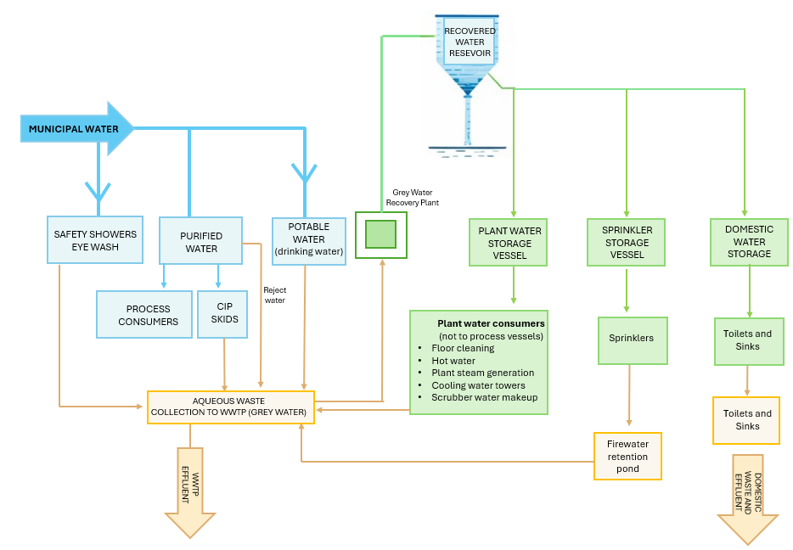
The Right Sequence
Water resilience is built in the order decisions are made — and it starts with a map of every stream on site.
01
UNDERSTAND
02
MEASURE
03
REDUCE
04
SEGREGATE
05
REUSE
06
RECOVER
07
EXPAND
THE PRINCIPLE
Expand supply last. It's the sequence we all know, yet one that is still routinely skipped.
Notes:
2.0 min
This is something we will share wit ha client early on to understand the various water types and their journey through the facility.
Talk the seven steps:
UNDERSTAND — map where water is used, why it is needed and which demands are critical.
MEASURE — baseline, flow pathways, peak demand.
REDUCE — remove avoidable demand.
SEGREGATE — keep streams separate by quality, temperature and contamination risk.
REUSE — match available quality to the next appropriate use.
RECOVER — capture water, heat and resources before discharge.
EXPAND — only then consider more supply, treatment or infrastructure.

Slide 13
INVESTIGATION THREE
Think like a detective
Notes:
7 mins
How we work- the water kaizen blitz method

Slide 14
The Water Lens
A water balance tells you where the flow goes. These six tell you why — and everything that follows is tested against all six.
01
02
03
04
05
06
QUANTITY
QUALITY
TIMING
DESTINATION
ENERGY
RISK
How much is actually needed?
What standard does this use require?
When is it needed, and when is it not?
Where does it go next?
What did it cost to move and heat?
What happens if it is not there?
WATER BALANCE
WATER STRATEGY
How much? Where? Volumes in and out, split by system , typically a snapshot in time.
Why? When? What quality? What risk? The purpose behind every demand,
and the consequence of getting it wrong.
From here on
A litre is never just a volume. Remember these six — we view all decisions through these lenses.
Notes:
[2.0 min — ends 22:30]
A water balance told us where the water went. It could not tell us why any of it was needed. That is the gap the Water Lens closes.
Quantity and Quality — "how much, and how good does it have to be. Most over-spend on site is quality, not quantity: purified water doing a job mains water could do.“
Timing and Destination — "when it is needed, and where it goes next. A demand that only exists eight hours a day is a different problem from one that runs continuously — and one stream's waste is often another's feed.“
Energy and Risk — "what it cost to move and heat, and what happens if it is not there. Energy is why a litre saved is rarely just a litre. Risk is why nobody wants to touch it — and the reason most of these systems are oversized in the first place.“
THE POINT (30 sec). "Balance is a snapshot. Strategy is the purpose behind each demand and the consequence of getting it wrong. Everything after this slide is tested against all six — and you will see each of the four investigations start by asking one of these questions.“
Land the line on the slide and let it sit: a litre is never just a volume.
HANDOFF (10 sec). "So that is the lens. Next — how you actually run it on a live site, in a fortnight, without stopping production."
If running late: cut the pairing commentary to Quality and Risk only, keep the closing line. If a hand goes up on Risk, park it — the salt trade-off later in the deck is the answer and it lands better with evidence behind it.

Slide 15
The Water Kaizen Blitz® Process
MAP
01
02
QUESTION
VERIFY
07
03
MEASURE
06
RECOVER
04
05
REDUCE
SEGREGATE
Why it works
Improvement compounds when the questions stay the same and the answers get sharper.
Notes:
2.0 min
HOW TO EXECUTE THE SEQUENCE
MAP
Draw the real system, not the design intent.
QUESTION
Ask why each demand exists at all.
MEASURE
Set the baseline before changing anything.
Remove avoidable demand first.
SEGREGATE
Keep streams apart by quality.
RECOVER
Capture water, heat and resources.
VERIFY
Prove the saving — then map again.
Verify does not close the project.
It points straight back to Map, with better questions —
and each pass is smaller than the last.

Slide 16

Who Is in the Room — and How It Runs
Operations
Knows what really happens at 3am.
TWO LEADERS
KAIZEN LEAD
Engineering
Knows what the system was designed to do.
WATER SPECIALIST
Maintenance
Knows which valve has leaked for years.
Environment
Knows the permit and the receiving water.
HOW IT RUNS
01
DISCOVERY
Days to weeks, before anyone travels.
v
Finance
Knows what the water really costs.
02
SITE VISITS
One or several. Walk the real system.
v
03
IN-PERSON KAIZEN
Two days. Ideas costed and opportunities understood.
v
The key point
The answers were already on site. Nobody had put these seven in the same room.
Notes:
[2.0 min — ends 26:30]
A framework, not a workshop: seven people, three phases
Carefully structured teams:
Experts in financially viable water conservation
Experts in site operations
Diverse balance of skills allows identification of robust, cost-attractive solutions
Short intense dive into how, when, why, where water used at facility
Development of ideas for water efficiency
Set out opportunities based on short, medium and long ROI, agreed with client so no surprises when the kaizen report is handed over.
Can start the short and some medium projects to demonstrate viability, prior to asking for CaPEX investment for long ROI projects.

Slide 17
INVESTIGATION FOUR
FOUR WATER MYSTERIES
Notes:
16mins total
29 ideas raised, 15 opportunities explored at kaizen stage, just over 32% savings, with 2 further costs reaching 40% reduction – but it pushes the site to their permit limits / compliance ceiling.
the study gives the site a defined, phased route to needing about a third less city water — and, critically, it identifies the constraint that would stop it going further (salt load concentrate). That combination is what resilience actually looks like here.
3 phases of work – short term ROI, medium and long term up to a 30 plus year payback, but starting with short ROI starts saving water now, not waiting on investment. Phase 1 can be deployed inside a drought response.
Salt - Which is why the report's recommended next step is salt control — focused diversion and treatment of high-strength wastes, or whole-discharge reuse. Under increasing stress, that becomes the enabling project,
About 13% of the sites water went to irrigation, changing the planting out over time removes this load.
Maintenance team have budget for critical production focused systems, not general leaks – expanding this is one of the quickest ways to waste.
The one-line answer for your audience: the work doesn't make the site drought-proof, but it means a restriction that would once have forced a production decision now lands on demand the site has already removed — and it tells the site exactly where its next limit is, which is the discharge consent rather than the water main.

Slide 18
Mystery #1 — Water Going Around in Circles
Problem
Treated water was being re-treated, again and again.
34.3m
litres saved a year
Question
Why is clean water returning to the front of the plant?
Discovery
A control philosophy, not a piece of equipment.
Treat
Return
Re-treat
What the water was actually doing
Lesson
Efficiency was hidden in how the plant was operated, not in what had been installed.
Notes:
3.0 min
The plant was making purified water, sending it out, and getting it straight back again — to be purified a second time.
Purified water the site did not need was being returned to the head of the treatment train and put through the membranes again. Every pass throws a share of the flow away, so the loop paid for the same water twice and lost some of it each time.
QUESTION Point at the loop: why is clean water arriving back at the front of the plant? A control philosophy, was responsible not a piece of equipment. The recycle was simply how the system had always been set to run, a sensible instinct, written years earlier, never revisited. There was no fault to find, which is why maintenance had never surfaced it.
About £7,000 of control work against £321,000 a year. Say "a week" and pause. Caveat: identified, not banked — and this was the fastest payback in the whole study
THE LESSON – This was about efficiency in operations not equipment. Looking back at our sankay diagram this water sits in the big utility band, water that does not touch the product.
This one was hiding inside the most sophisticated system on site. The next was not.
Likely question: "wouldn't the control system flag it?" No — nothing was out of range. Alarms catch faults, not intent.

Slide 19
Mystery #2 — The Cheapest Water on the Most Expensive Campus
Problem
Office and admin taps ran unrestricted while purified water was engineered to the litre.
17.0m
litres saved a year
Question
Where is the best return per pound actually sitting?
Discovery
The lowest-grade water on site had never been looked at.
Admin taps
Restrictors
3-week payback
What the water was actually doing
Lesson
The biggest return is not always in the most technical system. It can be in the one nobody thought worth measuring.
Notes:
3.0 min
"On a site where purified water is engineered to the litre, the taps in the office and admin buildings ran at whatever the fitting happened to deliver. Nobody had ever measured them."
Restrictors on the restroom and breakroom taps across three administration buildings — roughly two hundred fittings, taken from about seven and a half litres a minute down to two. No behaviour change, no process change, no quality standard touched.
"Where is the best ROI actually sitting?" The honest answer is that nobody looks here, because this is the least technical water on the most technical site.
Around £4,100 of fittings, less a utility rebate, for about £45,800 a year — three weeks RIO.
Contrast it out loud with the £10.2m replacement project sitting in the same programme. Be precise if challenged: this is the cheapest measure in the study and one of the fastest.
THE LESSON The biggest return is not always in the most technical system; it can be in the one nobody thought worth measuring.
HANDOFF "That one needed a spanner. The next needed somebody to notice what a machine does when it is doing nothing."

Slide 20
Mystery #3 — Equipment Drinking Water While It Sleeps
Problem
Autoclaves drew cooling water continuously, including when idle.
9.2m
litres saved a year
Question
Why does standby cost the same as production?
Discovery
No link between operating mode and resource demand.
Idle
Full draw
No work
What the water was actually doing
Lesson
Match resource use to operating mode. Equipment at rest should consume like equipment at rest.
Notes:
2.5 min
The autoclaves (sterilization units) were using water all the time, even when they weren't actually sterilising anything, between cycles and overnight.
Hot condensate leaving the unit has to be cooled before it can go to drain, so cold water is run once through to quench it. In standby the unit is still condensing steam, so the quench never stops. Small flow, every hour of every day, across a lot of units.
System set up for worst case condition – continuous use, so on a meter this looks like a healthy, stable baseline — flat overnight demand reads as normal, not as waste.
THE DISCOVERY No link between operating mode and resource demand. Nobody had priced what it costs to be permanently ready.
THE NUMBERS About 9.2 MILLION LITRES A YEAR, £5,400 of controls for £24,300 a year. The smallest of the four with a 10 week ROI.
THE LESSON -Equipment at rest should consume like equipment at rest “Timing lens” from slide 14
HANDOFF "Three down. The last one changes how you think about reuse."
Likely challenge: "isn't continuous flow a safety margin?" Yes — and the fix keeps it; the control links flow to operating “on” mode.

Slide 21
Mystery #4 — Good Water in the Wrong Place
Problem
High-purity water was being used for low-grade duties.
21.2m
litres saved a year
Question
Does this use genuinely need water of this quality?
Discovery
Quality had never been matched to purpose.
High grade
Low duty
Discharge
What the water was actually doing
Lesson
Reuse begins by matching quality to purpose — not by building another treatment step.
Notes:
2.5 min
SET UP "The most expensive water on site — purified water, still condensate, membrane reject was going to drain. Sanitisation dumps, sampling flows, blowdown. All of it made at high cost, none of it used twice."
THE QUESTION "Does this use genuinely need water of this quality — and does this stream genuinely need to be waste?" Almost nobody asks, because quality only ratchets one way: when in doubt you specify up, and no one is ever criticised for using water that was too clean.
THE DISCOVERY Quality had never been matched to purpose. This is the Quality lens from slide 14, and it is the most expensive kind of waste on a pharmaceutical site — modest volume, but every litre carries the full cost of purification. Callback to the cost ladder: purified is twice mains, WFI about five times. The fix is reclaim systems that capture those streams and put them back to work.
THE NUMBERS 21.2 MILLION LITRES A YEAR, About £207,000 of plant for £111,000 a year — under 2 year ROI. The only one of the four that needed real capital, and still an easy business case.
THE LESSON Reuse begins by matching quality to purpose, not by building another treatment step. The instinct is to add a plant that cleans water up; the cheaper move is usually to stop over-cleaning it in the first place. That is the £10 million question answered.
HANDOFF "Four questions, four different lenses. Here is what they add up to."
Likely question: "why not just reuse the whole effluent?" You can — and that is the salt trade-off later; concentrating what you recycle is exactly the limit this study ran into.

Slide 22
The Four Mysteries Together
Four measures, four different lenses
82 million litres
potential water saved every year
£501k*
Annual savings
Operating cost, every year
£222k*
Total investment
Capital across all four measures
4 of 15
Opportunities
The smallest slice of the programme
~5 mths
Simple payback
Three of the four paid back in weeks
* Converted from US$ to £ at 2021 rates.
Beyond the numbers
Four questions returned more than twice their capital cost in the first year alone.
Notes:
2.0 min
Four measures, 82 million litres a year, about £501,000 a year of operating saving for roughly £222,000 of capital, 5 MONTHS ROI.
Three of the four paid back in weeks; the reclaim project is the outlier at just under two years.
THE PROPORTION twenty-nine ideas were raised, fifteen taken to detailed evaluation, thirteen recommended. The four you have just heard are four of that fifteen — the smallest slice of the programme, not the programme.
THE ARGUMENT Four questions returned more than twice their capital cost in the first year alone. None of them required a new technology. Three required a settings change, a box of fittings and a controller.
GUARDRAIL Say identified rather than delivered this is a study of what the site can do.
HANDOFF "That is four. Now the whole site."

Slide 23
And Across the Whole Site
Thirteen opportunities, one campus, ten years — the four mysteries are 82 million litres of it.
222 million litres
potential water saved every year
Just over 30% of the site's total use, achieved
without relaxing a single quality standard.
Path to 40% identified as part of next (long ROI) phase – 2 opportunities.
£1.17m*
Annual savings
Operating cost, every year
£11.5m*
Total investment
Full programme. £1.26m without the major replacement project
10 yrs
Programme length
Incremental, not one big build
~10 yrs
Simple payback
Around 1 yr on everything but the replacement project
* Converted from US$ to £ at 2021 rates.
FUN FACT
These water savings could provide the annual water requirements to an entire British town with 4,500 residents
Notes:
2.0 min
OPEN
thirteen recommended opportunities, 222 million litres a year, just over 30% of what the site buys. The four you heard are 82 million of that, so roughly a third of the programme came from four questions.
This is not one big build.
Phase one is retrofits and controls that start saving now;
phase two the larger reuse and irrigation projects;
phase three the major replacement project on a long horizon.
Phase one could be deployed inside a drought response.
THE TWO BIG NUMBERS (Handle carefully). £11.5m against £1.17m a year reads as a ten-year payback and a hard sell. It is dominated by one item — the large replacement project at over £10m with a 30 year ROI but this is a replacement project not a water one. Reduces ROI to a about a year
THE 40% Identified, not costed, and it sits in the long phase — it needs whole-discharge reuse on top of everything else.
FUN FACT these savings would supply a British town of 4,500 people for a year. About 135 litres a head a day, so it stands up if anyone checks.
HANDOFF: every number moved the right way. So the study should have ended here right, but no…. Back to my previous point about one change has an impact somewhere else…

Slide 24
INVESTIGATION FIVE
Every Saving Moves Something Else
Notes:
11 min total
Back to my original point, every change has an impact on another area be it a positive or negative, this is a clear example of that impact.

Slide 25
The Savings Were There
✓
Demand down. Costs down.
Every number we had been asked to move, moved in the right direction.
And in the same study
The team that found the savings also modelled what they would do to the site’s discharge.
Notes:
1.0 min
Deliver this as a full stop, not a slide. "Demand down. Cost down. Every number we had been asked to move, moved in the right direction." Pause and let the room settle into thinking the story is over.
Then turn it: the same team, in the same study, also modelled what those savings would do to what leaves the site. Back to the point from the opening — everything is connected, and a change in one place always lands somewhere else.
Do not preview the answer. The next slide is the reveal.

Slide 26
…And the Model Showed the Catch
!
Flow fell
Hydraulic load on the plant dropped.
Discharge down 33%
Load did not
The same mass of salts and solids remained.
Salt mass unchanged
Concentration rose
And the discharge permit is written in concentration.
Salinity 58% → 79% of consent
The trade-off, quantified
The hydraulic problem got smaller. The compliance problem got larger — and it was on the page before anything was built.
Notes:
2.0 min
THE FINDING
Take the three rows in order.
Flow fell by about a third across the three phases — that is a straight win on hydraulic load.
The salts and solids did not fall with it; the same mass still had to leave the site.
So concentration rose, from about 58% of the consent limit to 79%.
WHY IT MATTERS The discharge permit is written in concentration, not in load.
Reduce the water and you move towards the limit even though you have not added a gram of anything. Above roughly 70% of a consent, the risk of an exceedance climbs sharply
THE POINT The hydraulic problem got smaller and the compliance problem got larger, and both were on the page before anything was built. This was a modelled consequence, not an incident.
Line to land: a water balance predicts this, and it is still routinely missed by the people setting the reduction target.
If asked how close that is to a breach: it is not a breach, it is loss of headroom — and headroom is what you spend during a drought.

Slide 27
Why?
Same salt. Less water.
Glass 1
Glass 2
More water
Less water
Less concentrated
More concentrated
The teaching moment
Same salt. Less water. Higher concentration — and a permit written in mg per litre.
Notes:
2.5 min
Same salt, less water, higher concentration.
the permit is written in milligrams per litre.
we removed water and immediately created a different problem. The hydraulic problem became smaller, the compliance problem became larger.
sustainability is not the optimisation of a single number. It is understanding consequences across a whole system.
Worth a beat of honesty: this moment changed how I think about efficiency work. Every saving moves something else, and if you are not modelling the something else, you are not finished.
Pause

Slide 28
The Systems Lesson
Three quantities that cannot be moved independently.
WATER
Change one
and you change all three
ENERGY
WASTEWATER
The deepest lesson
Optimising one number will always create a constraint somewhere else.
Model it in the same study, not the next one.
Notes:
2.0 min
Water, energy and wastewater are three quantities that cannot be moved independently — pull on one and the other two move whether you modelled them or not.
less water usually means less pumping and less heating, which is the good direction; it also means a stronger effluent, which is the bad one.
LESSON: optimising one number will always create a constraint somewhere else. Model it in the same study, not the next one — that is the difference between a finding and an incident.

Slide 29
What Happens Next
Every litre saved concentrates the salt that stays. As restrictions tighten, salt management stops being optional.
THE TRADE-OFF
NOT WHETHER — ONLY WHICH ROUTE, AND HOW SOON
CONSENT LIMIT
665
ROUTE A
79%
Divert and treat the strongest wastes
533
512
Separate the few strongest waste streams at source and deal with them on their own.
Smallest system, most direct cut in salt.
68%
71%
451
58%
OR
ROUTE B
Reuse the whole discharge
Treat the whole discharge as one stream: clean water comes back, salt leaves as a solid.
NOW
PHASE 1
PHASE 2
PHASE 3
Discharge flow, million litres/year (bars) | Salinity, % of consent limit (line)
Route A removes salt at the source. Route B buys headroom for every future saving. The only real decision left is which one, and how early.
As supply restrictions tighten, the site runs out of choice: without salt control the savings stop. This is the enabling project, not an environmental afterthought.
Notes:
3.0 min
READ THE CHART Two things moving in opposite directions. The bars are discharge volume falling as the phases land 665 million litres a year now, down to about 451 by phase three.
The orange line is salinity climbing across the same phases, 58% of consent to 79%. the more successful the water programme is, the closer the discharge gets to its limit.
THE FRAME This is not an argument against saving water. It is the reason salt management stops being optional every litre saved concentrates what stays behind.
THE TWO ROUTES
Route A: separate the few strongest waste streams at source and deal with them on their own. Smallest system, most direct cut in salt mass.
Route B: treat the whole discharge as one stream — clean water comes back, salt leaves as a solid. That buys headroom for every future saving, but it also cuts volume further again, so concentration still ends high; it is the enabling project for the 40% target rather than an alternative to it.
THE DECISION (Not whether — only which route, and how soon. As supply restrictions tighten the site runs out of choice: without salt control the savings stop.
TIMING Do it now, while it is a project with a business case and a programme. Do it later and it is a constraint with a deadline attached, chosen for you by a regulator or a drought.
Keep the discharge detail generic if questioned — describe the streams by strength, not by process.
Purification reject — the concentrate from the water-treatment trains. The single biggest salt contributor, and it gets worse as you push recovery up. There are two systems; the larger one is the bigger prize, and it's untouched in the current plan.
Cooling tower blowdown — salt concentrated by evaporation cycles. Second largest, and the one Route B's modelling is built around.
High-strength process waste — spent media and buffer, cleaning and sterilisation chemicals, neutralisation reagents. High concentration and high flow. Critically, some of it is already segregated and metered out gradually at two neutralisation systems, which is why Route A is cheap: the collection is done.
Domestic and sanitary — low concentration, high volume. This is the diluting stream, and it's one your savings reduce.
Incoming mains — worth saying out loud: a share of the salt was bought in with the water. You can't conserve your way out of it.
Route A — divert the strongest wastes (the neutralisation streams, and the larger purification reject) out of the outfall for treatment or off-site disposal. Smallest system, direct cut in salt mass.
Route B — treat the blended discharge as one stream: concentrate it, evaporate and crystallise, clean water returns, salt leaves as a solid.

Slide 30
INVESTIGATION SIX
Can this be applied anywhere else?
Notes:
5 min total
Was this really a pharmaceutical story?
Or was it actually a systems engineering story?
Then transition into:
Could the same thinking work in:
Offices
Hospitals
Universities
Cities

Slide 31
Offices, Hospitals, Universities and Cities
Could we point the same water lens — quantity, quality, timing, destination, energy, risk — at these buildings and places?
Continuity of care
Extreme variability
Scale and ownership
Hospitals
Universities
Cities
Water is never only water: it is infection control, HVAC, sterilisation and patient safety.
Demand swings with term time, research schedules and empty summer buildings.
Thousands of small demands, hundreds of users and stakeholders, one shared catchment.
Nothing can be switched off without a clinical consequence.
The baseline overnight load is usually the real story.
Can we move from cities that dispose of water to cities that circulate it?
OFFICES
COOLING
TOILETS
IRRIGATION
LEAKS
No cleanrooms. No permits. All six lenses still apply.
Chillers and condensers, driven by weather rather than occupancy.
Potable water doing a duty that never required it.
Landscape demand peaks when supply is scarcest.
Continuous overnight flow in a building nobody is in.
The constant
The constraints change completely. The lens does not change at all.
Notes:
[2.0 min — ends 55:30]

Slide 32
Future Cities
A city is a campus where nobody owns the whole system. Three moves already available.
01
02
03
RECLAIMED WATER
HEAT RECOVERY
DEMAND MANAGEMENT
Fit-for-purpose supply for irrigation and cooling.
Wastewater leaves warm. That heat can stay in the city.
Meter it, then shave the peaks — before expanding supply.
None of these are waiting on a technology breakthrough. They are waiting on sequence.
The shift
From cities that dispose of water to cities that circulate it.
Notes:
1.0 min
Frame: a city is a campus where nobody owns the whole system — that is what makes it hard, not the size.
Reclaimed water, heat recovery, demand management: none of these are waiting on a technology breakthrough. They are waiting on sequence — the same sequence from earlier, at city scale. Close on the shift: from cities that dispose of water to cities that circulate it. Then straight into the six questions.

Slide 33
Six Questions Every Engineer Should Ask
QUANTITY
How much does this system actually need?
QUALITY
What grade does the duty genuinely require?
TIMING
When is it needed, and when is it not?
01
02
03
DESTINATION
Where does it go next, and who gets it?
ENERGY
What did it cost to move, heat and treat?
RISK
What happens when it is not there?
04
05
06
Beyond water
Ask these before you assess any system — energy, carbon, waste, or the next building project.
Notes:
1.5 min Remember the six water lenses? Same six, same order — with the word “water” taken out
The more I work on these projects, the more I find myself returning to the same questions.
Not just for water.
For energy.
For carbon.
For waste.
For infrastructure.
For almost every complex system.
The questions are:
Where is it being used?
Why is it being used?
What quality is actually required?
What should remain separated?
What can be recovered?
What else changes when we it?
Not particularly glamorous questions.
But incredibly powerful ones.

Slide 34
CASE CLOSED?
No…
Because the next building, hospital, university campus and city have exactly the same investigation waiting to be carried out
Notes:
1 mins
We've covered a lot of ground this evening.
We've looked at hidden water.
We've looked at a highly regulated manufacturing site.
We've followed four engineering mysteries.
And we discovered something surprising.
None of the biggest opportunities began with major treatment systems.
None began with groundbreaking technology.
Most began with asking better questions.
Because the biggest lesson from this entire project can be summarised in one sentence:
"Don't start with the supply.
Start with the demand."
Thank you very much. I look forward to your questions.

Slide 35
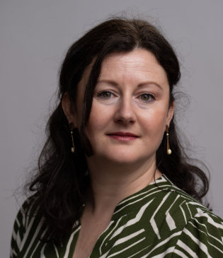

Q & A
Thank you!
Aoife Kelly
Global Lead Sustainable Design, Pharmaceuticals and Advanced Technology
ISPE Sustainability COP member
Aoife.Kelly@arcadis.com
Aoife Kelly | LinkedIn

