Slide 1
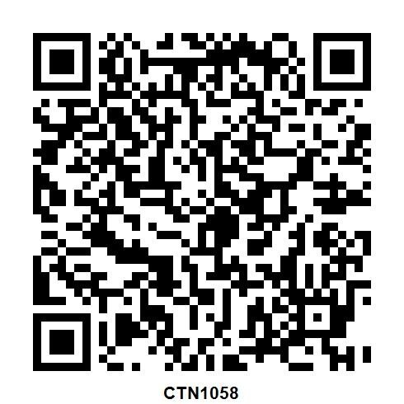
QrCode-CTN1058 (Microwave Materials Characterisation Techniques)
Record your CPD for this event in Career Manager
For IET members only
QR code valid for 3 months after event

