Slide 1
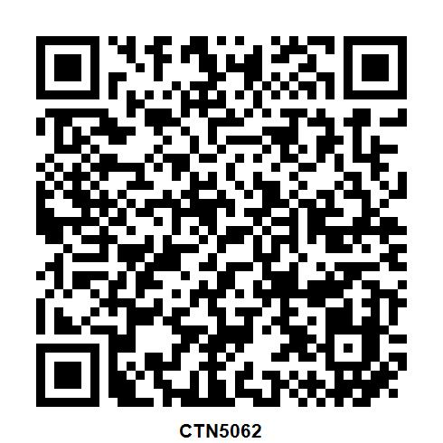
Record your CPD for this event in Career Manager
For IET members only
QR code valid for 3 months after event

