Slide 1
Railway Decarbonisation: carbon footprint and innovative techniques
Dr Zhongbei Tian (z.tian@bham.ac.uk)
Assistant Professor in Transportation Energy Systems, University of Birmingham

Slide 2
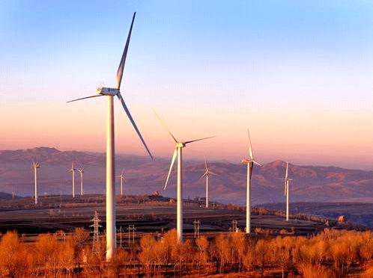
Contents
Research group
Background of the research
  Transport decarbonisation statistics
  Decarbonising Transport in the UK
  Research challenges
  Railway decarbonisation techniques
    Digital Twin for Transport Energy System
    Energy-efficient Train Control and Optimisation
    Smart Grid and Transport Energy Integration
  Recent projects and collaborators

Slide 3

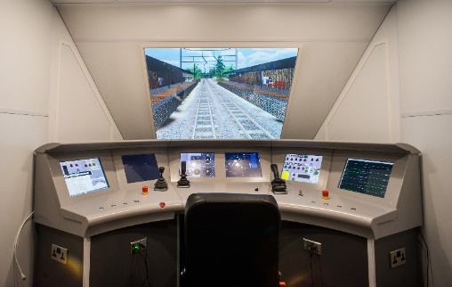
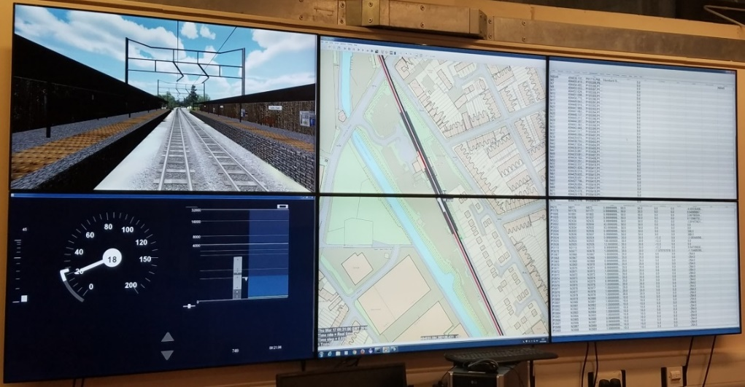
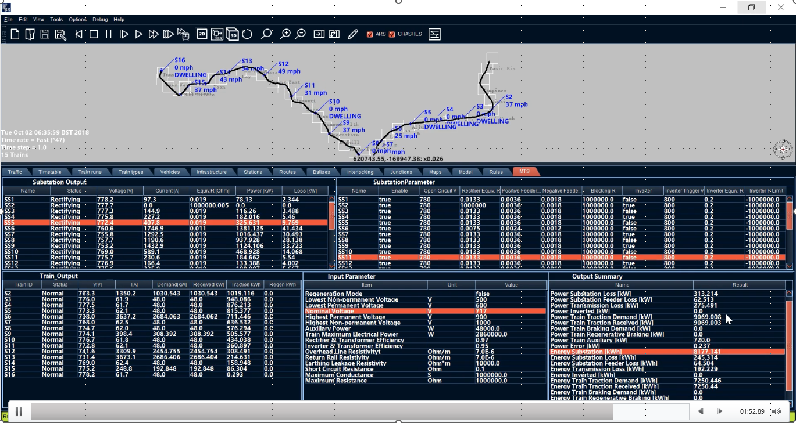
1. Research Group - BCRRE
Birmingham Centre for Railway Research and Education (BCRRE)
Railway research at Birmingham was founded in the 1970s
  The largest University based Railway group in Europe
  Nowadays we are a group of over 160 researchers and support staff
  2017 Queen’s Anniversary Prize for Higher and Further Education
  Lead for the £92M UK Rail Research and Innovation Network (UKRRIN)

Slide 4
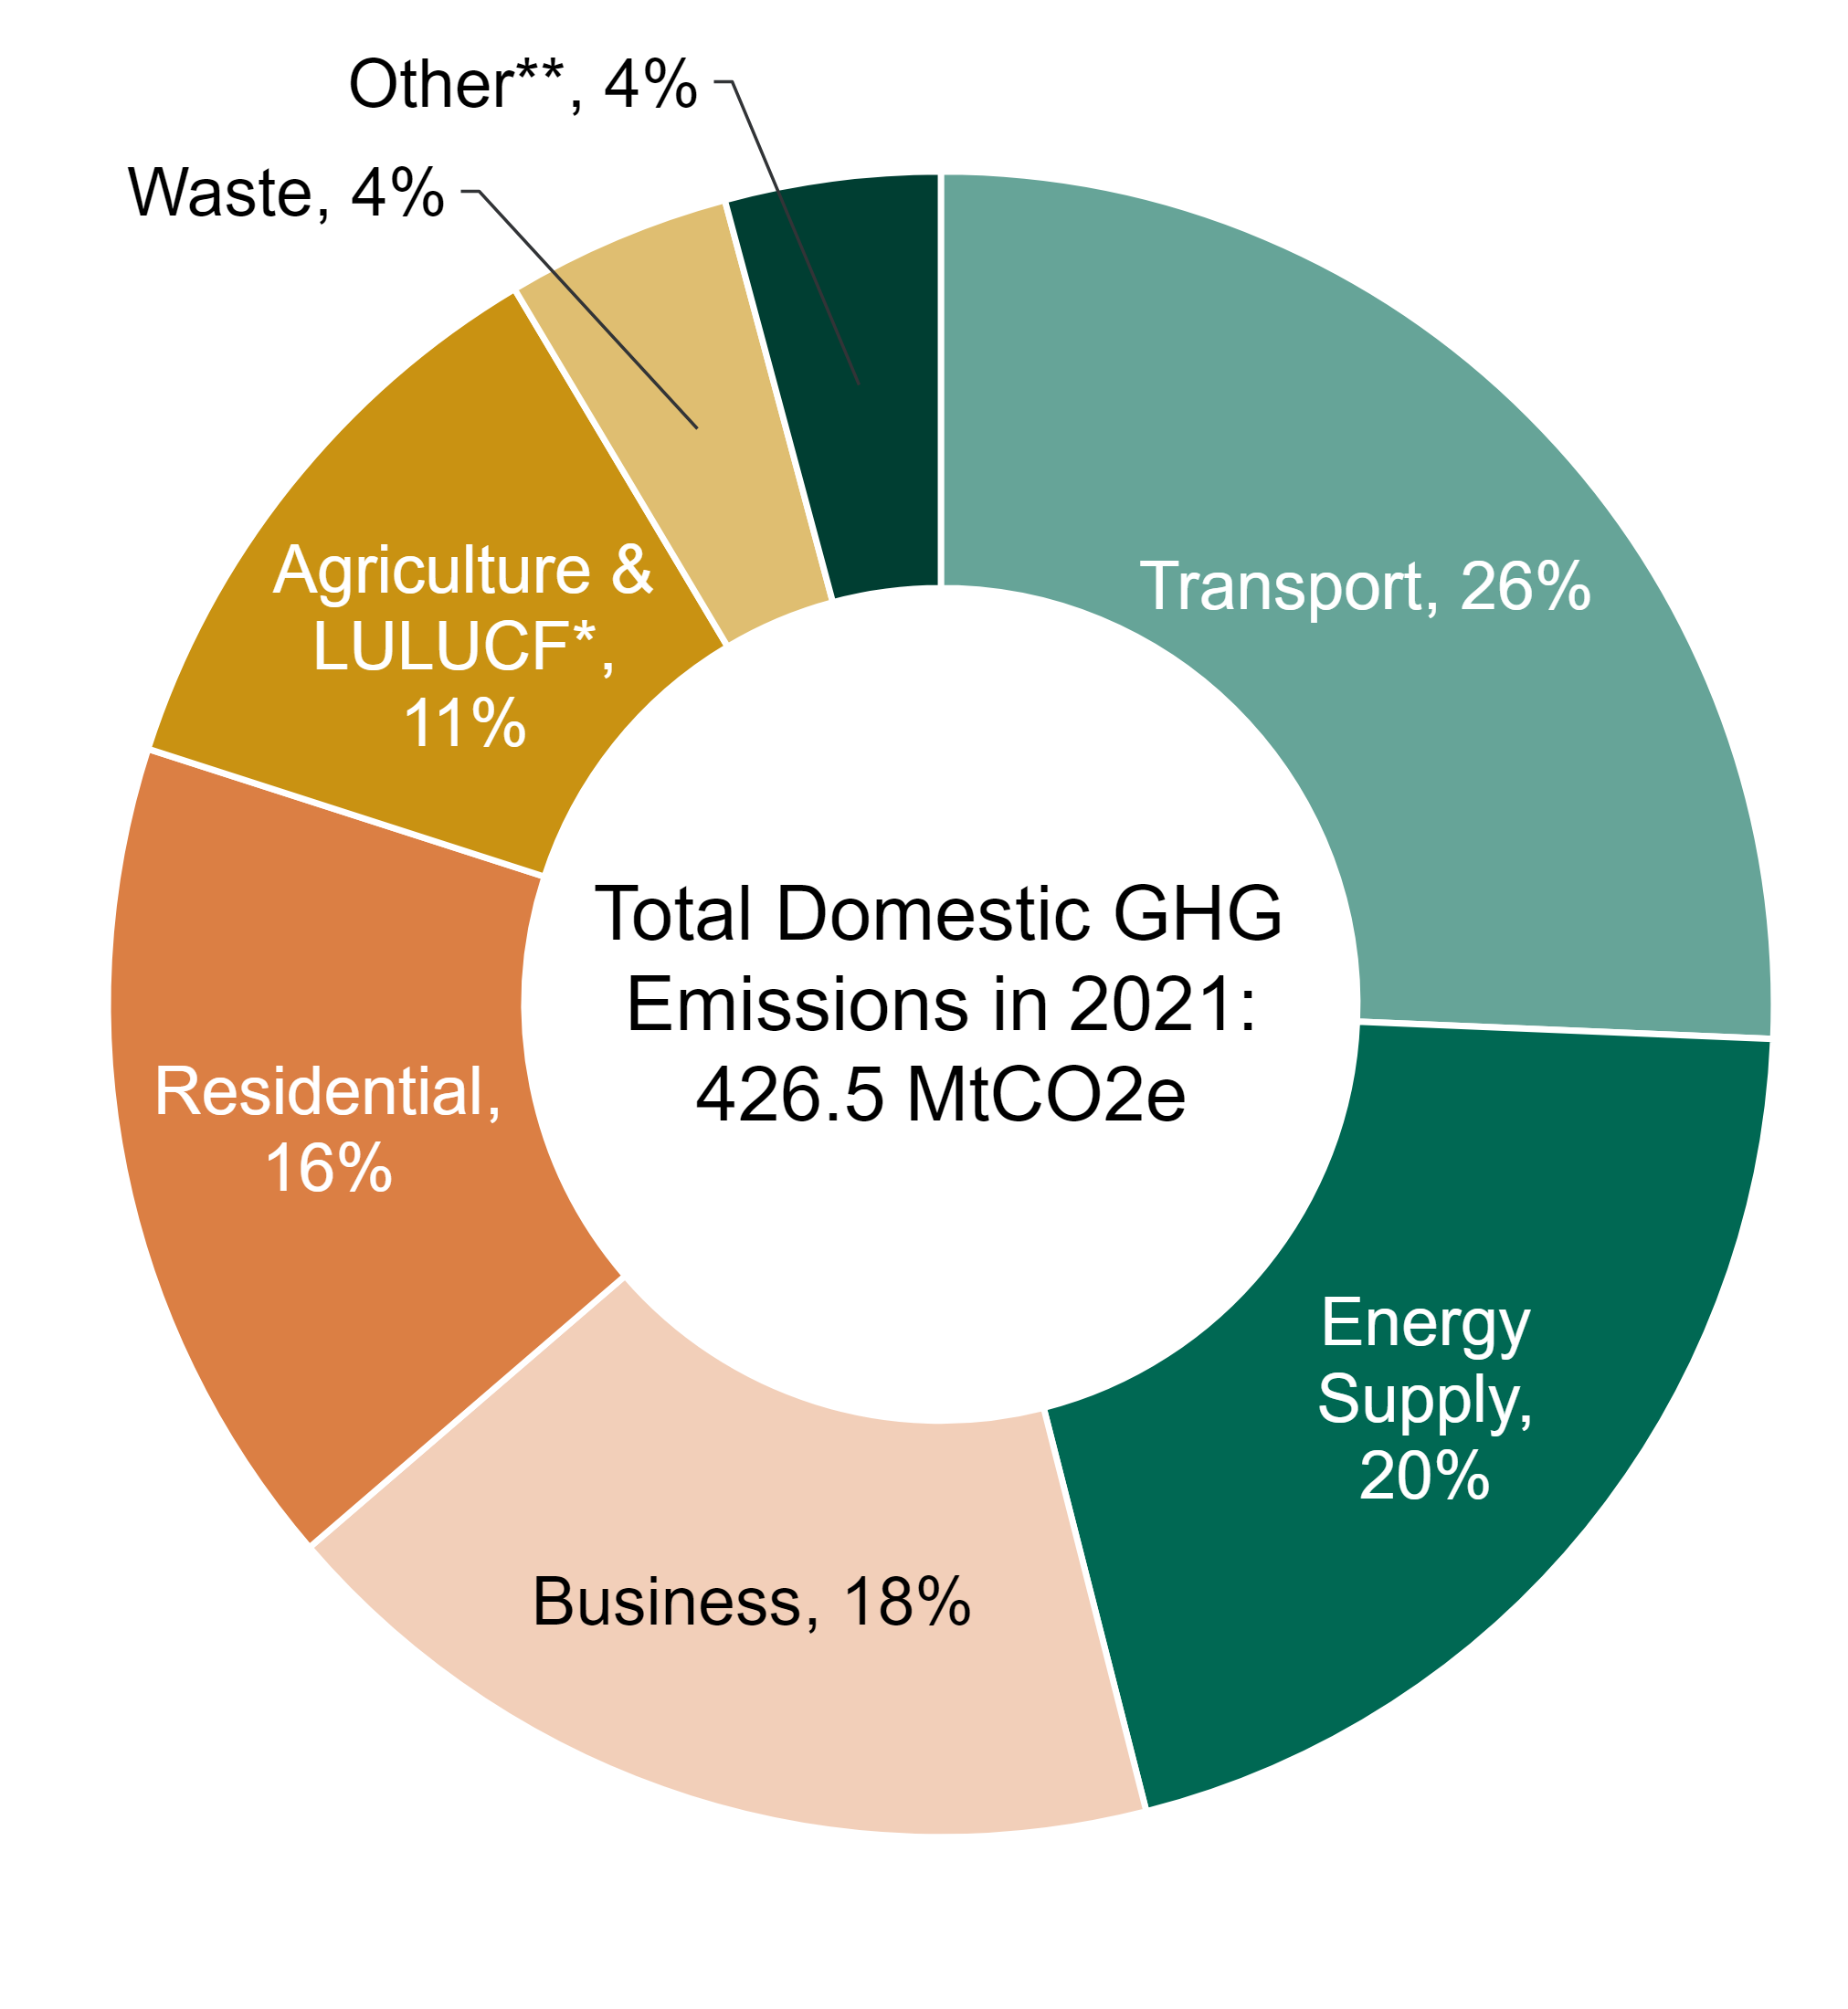
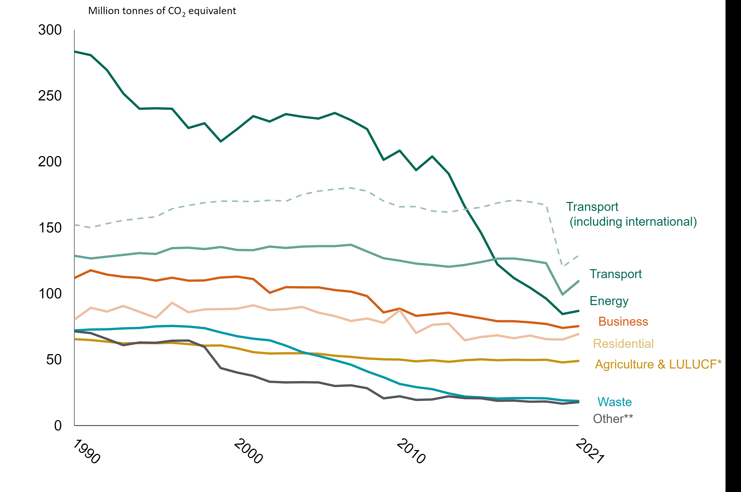
Background of Transport Emissions
Transport is the largest contributor to UK domestic greenhouse gas (GHG) emissions, responsible for 27% in 2019.
Greenhouse gas emissions by sector, 2021 (DESNZ, 2023)

Slide 5
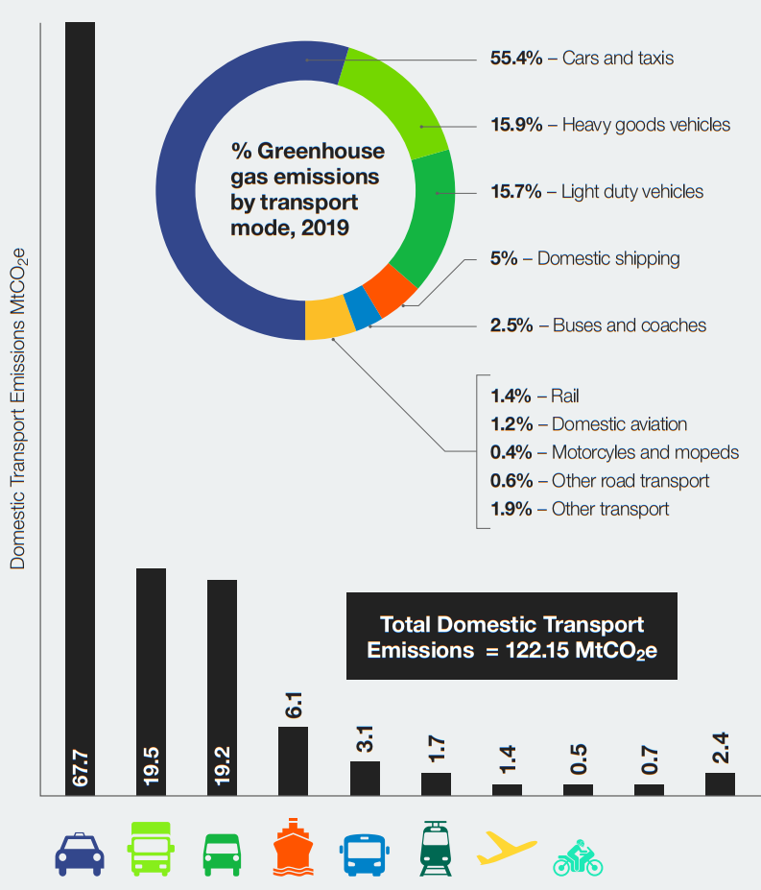
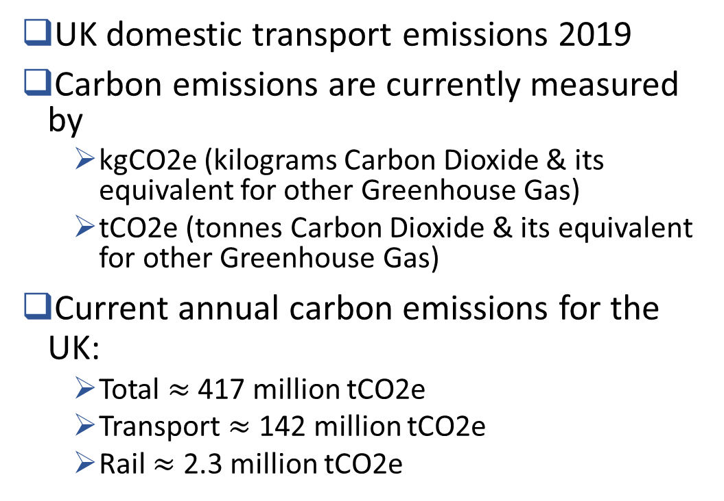
Decarbonising Transport in the UK
UK domestic transport emissions 2019
Carbon emissions are currently measured by
  kgCO2e (kilograms Carbon Dioxide & its equivalent for other Greenhouse Gas)
  tCO2e (tonnes Carbon Dioxide & its equivalent for other Greenhouse Gas)
  Current annual carbon emissions for the UK:
  Total $≈$ 417 million tCO2e
  Transport $≈$ 142 million tCO2e
  Rail $≈$ 2.3 million tCO2e
  Source
  Decarbonising Transport - A Better, Greener Britain, 2021
  UK Department for Energy Security & Net Zero (2023) – 2022 UK Greenhouse Gas Emissions, Provisional Figures
  Office or Rail & Road (2022) – Rail Emissions, April 2021 to March 2022

Slide 6
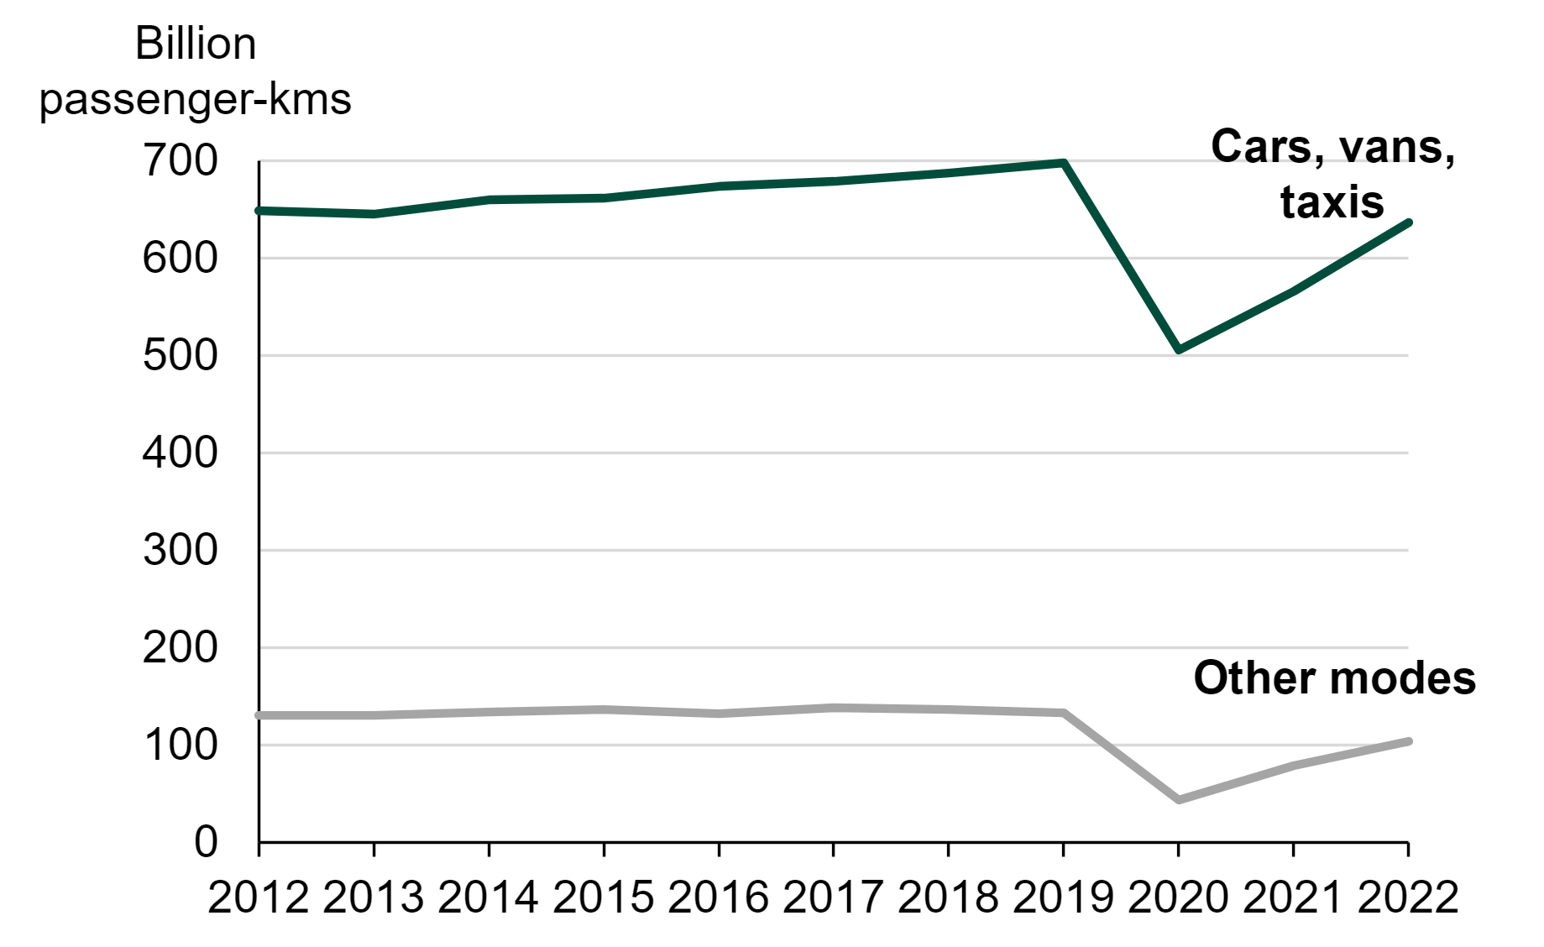
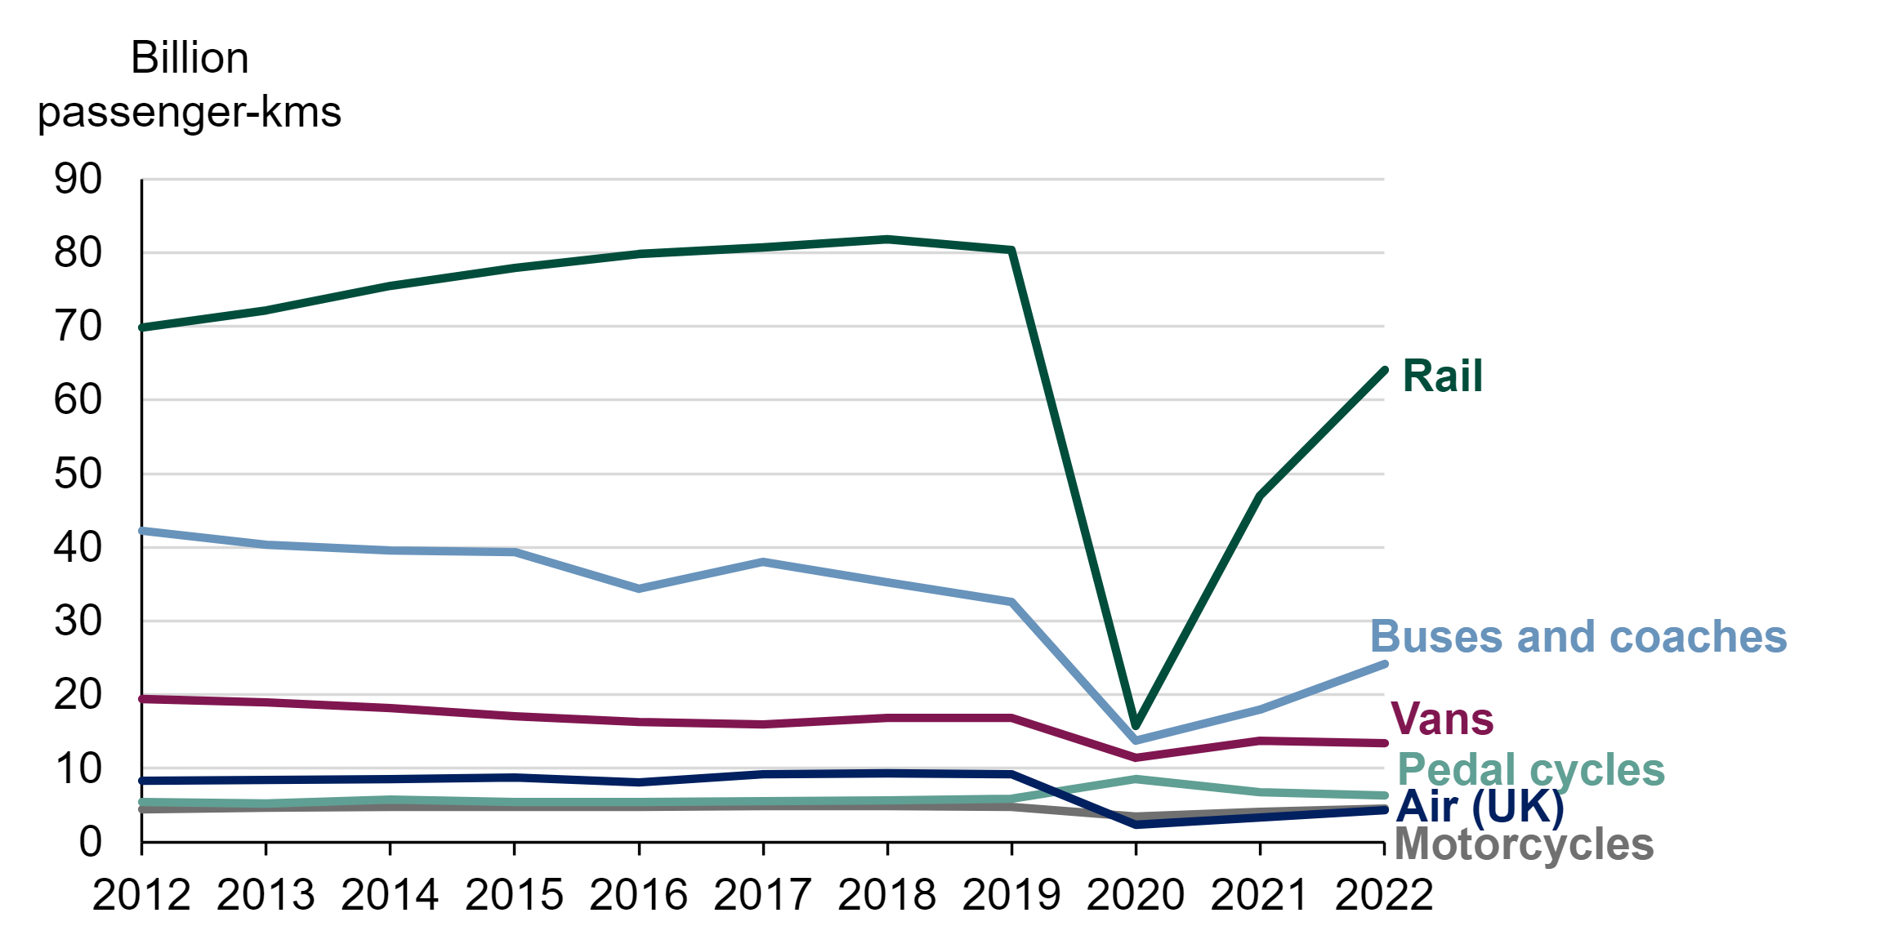
Decarbonising Transport in the UK
Of this total, 82% of passenger kilometres travelled in Great Britain was made by cars, vans and taxis.
Distance travelled by rail increased steadily from 1983 onwards, which accounts for up to 9.5%.
Passenger kilometres by modes in Great Britain, since 2012
Source: Transport Statistics Great Britain: 2022 Domestic Travel

Slide 7
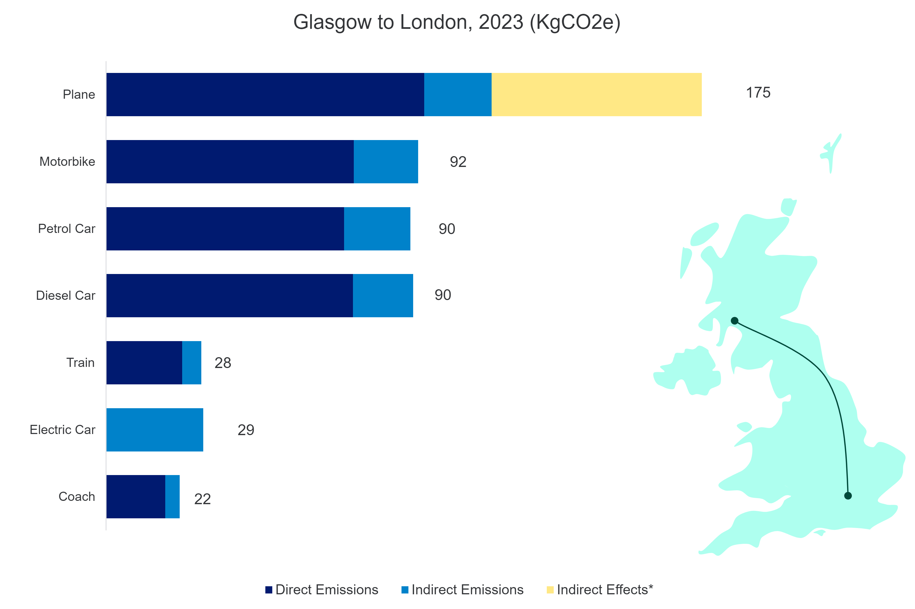
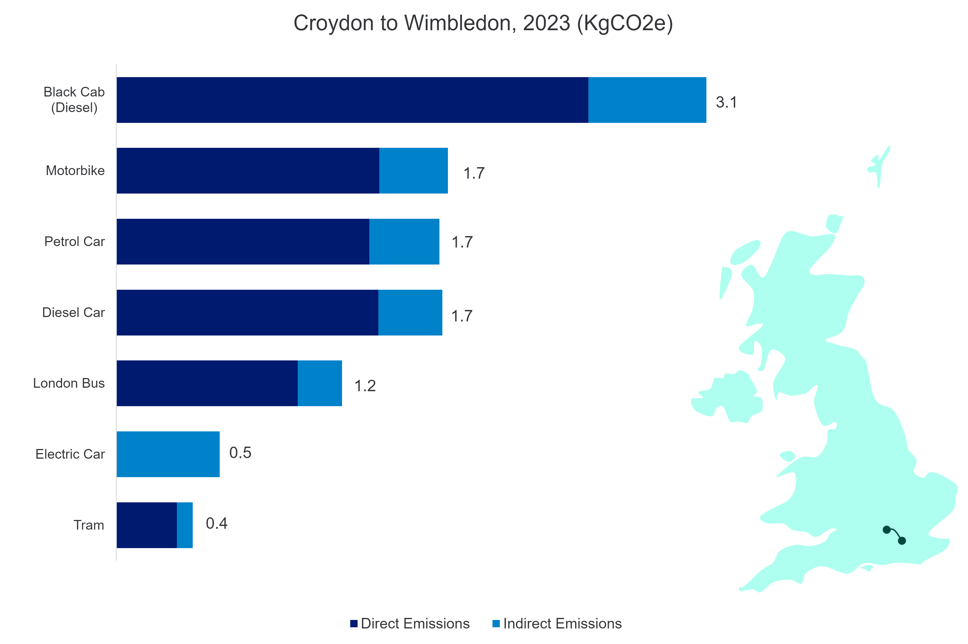
Decarbonising Transport in the UK
Indicative GHG emissions (KgCO2e) for a single passenger on example journeys, 2023 (Table ENV0701)
Direct emissions are emissions produced by the vehicle itself.
Indirect emissions are emissions produced by the extraction, refining, and transportation of the fuel used to power the vehicle.
Indirect effects refer to the climatic effect of non-CO2 pollutants, such as water vapour, aerosols and nitrogen oxides.
Notes:
Metric tons of carbon dioxide equivalent

Slide 8
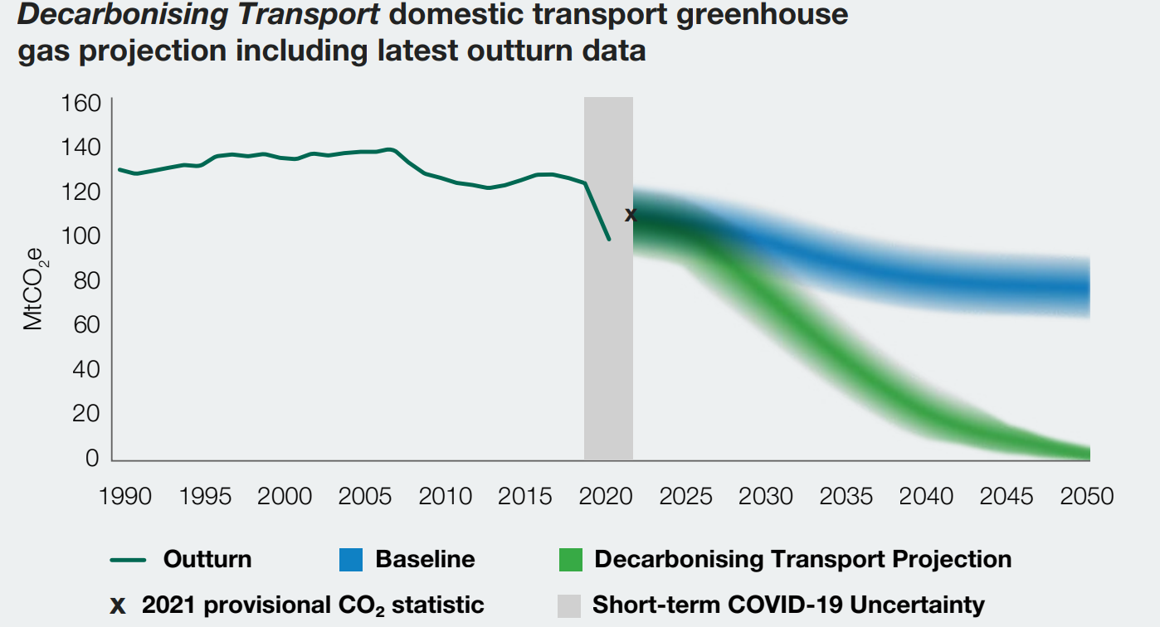
Decarbonising Transport in the UK
To meet net zero by 2050, and our stretching carbon budgets on the way, we must continue to make rapid progress.

Slide 9
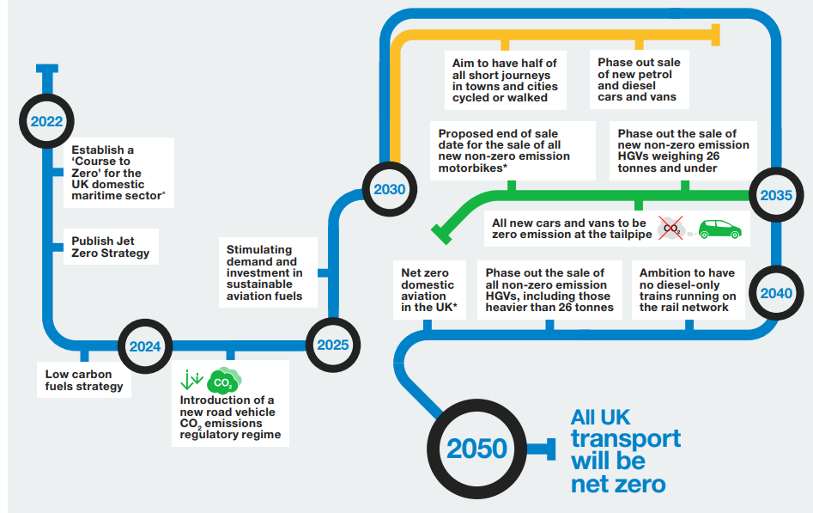
Pathway to 2050 – timeline of key commitments
Source: Decarbonising Transport
A Better, Greener Britain - One Year On

Slide 10
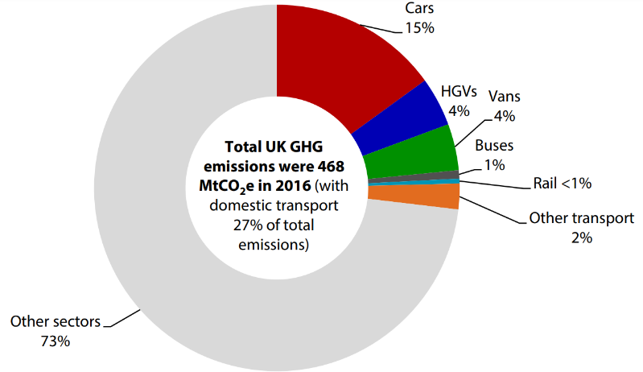
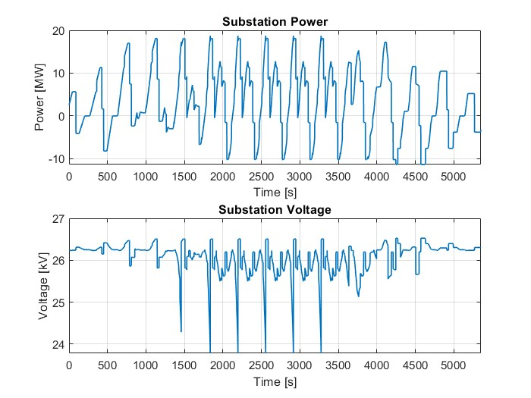
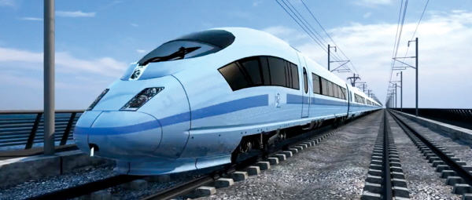
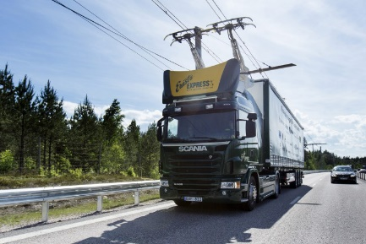
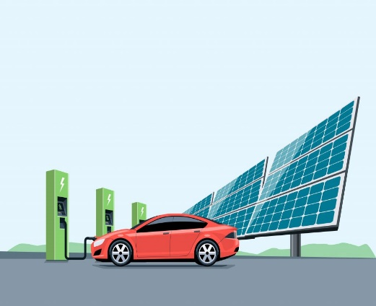
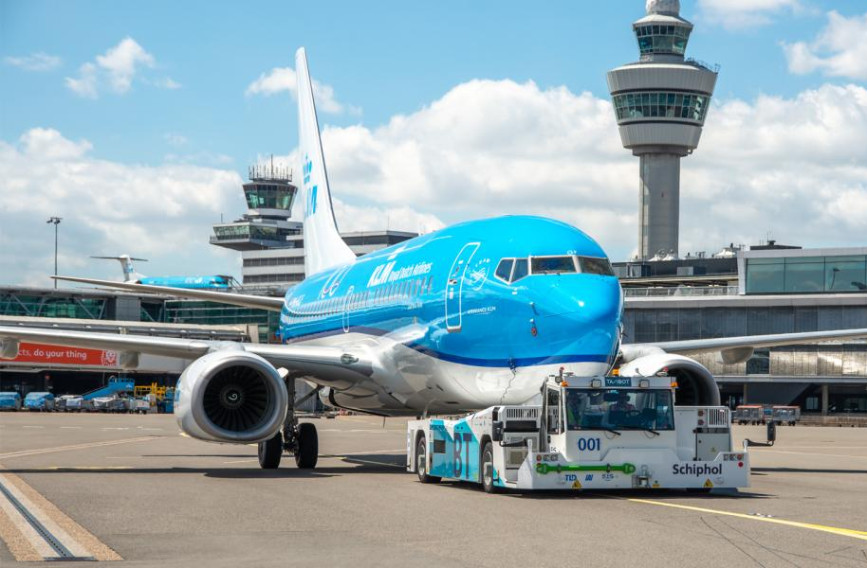

Research challenges
UK’s target to achieve Net-Zero by 2050
Complexity of muti-vector energy supply infrastructure for Multimodal transportation systems
Operation strategies of multimodal transportation systems
Power and energy quality due to the rapid transport electrification
CCC Progress Report 2018
Notes:
UK railway electrification rate is 38% in 2020
Reduce railway CO2 by 50% in 2030
Zero emission for all new cars and vans by 2040
Railway accounts for 1-2% UK electricity demand

Slide 11
Railway decarbonisation technologies
Digital Twin for Transport Energy System
Energy-efficient Train Control and Optimisation
Smart Grid and Transport Energy Integration

Slide 12
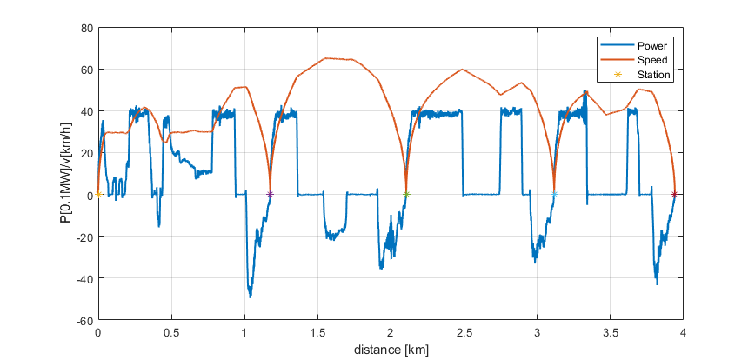
Railway decarbonisation technologies
Digital Twin for Transport Energy System
  AC and DC railway power system simulation
  Railway power flow analysis
  Hybrid train simulation and evaluation
  Fault simulation and monitoring
Energy-efficient Train Control and Optimisation
  Train driving speed optimisation
  Timetable scheduling and optimisation
  Regenerative braking energy utilisation
  Driver advisory system (DAS) design
Smart Grid and Transport Energy Integration
  Renewable energy and transport integration
  Railway and vehicle to grid analysis
  Smart energy management
  Transport and grid operation control

Slide 13
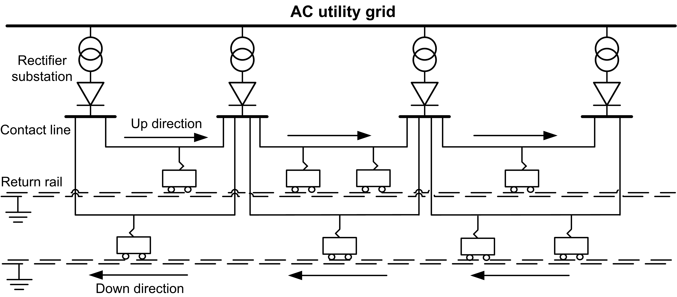
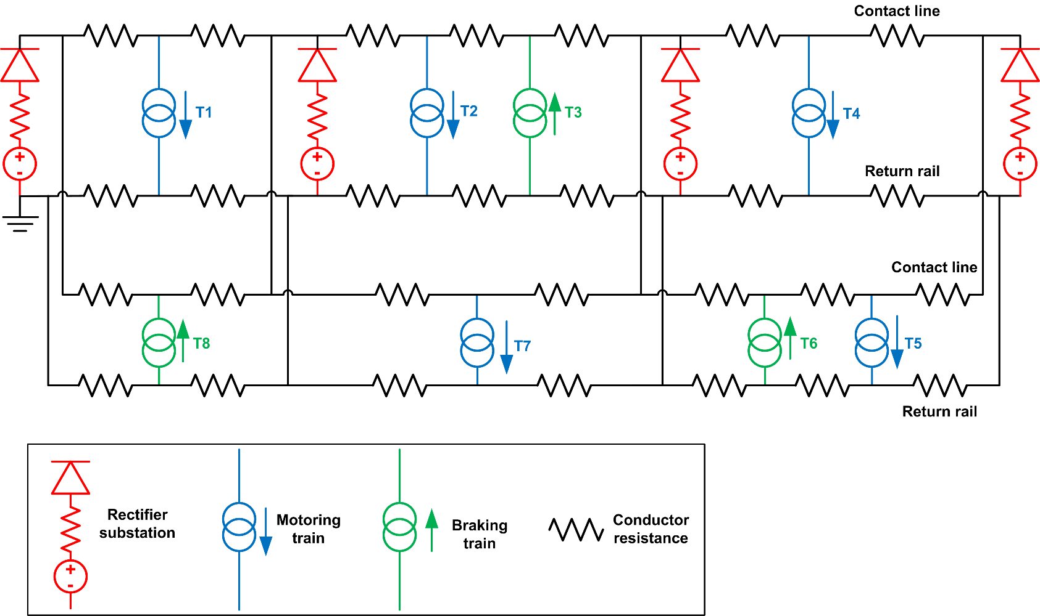
Digital Twin for Transport Energy System
Digital Twin of railway traction, power and faults
Integrated simulation: train operation + power network
Hybrid simulation: Steady and transient state
Train traction system
Electrical infrastructure
Z. Tian, et al, "Energy evaluation of the power network of a DC railway system with regenerating trains," IET Electrical Systems in Transportation, vol. 6, no. 2, pp. 41-49, 2016.
Notes:
Singapore metro, increase train services, extend the rout and more powerful trains and check the hotspot

Slide 14
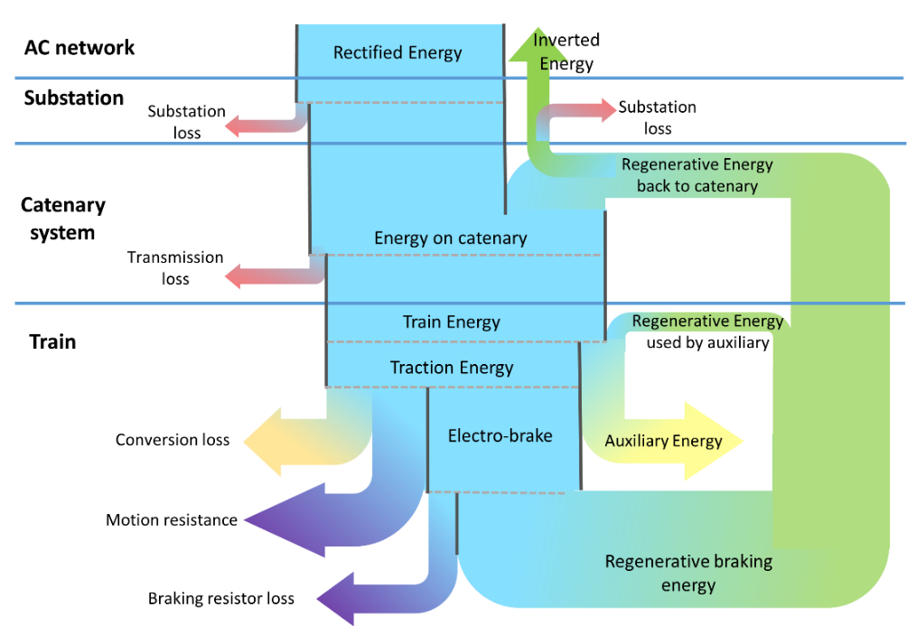
Railway energy systems
Energy flow between railway and power grid
Notes:
Singapore metro, increase train services, extend the rout and more powerful trains and check the hotspot

Slide 15
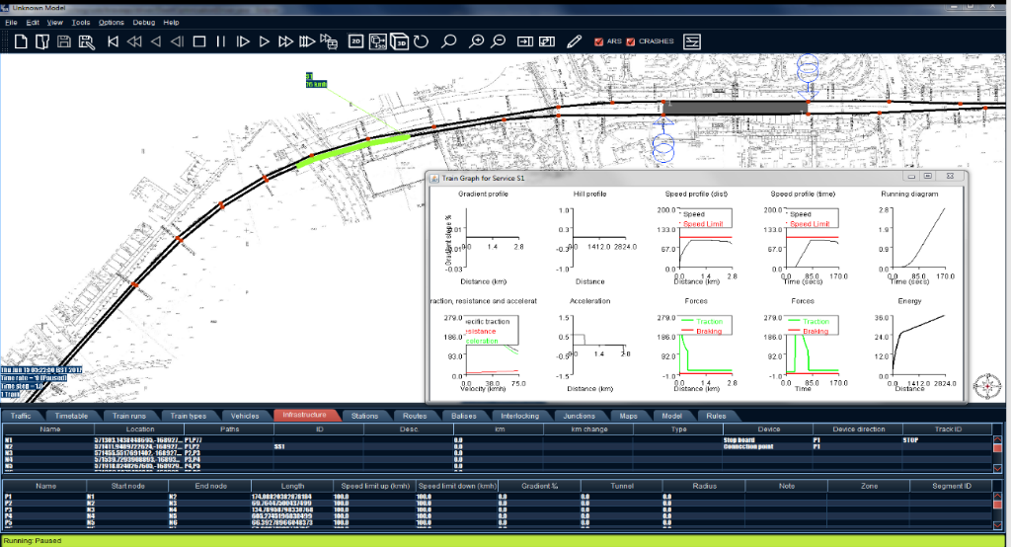
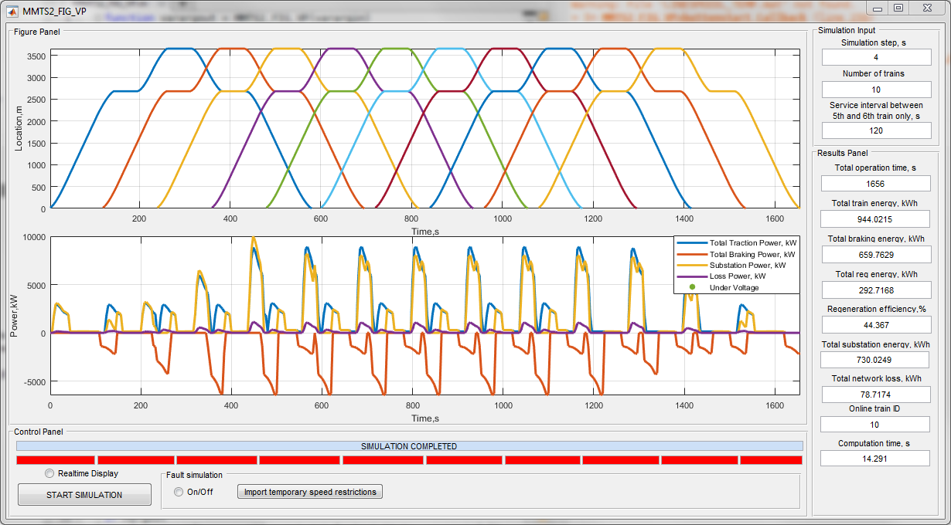
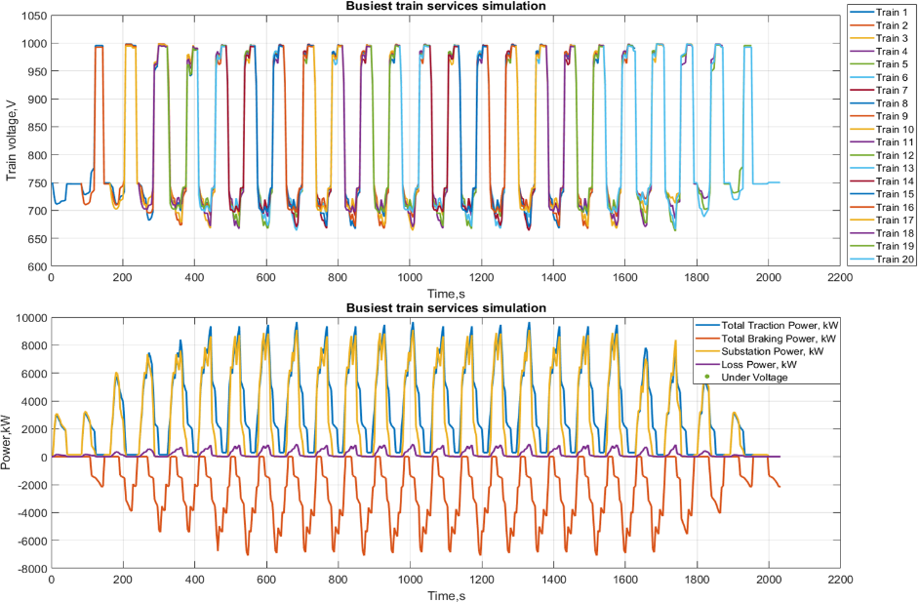
Railway System Digital Twin

Slide 16
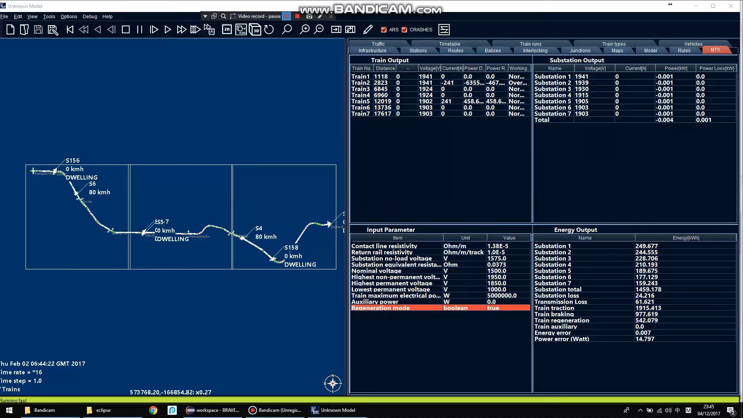

Slide 17
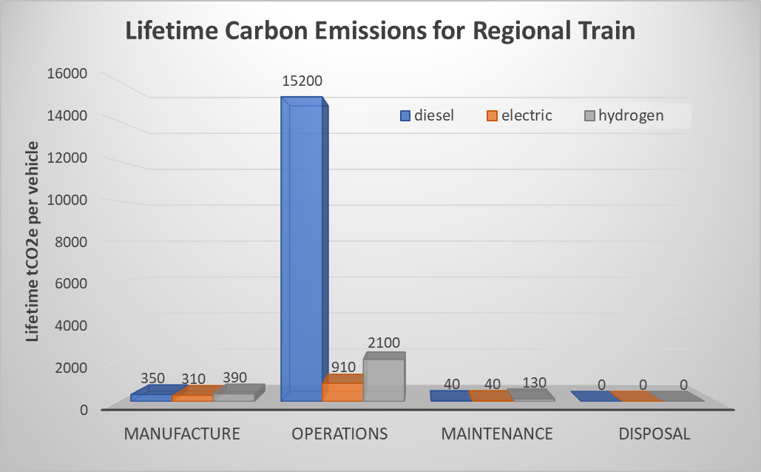
Estimating Emissions – Example Results
Examples of Regional Train by RSSB T1237 DECARB: Whole Life Carbon Reduction in Trains Through Effective Design and Specification
Key points:
  dominated by operations
  electric approx. 1/17th of diesel
  hydrogen approx. 1/7th of diesel
  manufacture significant proportion of total for electric and hydrogen
  maintenance of lower order and disposal negligible
  similar for other train types
Notes:
  electric based on least optimistic FES average from 2020-50
  hydrogen from grid electricity based on same FES data
Notes:
Whole train life carbon reduction

Slide 18
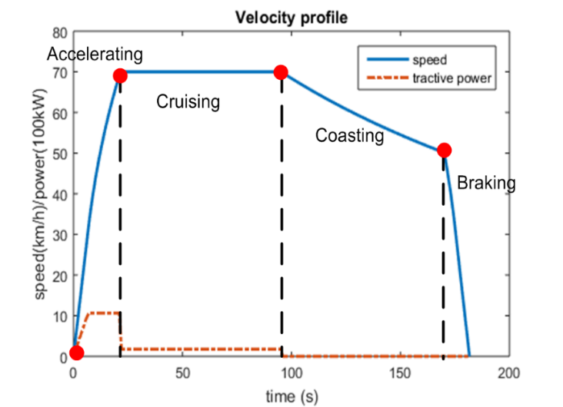
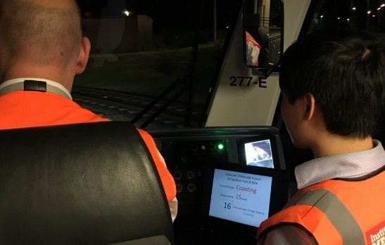
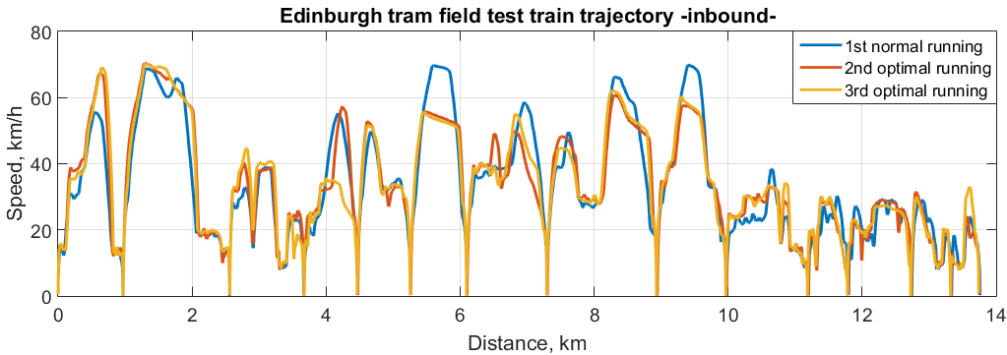
Train control and optimisation
Train driving optimisation: SmartDrive
Traffic timetable optimisation
Regenerative braking energy utilisation
Automatic train controls/Driver advisory system (DAS) design
Multi-train coordinated control
Impact and outcomes
  Field test with Edinburgh Trams, Beijing Metro, and Guangzhou
  Reduce energy by 10-20%
  Daily operation in Edinburgh Trams
  ‘SmartDrive’ package to railway operators

Slide 19
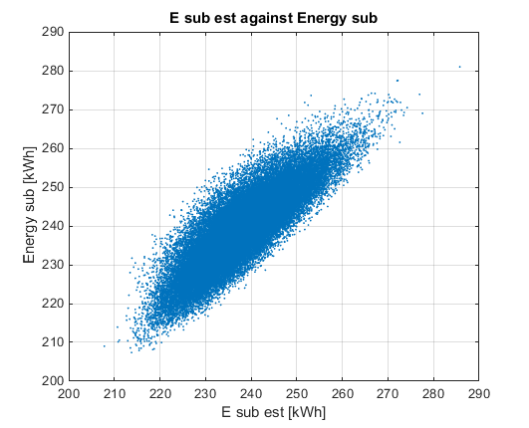
Multi-train Coordinated Operation Optimisation
Traction energy saving is not substation energy saving
Regenerative braking energy efficiency
Monte Carlo for correlation
Neural Network
 | Current ATO operation | Traction energy-saving operation* | System energy-saving operation**
Cycle running time (s) | 4281 | 4281 | 4287
Headway (s) | 254 | 254 | 254
Substation energy (kWh) | 331 | 232 (-29.9%) | 203 (-38.6%)
Substation loss (kWh) | 14 | 7 | 6
Transmission loss (kWh) | 25 | 17 | 15
Traction energy (kWh) | 526 | 372 (-29.2%) | 375 (-28.7%)
Motion resistance (kWh) | 106 | 82 | 82
Electro-braking energy (kWh) | 290 | 199 | 201
Regenerative energy (kWh) | 245 | 163 | 192
Regeneration efficiency | 80.6% | 82.1% | 95.5%
Traction energy
Integrated
method
regenerated energy
Substation energy
Transmission loss
Z. Tian, P. Weston, N. Zhao, S. Hillmansen, C. Roberts, and L. Chen, "System energy optimisation strategies for metros with regeneration," Transportation Research Part C, vol. 75, pp. 120-135, 2017

Slide 20
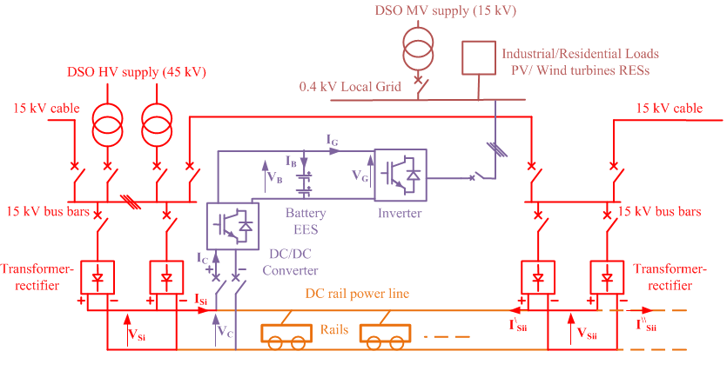
Smart Grid and Transport Energy Integration
Interface of multi-systems
Power demand analysis
Renewable power predication
Traffic demand prediction
Energy management and optimisation
Improve system efficiency, resilience and sustainability
Hybrid train energy management
Notes:
Mention national grid - Charging Hubs
Charging Hubs
Beyond MSAs, the TDP highlighted the need for multi-modal, place-based infrastructure solutions to contribute towards emission reductions, particularly for freight. We agree and believe that bringing multiple transport types together at strategic shared interface locations would make more efficient use of energy infrastructure, as power is brought to key places to meet the demand for the hub. In principle, we welcome the hub approach and believe this can be broadened beyond meeting the needs of the freight sector to include other vehicle groups that will require charging around urban areas. This could include buses, taxis, blue light vehicle hubs and even rail, airports and ports at certain locations.
Therefore, co-ordination, the planning for and delivery of such hubs will be critical in meeting local and regional decarbonisation ambitions. The key to ensuring charging hubs can be successfully developed, will be planning for the underlying electricity infrastructure that will be needed to power them. Economies of scales are important, the larger the hub with numerous diverse market participants, the more economically efficient the addition of capacity through
connections will be. However, with larger hubs that bring together multiple organisations across different transport sectors, from both the private and public sectors, the need for a coordinating body is clear, Government could act as the coordinator or identify which organisations should coordinate.

Slide 21
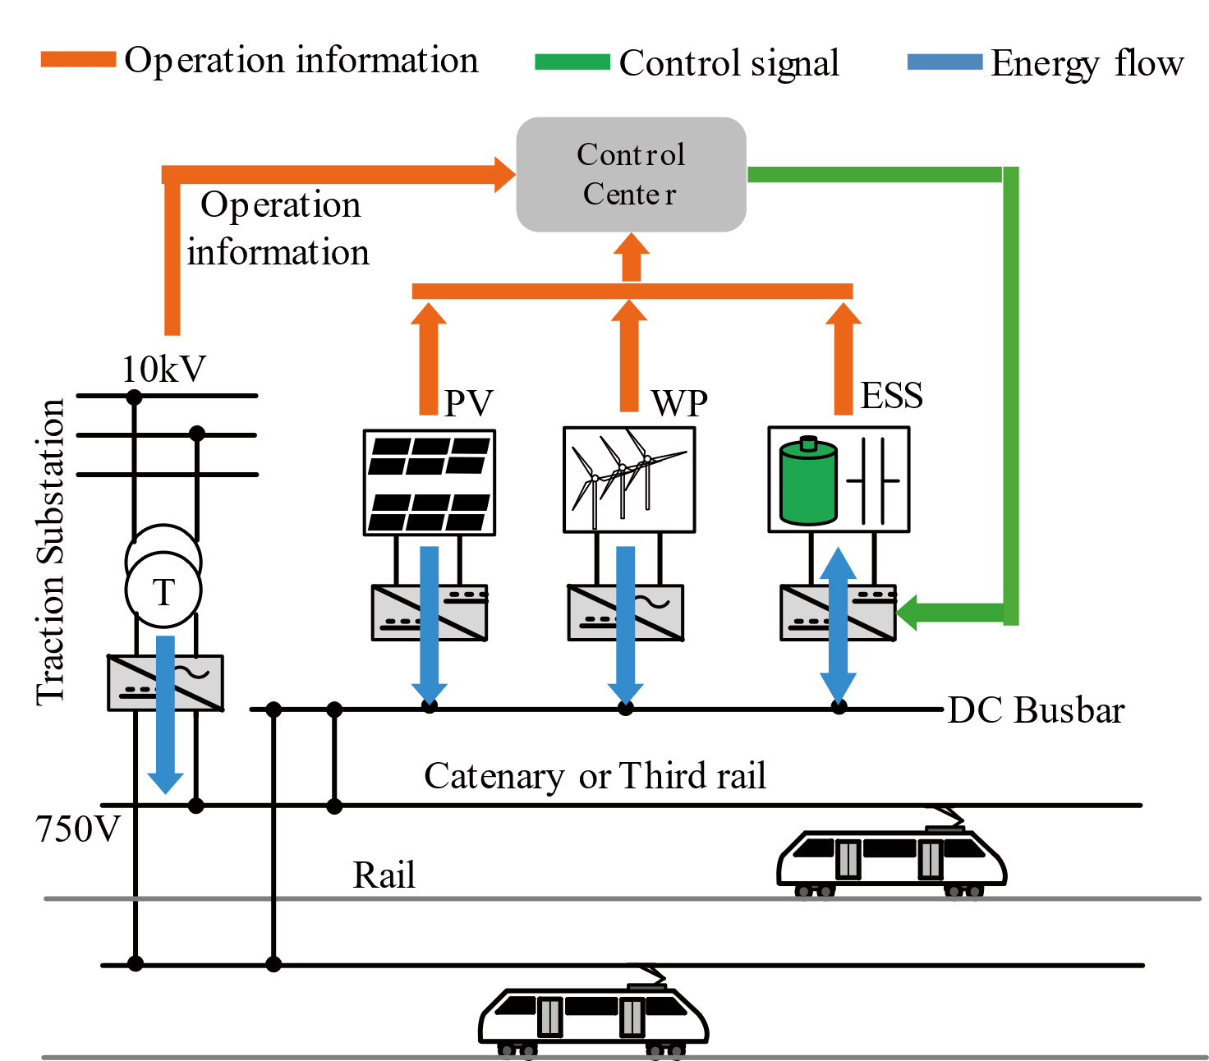
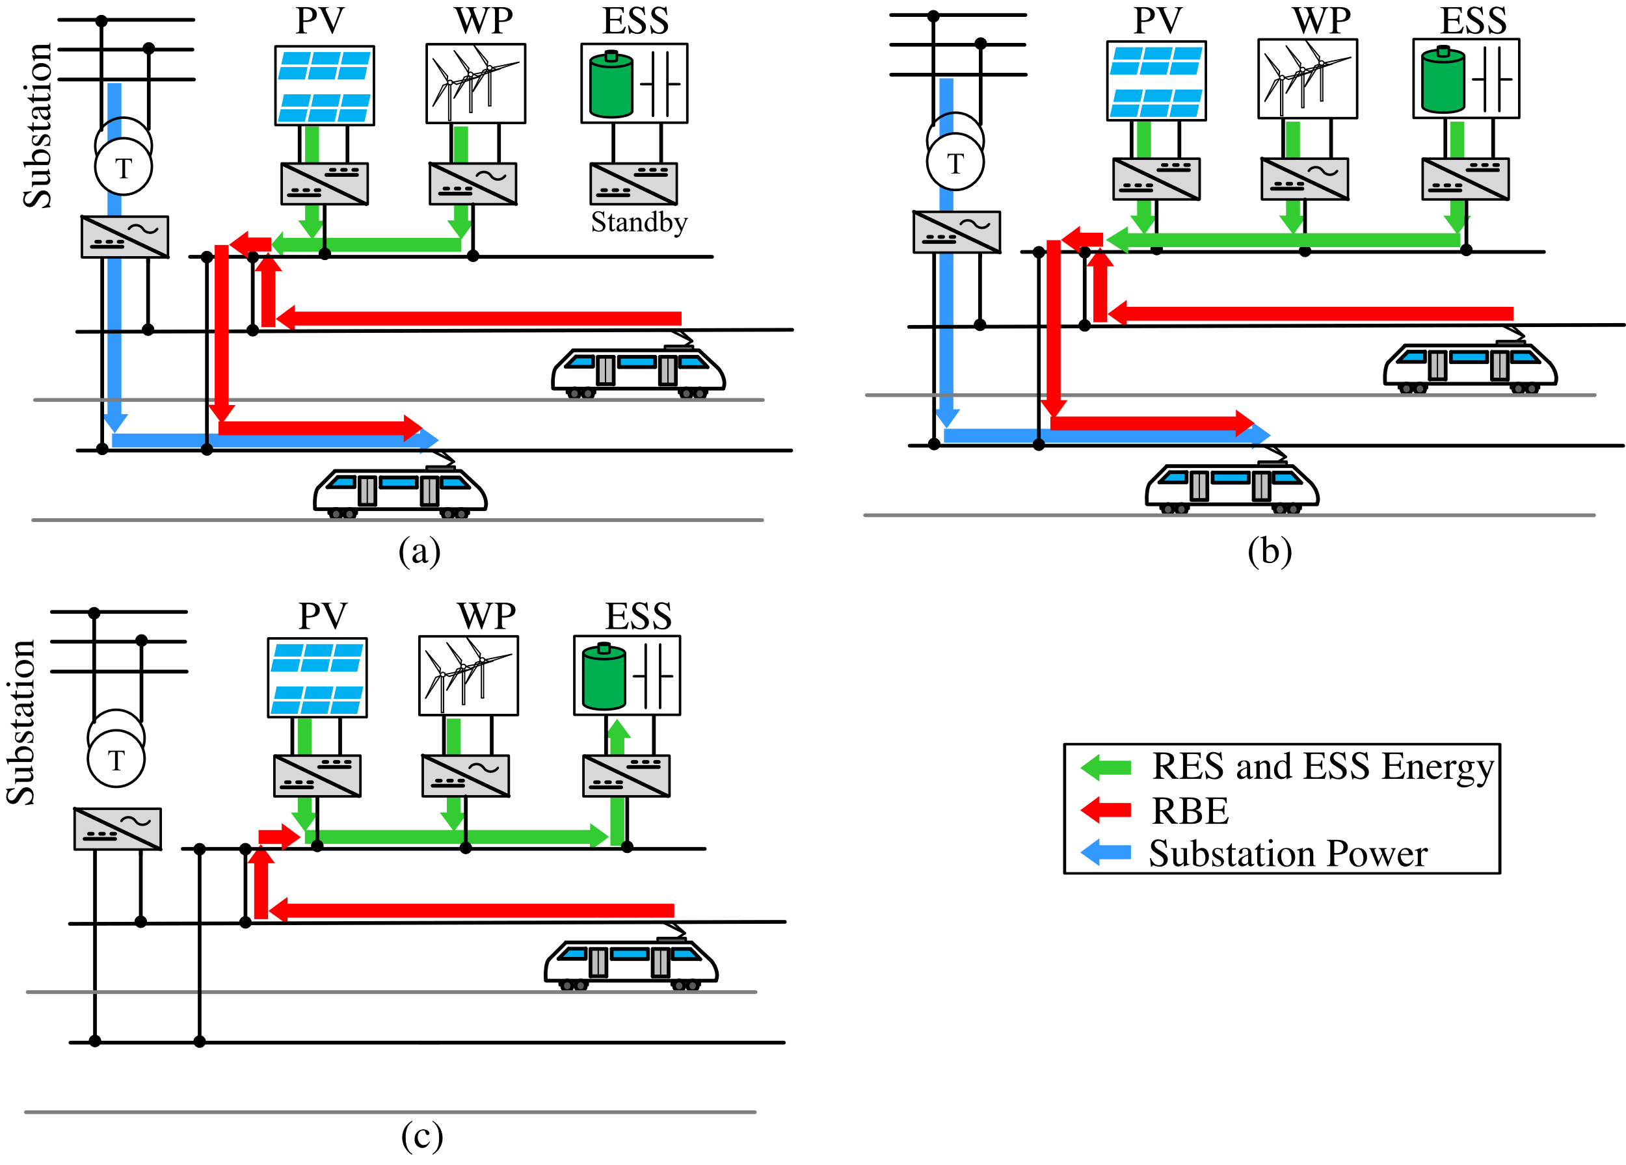
Operation modes of the proposed MSTS
Renewable Railway Power Network Design with Optimal Energy Management
Multi-source traction system (MSTS）
According to the power demand from the substation, the proposed MSTS has three main operation modes
EV charging

Slide 22
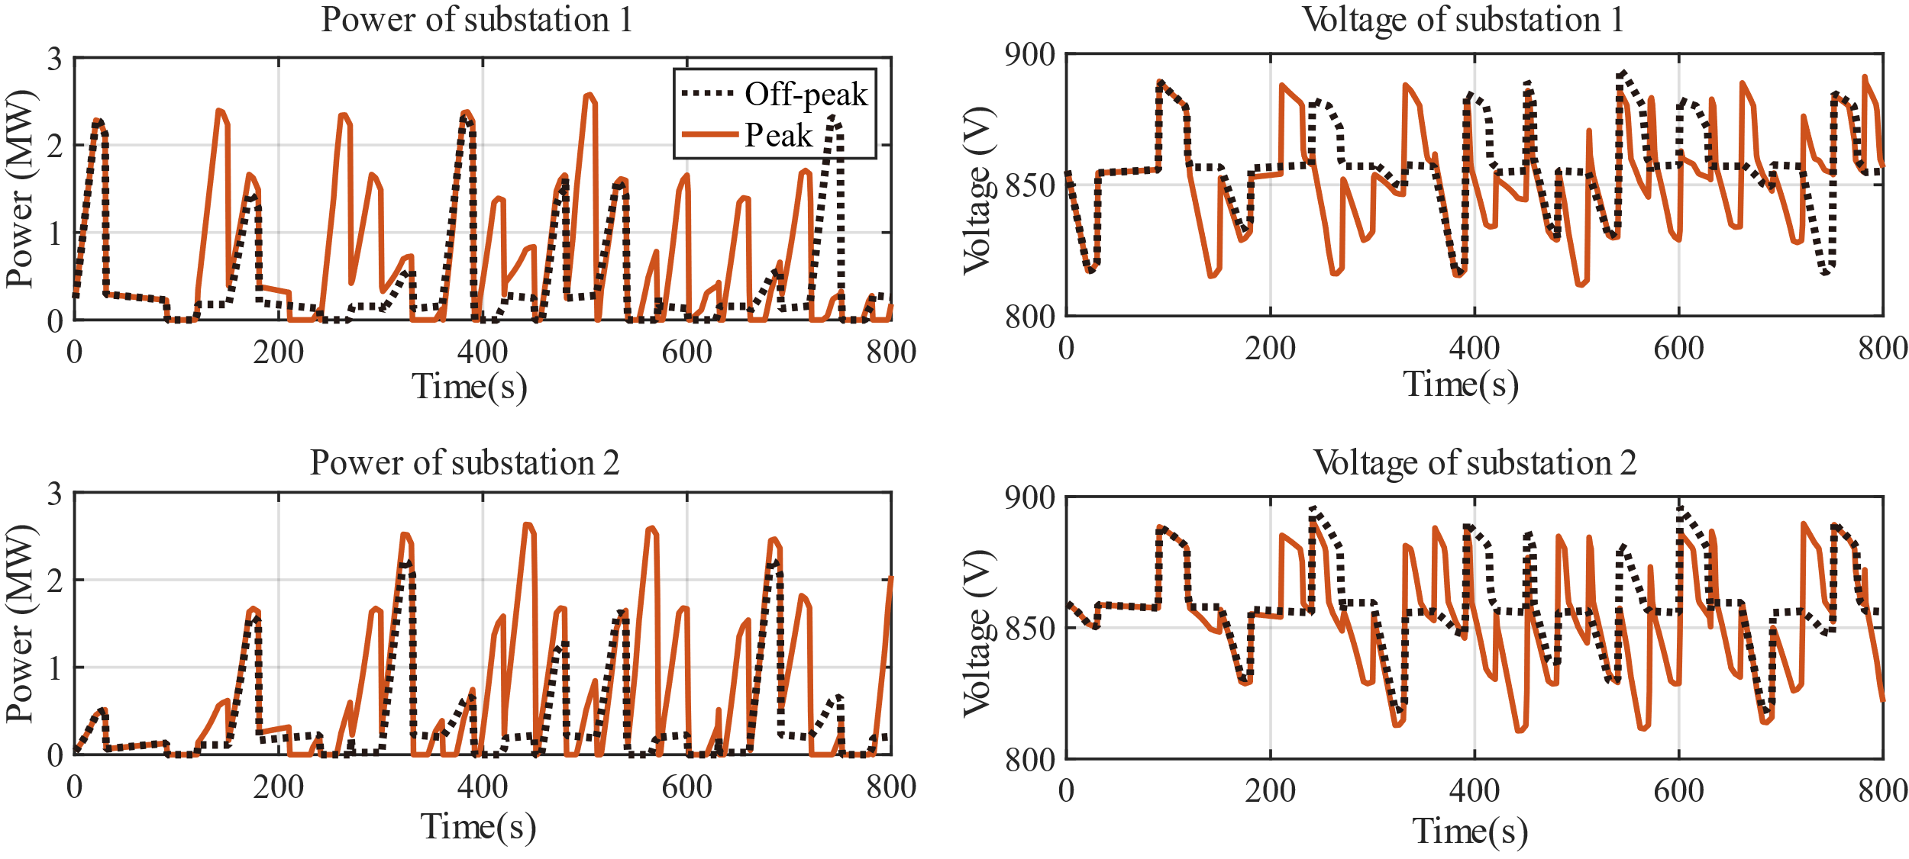
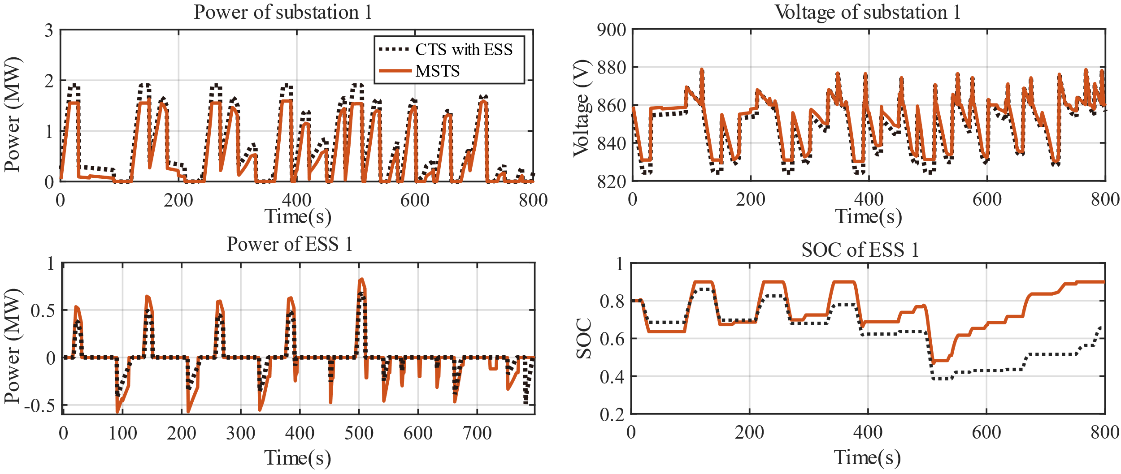
Energy management strategies
 | ESS | RES | Peak period | Off-peak period
Scenario A | ✓ |  | ✓ | ✓
Scenario B |  |  | ✓
Scenario C | ✓ |  |  | ✓
Scenario D | ✓ | ✓ | ✓
Scenario E | ✓ | ✓ |  | ✓
H. Dong, Z. Tian, J. W. Spencer, D. Fletcher and S. Hajiabady, "Coordinated Control Strategy of Railway Multisource Traction System With Energy Storage and Renewable Energy," in IEEE Transactions on Intelligent Transportation Systems, vol. 24, no. 12, pp. 15702-15713, 2023.
CTS results
CTS with ESS and MSTS result

Slide 23
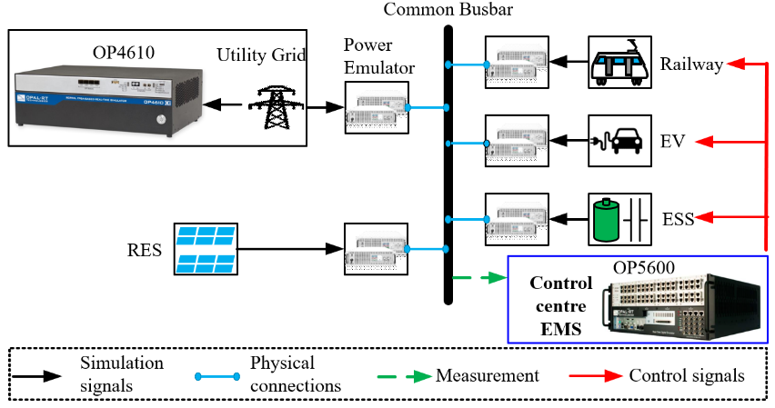
Smart Grid and Transport Energy Integration
Renewable Railway Power Network Design with Optimal Energy Management - Multi-source traction system (MSTS）
AI-based EMS for various case studies in HS2, mainlines, and metros to reduce energy consumption by 10-20%, peak power demand by up to 50%.
Power quality analysis and new feeding schemes for improvement.
EV charging
Figure 1 The architecture of station energy hub
Notes:
Publish over 100 reserch papers.

Slide 24
Recent projects
Network Rail - Understanding the Relationship between Hot Weather, Traction Load and OLE Performance
  To evaluate the thermal effects due to different current on top of background temperature rise due to load, along with duration.
  To analyse the OLE system operation status under the various parameters, cable analysis, feeding scheme, environmental temperature, tension
EPSRC - Connected and Coordinated Train Operation and Traction Power Supply Systems (COOPS)
  Digital twin for traction power supply with train operation schemes
Innovate UK - Renewable traction power supply network for GCRE site – Phase 1 and 2
Royal Society - A Digitalised Station Energy Hub for Land Transport Decarbonisation
N8 - Network for Innovative Sustainable Transportation co-simulation
EPSRC - Renewable Railway Power Network Design with Optimal Energy Management
Notes:
Cigre- ice standard
Wire – cable

Slide 25

















Collaborations

Slide 26
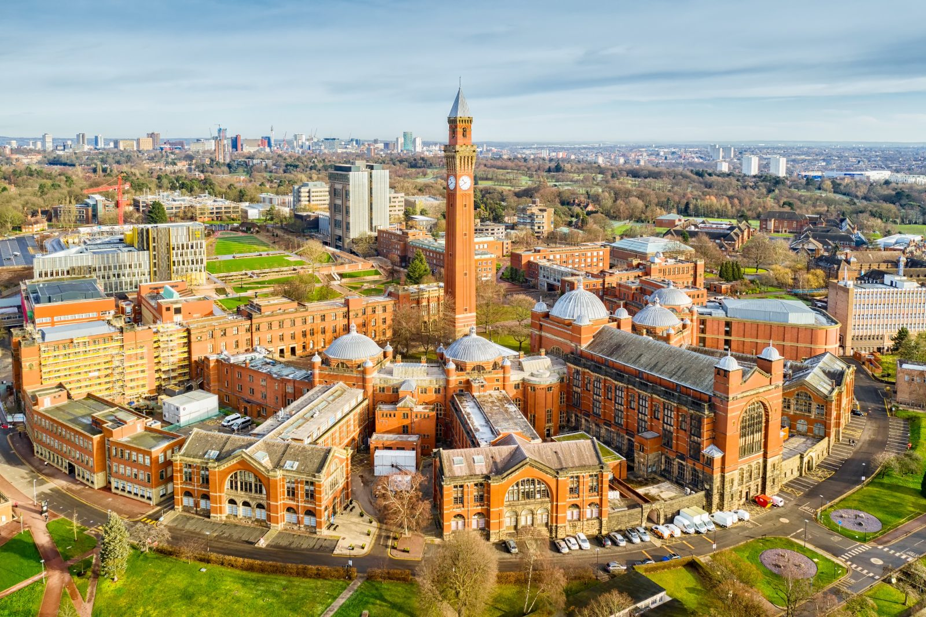

Welcome to Birmingham
Dr Zhongbei Tian (z.tian@bham.ac.uk)
Thank you!

