Slide 1
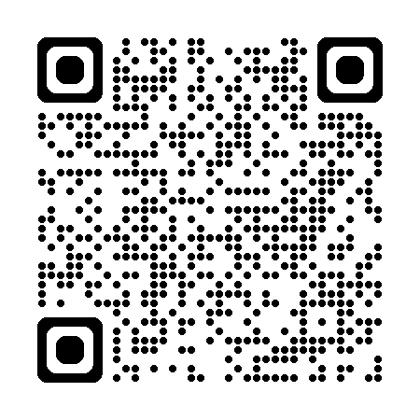
IET Journals
Looking for a home for your next research paper?
The IET journal portfolio is made up of over 45 high quality, fully Gold Open-Access journals, published online in partnership with Wiley.
All journals are free to access and read without subscription
QR code to IET Hub on the Wiley Online Library

Slide 2
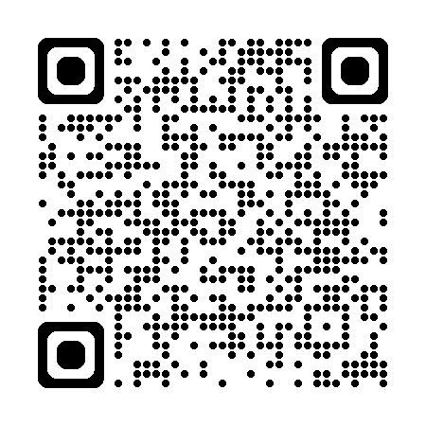
IET Microwaves, Antennas and Propagation
CiteScore 4.3, IF 1.1
Microwave and RF circuits, microwave and millimetre wave amplifiers, oscillators, switches, mixers and other components
Editor in Chief – Dr Tim Brown (University of Surrey)
Rigorous peer review process, every paper seen by Editor in Chief to ensure consistent peer review
Questions? Contact the Managing Editor:
Dr Andrew Harvey
Andrewharvey@theiet.org

Slide 3
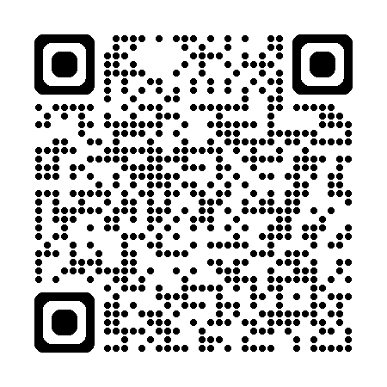
Electronics Letters
Broad scope, rapid communication Letters journal established in 1969
Specialised sections in Antennas and Propagation, Electromagnetism, and Microwave Technology
Currently accepting applications for editorial board members and reviewers, please contact the Managing Editor if interested
Questions? Contact the Managing Editor:
Dr Andrew Harvey
Andrewharvey@theiet.org

