Slide 1
Presentation Skills
The Institution of Engineering and Technology (IET)
Coventry and Warwickshire Young Professionals Committee

Slide 2
Agenda
In-person presentation
Introduction
The story
Slide structure and design
Time management
Tone of voice and body language
Filler words and phrases
Online presentations
Technical & Setup Essentials
Engagement & Interaction Strategies
Design & Content Tips for Virtual
Body Language & Vocal Delivery
Dealing with Virtual Fatigue

Slide 3
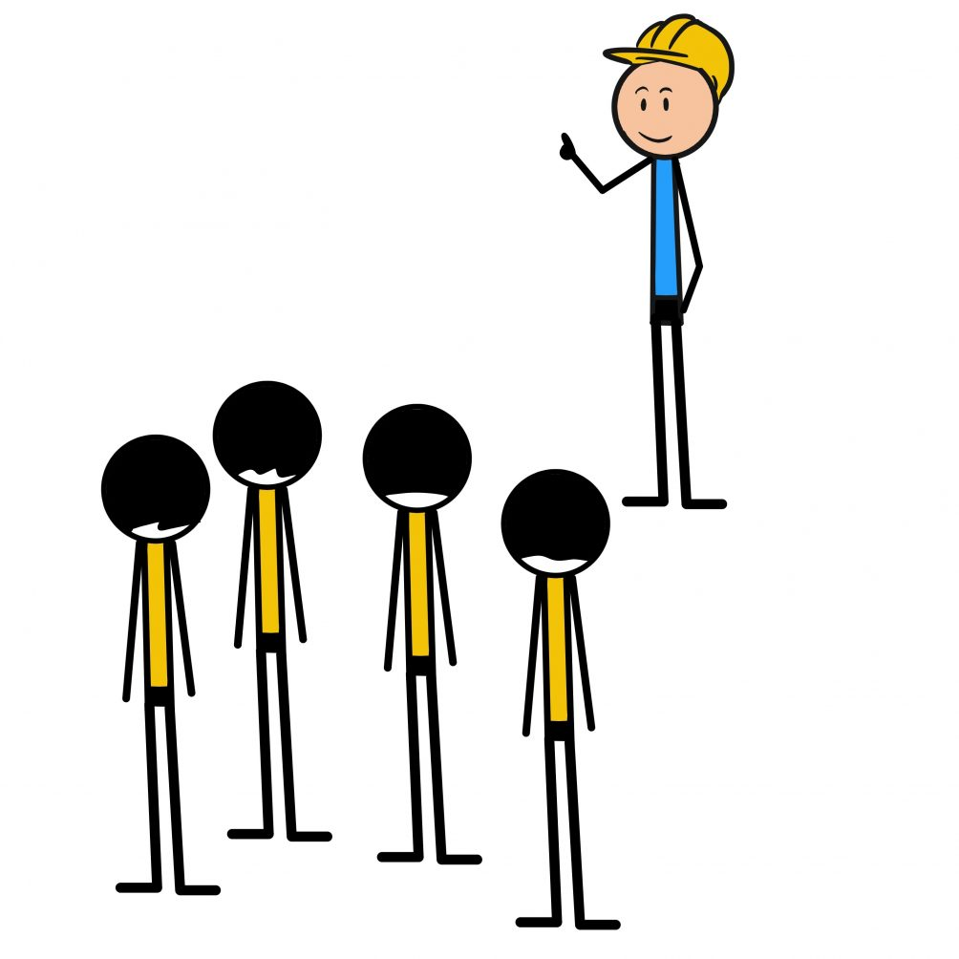
Introduction – What is a good presentation?
Present the topic clearly and at the right level
Keep slides readable and easy to understand
Slides are prompts, not a script
Practice your delivery!
Know your topic inside out!
Know your audience
Clear structure (Start, Middle and End)
Know your location (i.e. reduce the chance of technical difficulties)

Slide 4

Audience Awareness
Know Your Audience
Before presenting, ask:
Technical or non-technical?
Students, professionals, or mixed?
What do they already know?
What do they care about?
What do you want them to remember?
Tailor examples and language accordingly.

Slide 5


The story
Every presentation tells a story:
What’s the problem?
Why should we care?
What did you do?
What did you find?
Why is that important?
Keep the structure simple:
Start: context
Middle: main points
End: conclusions, summary + key takeaways
The Hero
The Problem
The resolution
3 – steps for storytelling

Slide 6
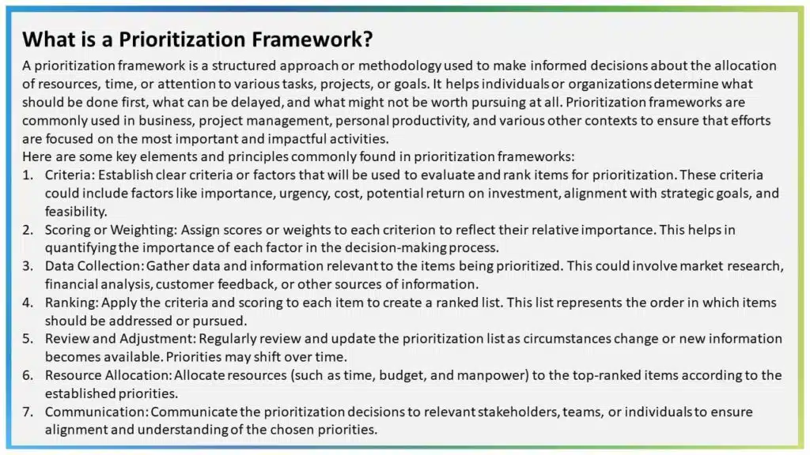
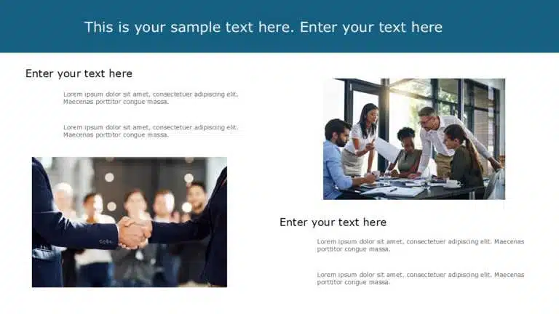
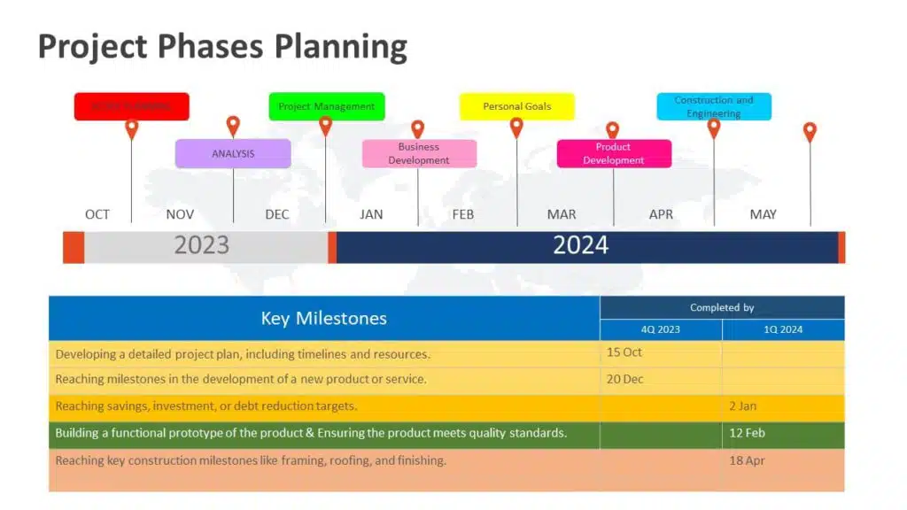

Slide Structure – Common mistakes
Do:
Keep one main idea or point per slide
Use keywords, not full paragraphs
Limit the use of jargon
Use consistent fonts and font sizes
Keep text big enough to read from the back
Visuals > words (diagrams, photos, graphs)
DO NOT USE AS A SCRIPT
Number your slides

Slide 7
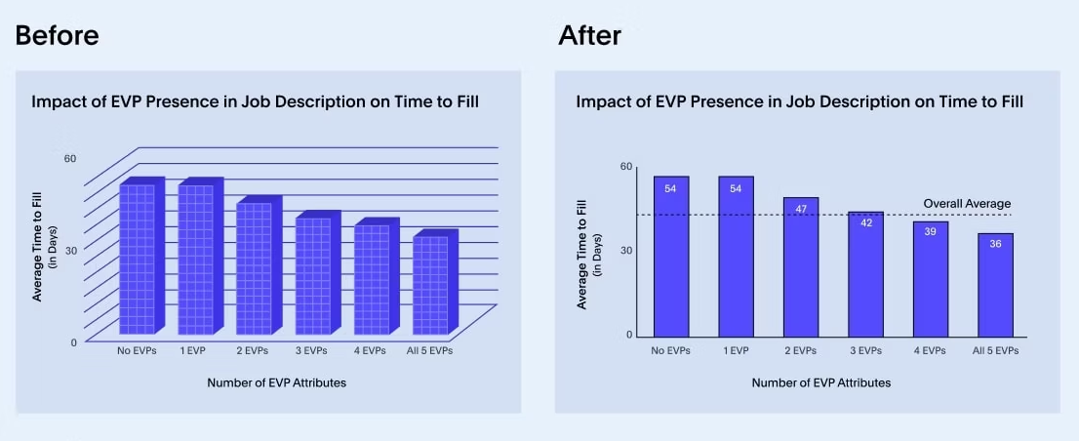
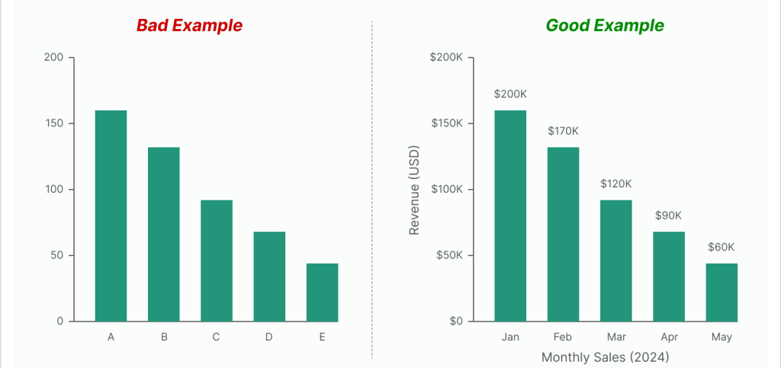
Slide structure – Data visualisation
Try to avoid:
Showing unformatted graphs from Excel
Using tables instead of clear charts
Putting multiple graphs on one slide
Expecting people to read a full dataset
Do:
Keep a consistent colour scheme
Make axis labels big and clear
Highlight the important part!
Use simple units and readable scales

Slide 8


Time management
Most people will run over or under because:
Over-explain topics
Add extra comments on the fly – good and bad
Don’t rehearse out loud
Naturally, nervousness makes you speak faster
To reduce the likelihood of overrunning:
Wear a watch, or keep an eye on the time
Rehearse out loud with a timer
Cut content, don’t speak faster
Leave time for your ending (don’t rush concluding remarks)

Slide 9

Tone of voice and body language
Stand tall, shoulders relaxed
Avoid turning your back to the audience
Make eye contact (3–5 seconds per person)
Use pauses — silence is powerful
Vary your tone (don’t speak in one flat pitch)
Slow down at key points
Smile at the start — it reduces nerves
Don’t read the slides
Remember: Confidence looks calm, not loud.

Slide 10
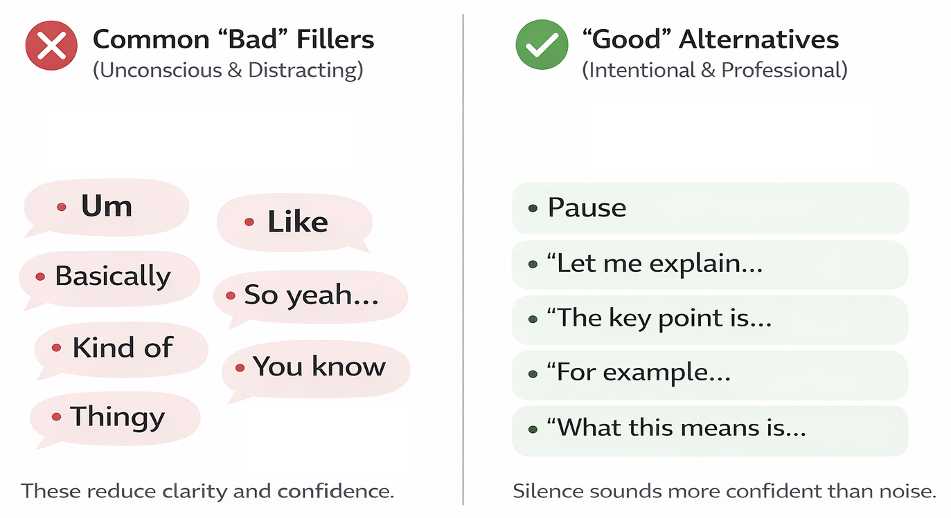
Filler words and phrases
How to Reduce Them
Pause instead of filling silence
Slow your pace slightly
Rehearse out loud
Record yourself and listen back
Replace filler with a breath
Silence sounds more professional than filler.

Slide 11

Handling Questions
Listen fully before answering
Repeat or summarise the question
If unclear, ask for clarification
Structure your answer (Point → Explain → Conclude)
It’s okay to say: “That’s a great question — I’ll need to look into that.”
Keep answers concise
Do not attempt to ‘wing it’! Be honest!
Stay calm — questions show engagement.

Slide 12
Online Presentations
The Institution of Engineering and Technology (IET)
Coventry and Warwickshire Young Professionals Committee

Slide 13




Technical Setup Essentials
Camera
Lights
Audio
2
1
3
Hack! Use a two monitors to have your notes handy, or use:
Notes:
Technical & Setup Essentials
Lighting: Try to have your lighting facing you directly so that it lights your face from the front. Emphasize lighting your face from the front (e.g., natural light from a window) rather than having a bright window behind you, as your picture won’t come up as clear as you want it to.
Camera Position: Make sure your camera is at eye level so are looking at your audience, not down at them.
Audio Quality: Test everything before you go live – Teams has as preview page for this where you can record your sound from the Settings page. You can use external microphones or headsets for clear, noise-free sound, and experiment with the sound settings to get the best quality possible.
The "Double Monitor" Hack: use one screen for notes and the other for the presentation to keep eye contact.

Slide 14

Engagement & Interaction Strategies
Q&As are your friend
Break The Ice: Use tools like Mentimeter
Collaboration Tools
Timing Matters
Don’t Forget YOU are the presentation.
Not your slides!
Notes:
Engagement & Interaction Strategies
The 10-Minute Rule: If your online presentation is quite a long one, it’s usually best to do something interactive roughly every 10 minutes to keep attention. This can be anything from polls, chat questions or even emoji reactions. This means that you know everyone is paying attention and gives them a good amount of opportunity to personally engage with you.
Icebreakers: A really great idea is to start your presentation with a poll or a quick, non-work-related question to build rapport immediately. A tool I love to use for this is called Mentimeter, as your audience can join using their phones, and there are lots of different ways you can interact with your audience outside of icebreakers as well.
Q&A Techniques: You can use the Q&A feature when you set up your online presentation call link ahead of time for ongoing questions, so you can take questions at any point you choose, or at the end. You can also disable microphones and cameras for audience members whenever you like if you want your presentation to be completely interrupted.
Whiteboarding: Collaborative tools like Microsoft Whiteboards or, again, Mentimeter for: brainstorming, polls, and conversation. This can really make your audience feel like they are a part of your presentation, especially if is project-based, but you can customize it to fit what you wish to say.

Slide 15


Design & Content Tips for Virtual Presentations
1
Minimalist Slides
2
High-Contrast Visuals
3
Complex Animation
Notes:
Design & Content Tips for Virtual Presentations
Minimalist Slides: Don’t be afraid to keep your slides minimal here so there are fewer visual distractions. Focus on one idea or small topic per slide to prevent the audience from reading ahead. Don’t forget as I’ve said previously, YOU are the presentation.
High Contrast Visuals: Use clear, large images and bold, simple charts that are easy to see on smaller screens.
Complex Animation: Whilst using animations can look great, try to keep them quite minimal, as they can look jerky over lower-bandwidth connections. This is also why it’s a also a good idea to test your bandwidth before presenting if possible.

Slide 16

Body Language & Vocal Delivery
Looking at the Camera
Varying Tone
Standing Up
Notes:
Body Language & Vocal Delivery
Looking at the Camera: The best kind of “eye contact" means looking directly into the camera lens, not at the faces on the screen. Make sure to practice looking away from your presentations and notes every so often to maximise this.
Standing Up: You can also stand up if safe to do so, especially if you have a standing desk, as this can boost energy and allow for more natural, visible gestures. It may also help to slightly exaggerate you gestures and expressions as you’ll appear quite small on screen, but make sure you practice this in-situ first.
Varying Tone: Avoid a monotone voice, which is magnified online. As per the previous point, you can record yourself to practice this, and find your natural rhythm when speaking online.

Slide 17


Dealing with Virtual Fatigue
Hide Self-View
Take Regular Breaks
Notes:
Dealing with Virtual Fatigue
And for the final topic, I’m sure you’ve all been fatigued by screens before when presentations have lasted for a very long time. Here are a couple of tips I can suggest here:
The "Hide Self View" Feature: On Microsoft Teams for example, you can hide your own video to avoid the distraction of watching yourself. You can focus on looking into the camera instead, and be fully present on what you’re speaking about.
Strategic Breaks: If the presentation is long, build in brief, scheduled breaks. You can even observe the 20-20-20 rule. Every 20 minutes, you should take a 20-second break to look at something 20 feet away (around 6 metres). This can also help in planning your presentation, as factoring in breaks every so often can split it up into good bite-sized chunks, which will ultimately help in your audience stay engaged online.

Slide 18

Who Are The IET?
The IET is one of the world's leading professional societies for the engineering and technology community
More than 168,000 members in 150 countries and offices in Europe, North America and Asia-Pacific.

Slide 19
Stay Up To Date With Us:
Want To Join Us?
Ask one of our committee members, contact us on Social Media, or email us at: ietypcovwarks@outlook.com
Follow Us On Social Media:
  /ietypcovwarks
  @ietypcovwarks
  @ietypcovwarks
  @ietcovwarks

Slide 20
Thank You For Attending!
Any Questions?

